Slide 1

ЕГЭ
английский язык
ВАРИАНТ 6
Время выполнения работы 3 часа 10 мин ( 190 минут)
Работа состоит из четырёх разделов: «Аудирование», «Чтение", "Грамматика и лексика», «Письменная речь». Раздел 1 («Аудирование») содержит 9 заданий. Рекомендуемое время на выполнение заданий раздела 1 составляет 30 минут. Раздел 2 («Чтение») содержит 9 заданий. Рекомендуемое время на выполнение заданий раздела 2 составляет 30 минут. Раздел 3 («Грамматика и лексика») содержит 20 заданий. Рекомендуемое время на выполнение заданий раздела 3 составляет 40 минут. Раздел 4 («Письменная речь») состоит из 2 заданий. Рекомендуемое время на выполнение заданий этого раздела работы – 90 минут.

Slide 2

Раздел 1. Аудирование
1
Задание 1
Прослушайте шесть высказываний. Установите соответствие между высказываниями каждого говорящего A–F и утверждениями, данными в списке 1–7. Используйте каждое утверждение, обозначенное соответствующей цифрой, только один раз. В задании есть одно лишнее утверждение. Занесите свои ответы в таблицу.
The benefits of recycling are questionable.
Recycling is an inconvenience.
Recycling should be profitable for people.
We possess more things than we need.
Recycling is about reusing what we have.
Recycling is the government’s issue.
Wealth allows people not to recycle.
Говорящий | A | B | C | D | E | F
Утверждение

Slide 3
Задание 2
Вы услышите диалог. Определите, какие из приведённых утверждений А–G соответствуют содержанию текста (1 – True), какие не соответствуют (2 – False) и о чём в тексте не сказано, то есть на основании текста нельзя дать ни положительного, ни отрицательного ответа (3 – Not stated). Занесите номер выбранного Вами варианта ответа в таблицу. Вы услышите запись дважды.
A. The registration at the leisure centre has time limits.
B. Jim doesn’t know how to organize his free time properly.
C. Jim doesn’t have any communication problems at school.
D. Jim has a background in sports.
E. Jim thinks most people enjoy books and movies.
F. Jim has no chance to find the necessary books in his library.
G. The classes Jim is interested in take place three times a week.
2
Говорящий | A | B | C | D | E | F | G
Соответствие диалогу

Slide 4

Задание 3
Вы услышите интервью. В заданиях 3–9 запишите в поле ответа цифру 1, 2 или 3, соответствующую выбранному Вами варианту ответа. Вы услышите запись дважды.
3
What do we learn about Oliver at the beginning of the interview?
1) He wants to be known all over the world.
2) He has been working for 31 years.
3) He became very famous as a young man.
4
What is the main criterion of success for Oliver?
1) Number of friends in social networks.
2) Sales figures.
3) Impact on people’s lives.
5
What is special about Oliver as a designer?
1) He is very realistic.
2) He was taught in an orphanage.
3) He’s got a rich imagination.
6
Which of the following is TRUE about the beginning of Oliver’s career?
1) He became a successful lawyer.
2) He studied in different countries.
3) He started his own company.
7
Which of the following is typical of Oliver’s day?
1) Working till late at night.
2) Partying with celebrities.
3) Taking pictures of himself for Instagram.
8
Oliver describes himself to be rather …
1) lonely.
2) eccentric.
3) reserved.
9
Why did Oliver start a profile on Instagram?
1) To advance his designs.
2) To hide from real life.
3) To meet more people.

Slide 5
Раздел 2. Чтение
10
Установите соответствие между заголовками 1–8 и текстами A–G. Занесите свои ответы в таблицу. Используйте каждую цифру только один раз.
В задании один заголовок лишний.
A job for anybody 5. Zoopsychologist
Start your business 6. Night work
A job with a high salary 7. Working with your hands
Choosing a job 8. Working for royals
A. Some people can’t get out of the house easily to shop, don’t have the time to do it or just don’t enjoy shopping. If shopping is something you enjoy, turn it into a self-employed career. Personal shoppers give advice to customers and suggest products that may suit their needs. This can be anything from gifts to household goods to clothing. Advertise your services at locations such as senior citizens’ centres, community centres, shopping malls and grocery stores. Meet with the clients and find out what items (groceries, clothing, etc.) they need and how often.
B. The market is changing very fast. In fact, there may be careers that exist when a student gets out of college that simply didn’t exist when they started. So rather than asking, “What do I want to be?,” pose these questions: “What skills do I have? What kinds of people do I like to work with? In what kind of environment?” This is a way to think about a career without necessarily naming it. You describe yourself in a functional way and then figure out what that’s called and if people get paid to do it.
C. The regulations define this as the period between 11 pm and 6 am although this agreement can be slightly varied between employers and workers. Generally, people who work for at least three hours within the period must be offered a free health assessment before they begin their work duties and on a regular basis. Workers, however, do not have to accept this check. In general, workers must be over 18, although there are some exceptions to this rule. Teenagers aged 16 and 17, for example, can work according to this schedule, but only for 40 hours per week.

Slide 6
D. When your dog won’t roll over or your cat is making a mess, you might have to call someone who specialises in pet behaviour to solve your problems. This person analyses the pet’s confidence and security inside and outside the home to find the source of the problem. By studying their instincts and social rituals in their natural habitat as well as around humans, they modify the unwanted behaviour. It is all about helping dogs, cats and horses feel safe and confident and secure inside and outside our homes.
E. Being a queen’s piper involves playing the bagpipes for 15 minutes at 9 am under the Queen’s window when she is in residence at Buckingham Palace, Windsor Castle, the Palace of Holyroodhouse or Balmoral Castle. The piper is also responsible for the co-ordination of the 12 Army pipers who play around the table after State Banquets. It’s important to be presentable and patient enough when escorting the Queen to the various audiences that she has throughout the day.
F. A surgeon starts with a Bachelor’s degree, specializes in medicine and finally, surgery and then spends up to seven years as an intern or a resident. If you want to cut people open, they want to be really sure you know what you are doing. The field will be growing, as people now live longer. This is one of the highest demand and best paid jobs in the US because it takes so much skill and precision. Wages vary depending on the type of surgery, but on average this was the highest paid medical job in 2015.
G. Imagine you’re an electrician, you’re installing a pipe and have to bend around the corners to make everything line up. This kind of work requires improvisation and creativity. Besides, the wages of manual workers are greater than in many office jobs. For instance, a skilled mechanic usually earns more than a sociology graduate working in publishing. Besides, the job offers small moments of joy, like when the bike you’re mending starts up and runs. But not everything about manual work is rosy. Furniture making, for example, is not a good career move.
Текст | A | B | C | D | E | F | G
Заголовок

Slide 7
Прочитайте текст и заполните пропуски A–F частями предложений, обозначенными цифрами 1–7. Одна из частей в списке 1–7 — лишняя. Занесите цифры, обозначающие соответствующие части предложений, в таблицу.
11
The Science of Sound
The science of sound, or acoustics, as it is often called, has been made over radically within a comparatively short space of time. Not so long ago the lectures on sound in colleges and high schools dealt chiefly with the vibrations of such things as the air columns in organ pipes. Nowadays, however, thanks chiefly to a number of electronic instruments engineers can study sounds as effectively (A) ______. The result has been a new approach to research in sound. Scientists have been able to make far-reaching discoveries in many fields of acoustics (B) ______.
Foremost among the instruments that have revolutionized the study of acoustics are electronic sound-level meters also known as sound meters and sound-intensity meters. These are effective devices that first convert sound waves into weak electric signals, then amplify the signals through electronic means (C) ______. The intensity of a sound is measured in units called decibels. “Zero” sound is the faintest sound (D) ______. The decibel measures the ratio of the intensity of a given sound to the standard “zero” sound. The decibel scale ranges from 0 to 130. An intensity of 130 decibels is perceived not only as a sound, but also (E) ______. The normal range of painlessly audible sounds for the average human ear is about 120 decibels. For forms of life other than ourselves, the range can be quite different.
The ordinary sound meter measures the intensity of a given sound, rather than its actual loudness. Under most conditions, however, it is a quite good indicator of loudness. Probably the loudest known noise ever heard by human ears was that of the explosive eruption in August, 1883, of the volcano of Krakatoa in the East Indies. No electronic sound meters, of course, were in existence then, but physicists estimate that the sound at its source must have had an intensity of 190 decibels, (F) ______.
and finally measure them.
since it was heard 3,000 miles away.
and they have been able to put many of these discoveries to practical use.
since a loud sound is of high intensity.
as they study mechanical forces.
as a painful sensation in the ear.
that the unaided human ear can detect.
Пропуск | A | B | C | D | E | F
Часть предложения

Slide 8
Прочитайте рассказ и выполните задания 1–7. В каждом задании обведите букву A, B, C или D, соответствующую выбранному вами варианту ответа.
Experience: I founded my own country
My father wasn’t a king, he was a taxi driver, but I am a prince – Prince Renato II, of the country Pontinha, an island fort on Funchal harbour. It’s in Madeira, Portugal, where I grew up. It was discovered in 1419; Captain James Cook was here, and there are paintings of his visit.
In 1903, the Portuguese government didn’t have enough money to build a harbour port, so the king sold the land to a wealthy British family, the Blandys, who make Madeira wine. Fourteen years ago the family decided to sell it for just €25,000 (?19,500). It was of no use to them. But nobody else wanted to buy it either. I met Blandy at a party, and he told me about Pontinha. He asked if I’d like to buy the island. Of course I said yes, but I have no money – I am just an art teacher.
I tried to find some business partners, but they all thought I was crazy to want to buy what is essentially a large rock: it has a small cave, a platform on top, and no electricity or running water. So I sold some of my possessions, put my savings together and bought it. Of course, my wife, my family, my friends – they all thought I was mad.
When the King of Portugal originally sold the island in 1903, he and all the governors signed a document, selling all the “possessions and the dominions” of the island. It means I can do what I want with it – I could start a restaurant, or a cinema, but nobody thought that someone would want to start a country. So that’s what I did.
When I bought it, I went to speak to the governor of Madeira. I introduced myself and explained that I was a Madeiran citizen and was also now the ruler of his neighbour state. He immediately asked to buy my island. Of course, I said no. He said that unless I sold it back to the state, he wouldn’t let me connect to any electricity. So now, as long as I don’t cause any trouble (for instance, trying to charge cruise ships that dock here) they will leave me alone. I have a solar panel and a small windmill, and maybe in the future I’ll be able to generate power from the ocean around Pontinha. I am a pacifist, and I don’t need any money.
I have both a Portuguese passport and a passport for Pontinha (where my passport number is 0001). There are four citizens: me, my wife, my son and my daughter. I am the police, the gardener, everything. I am whatever I want to be – that’s the dream, isn’t it? Of course, my power is only absolute here, where I am the true sovereign.

Slide 9
The Portuguese gastronomic specialty is bacalhau. But we are running out of cod in our oceans now, and we buy it from another country. So my country’s specialty is takeaway.
I don’t live in my country full time, but I am often there. My family sometimes drops by, and other people come every day because the country is free for tourists to visit; I never close for bad weather. Sometimes I am alone, on the days I feel more troubled by the excessive power of the Portuguese state. Sometimes I come here when I’m feeling lively.
Madeira is surrounded by water, but for some reason we all have to pay to swim in the ocean now, at the swimming spots. How did that happen? Still, I have my island, which means I can come swimming whenever I want – it’s as if someone has given me the key to the waters.
Our lives are gone in a flash. My son is 27 and if I were his age, I would probably sell the island and buy a Ferrari. But I am 56 years old, and I want to enjoy everything I have. Pontinha means “a point”. All change in the world begins with something very small, and this is my country – just a little point.
12
What do we learn about Renato’s origin?
A) He is a James Cook descendant.
B) He comes from a royal family.
C) His parents worked for the Portuguese government.
D) He comes from a simple family.
13
How did Renato get the money for the island?
A) He sold some of his belongings.
B) He found business partners.
C) His friends helped him.
D) He borrowed from Blandy.
14
How does Renato explain his decision to found a country?
A) He followed the advice from the governor of Madeira.
B) He didn’t see any formal objections to it.
C) He obeyed the order of the King of Portugal.
D) He thought of it as a way to avoid starting a restaurant.

Slide 10
15
How may the reaction of the governor of Madeira to the news of Renato’s decision be described?
A) Indifference.
B) Anger.
C) Worry.
D) Disbelief.
16
We may conclude that bacalhau …
A) is Renato’s favourite food.
B) is made with fish.
C) is imported from Pontinha.
D) was invented by Renato.
17
What does Renato say about his attitude towards tourists?
A) They are always welcome on his island.
B) He prefers to stay alone.
C) He doesn’t like it when they come in bad weather.
D) He treats them as his own family.
18
What are Renato’s plans about his island?
A) He wants to pass it to his son.
B) He wants to sell it.
C) He wants to die on the island.
D) He wants to keep it.

Slide 11
Раздел 3. Грамматика и лексика
Прочтите текст ниже. Преобразуйте слова, напечатанные заглавными буквами в конце строк, обозначенных цифрами 19-24, чтобы они грамматически соответствовали содержанию текста. Заполните пропуски словами, которые вы получили. Каждый проход соответствует отдельной задаче из группы 19-24.
The compass
What do you know about the invention of the compass? You might think that sailors ______ the compass for centuries to navigate in the open sea. The truth is, there was no such thing as the compass in ancient times, and even after ______ invention the compass wasn’t used all that much for marine navigation. No one knows where or when the first compass ______. It may have been in China or in the Near East or in Italy.
A kind man
A truck driver was driving 100 penguins to the New York Zoo when his truck broke down on the freeway. The driver got out of the cab. He ______ at the engine when another truck stopped in front of him. The second truck driver asked if his colleague needed any help. The penguins’ driver explained that he was taking the penguins to the zoo and asked if the other man ______ the penguins there. He agreed. Some hours later, the second truck driver drove past the first one, who was still waiting on the freeway for help to come. The penguins, however, _____ still on the truck! “I thought I asked you to take those penguins to the zoo,” shouted the first driver. The second replied, “I did, but I had some money left, so we’re going to the cinema now.”
19
USE
20
IT
21
INVENT
22
LOOK
23
TAKE
24
BE

Slide 12
Преобразуйте, если необходимо, слова, напечатанные заглавными буквами, так чтобы они грамматически и лексически соответствовали содержанию текста. Каждый пропуск соответствует отдельному заданию из группы 28-29. Впишите слова в поле ответа.
Visiting Uluru
If you are thinking of making the journey to witness the incredible red rock Uluru in person, here are some facts you should know before you leave. Thousands of _____ to Australia go to see Uluru. Uluru is located west of the Simpson Desert 335 km southwest of Alice Springs. While some people believe it to be the largest monolith in the world, this title is ______ held by Mount Augustus in Western Australia.
Uluru is known to undergo a series of colour changes. These can be just subtle ______ when it rains. However, the view undergoes amazing ______ when caught by the spectacular sunset rays. This is so partially because the surface of Uluru is full of unusual caves and holes due to millions of years of erosion.
Uluru is a sacred site to the indigenous people of the area, and guides ______ tourists from climbing the rock.
25
VISIT
26
ACTUAL
27
DIFFER
28
TRASFORM
29
COURAGE

Slide 13
Прочитайте текст с пропусками, обозначенными номерами 30 – 36.
Эти номера соответствуют заданиям 30 – 36, в которых представлены возможные варианты ответов (А, B, C, D). Установите соответствие номера пропуска варианту ответа.
Brenda
Brenda Dowson looked up at the departure monitor on the wall above her desk. She was relieved to see that United’s flight 99 bound for JFK had finally taken (1) ______ at 1.40. Forty minutes behind schedule.
Brenda founded Art Locations nearly ten years ago. Brenda was really married to the job, despite its long hours, demanding customers and planes, trains and cargo vessels that never (2) ______ on time. Moving great works of art from one corner of the globe to the other (3) ______ her to combine a natural flair for organization with a love of beautiful objects.
Brenda travelled around the world (4) ______ commissions from governments who were planning national exhibitions. She also dealt with several private collectors, who often wanted nothing more than to move a favourite painting from home to another. Over the years many of her customers had become personal friends. But not Andrew Stratford. Brenda long ago (5) ______ that the words “please” and “thank you” were not in the man’s vocabulary, and she certainly wasn’t on his Christmas card list. Brenda tried to (6) ______ no attention to his impolite ways. Stratford’s latest demand had been to collect a Van Gogh from Victoria Hall and transport it, without (7) ______ to his office in Boston. Again, he didn’t say either “please” or “thank you”.
30
31
32
33
34
35
36
30
A) in B) out C) off D) on
A) arrived B) reached C) entered D) achieved
A) amounted B) allowed C) applied D) admitted
A) accepting B) attempting C) adopting D) assuming
A) included B) concluded C) supposed D) suggested
A) draw B) bring C) take D) pay
A) delay B) setback C) break D) stop
31
32
33
34
35
36

Slide 14
37
Раздел 4. Письменная речь
You have received an email message from your English-speaking pen-friend Susan:
From: Susan @mail.uk
To: Russian_friend@ege.ru
Subject: internet
... I find the Internet really useful with my schoolwork and catching up with friends... plus chat rooms are a great way of making friends in different countries. But I don't write anything personal that would let people contact me anywhere except online... Which information do you give about yourself? Do you think it's safe to put your picture on the Internet? What do you think about 'internet dating’? I’m planning to take scrapbooking lesson online soon…
Write an email to Susan. In your message: − answer his questions; − ask 3 questions about her scrapbooking lesson . Write 100–140 words. Remember the rules of email writing.
From: Russian_friend@oge.ru
To: Susan@uk.com
Subject: internet

Slide 15
Выберите только ОДНО из двух предложенных заданий (38.1 или 38.2), укажите его номер в БЛАНКЕ ОТВЕТОВ № 2 и выполните согласно данному плану. В ответе на задание 38 числительные пишите цифрами
Imagine that you are doing a project on what qualities teenagers value in their friends in Zetland. You have found some data on the subject – the results of the opinion polls (see the table below). Comment on the data in the table and give your opinion on the subject of the project.
38.1
Qualities | Number of respondents (%)
A good sense of humour | 32
Support | 27
Honesty | 26
Kindness | 10
Loyalty | 5
Write 200–250 words. Use the following plan: – make an opening statement on the subject of the project; – select and report 2–3 facts; – make 1–2 comparisons where relevant and give your comments; – outline a problem that can arise within a friendship and suggest a way of solving it; – conclude by giving and explaining your opinion on the importance of teenage friendship.

Slide 16
Imagine that you are doing a project on the most important occasions for buying gifts in Zetland. You have found some data on the subject – the results of the opinion polls (see the pie chart below). Comment on the data in the pie chart and give your opinion on the subject of the project.
38.2
Occasions for buying gifts
Wedding
4%
New Year
40%
Woman’s Day
10%
Birthdays
26%
St.Valentine’s Day
20%
Write 200–250 words.
Use the following statement on the subject of the project;
– select and report 2–3 facts;
– make 1–2 comparisons where relevant and give your comments;
– outline a problem that one can face choosing a gift and suggest a way of solving it;
– conclude by giving and explaining your opinion on reasons why people buy gifts.

Slide 17
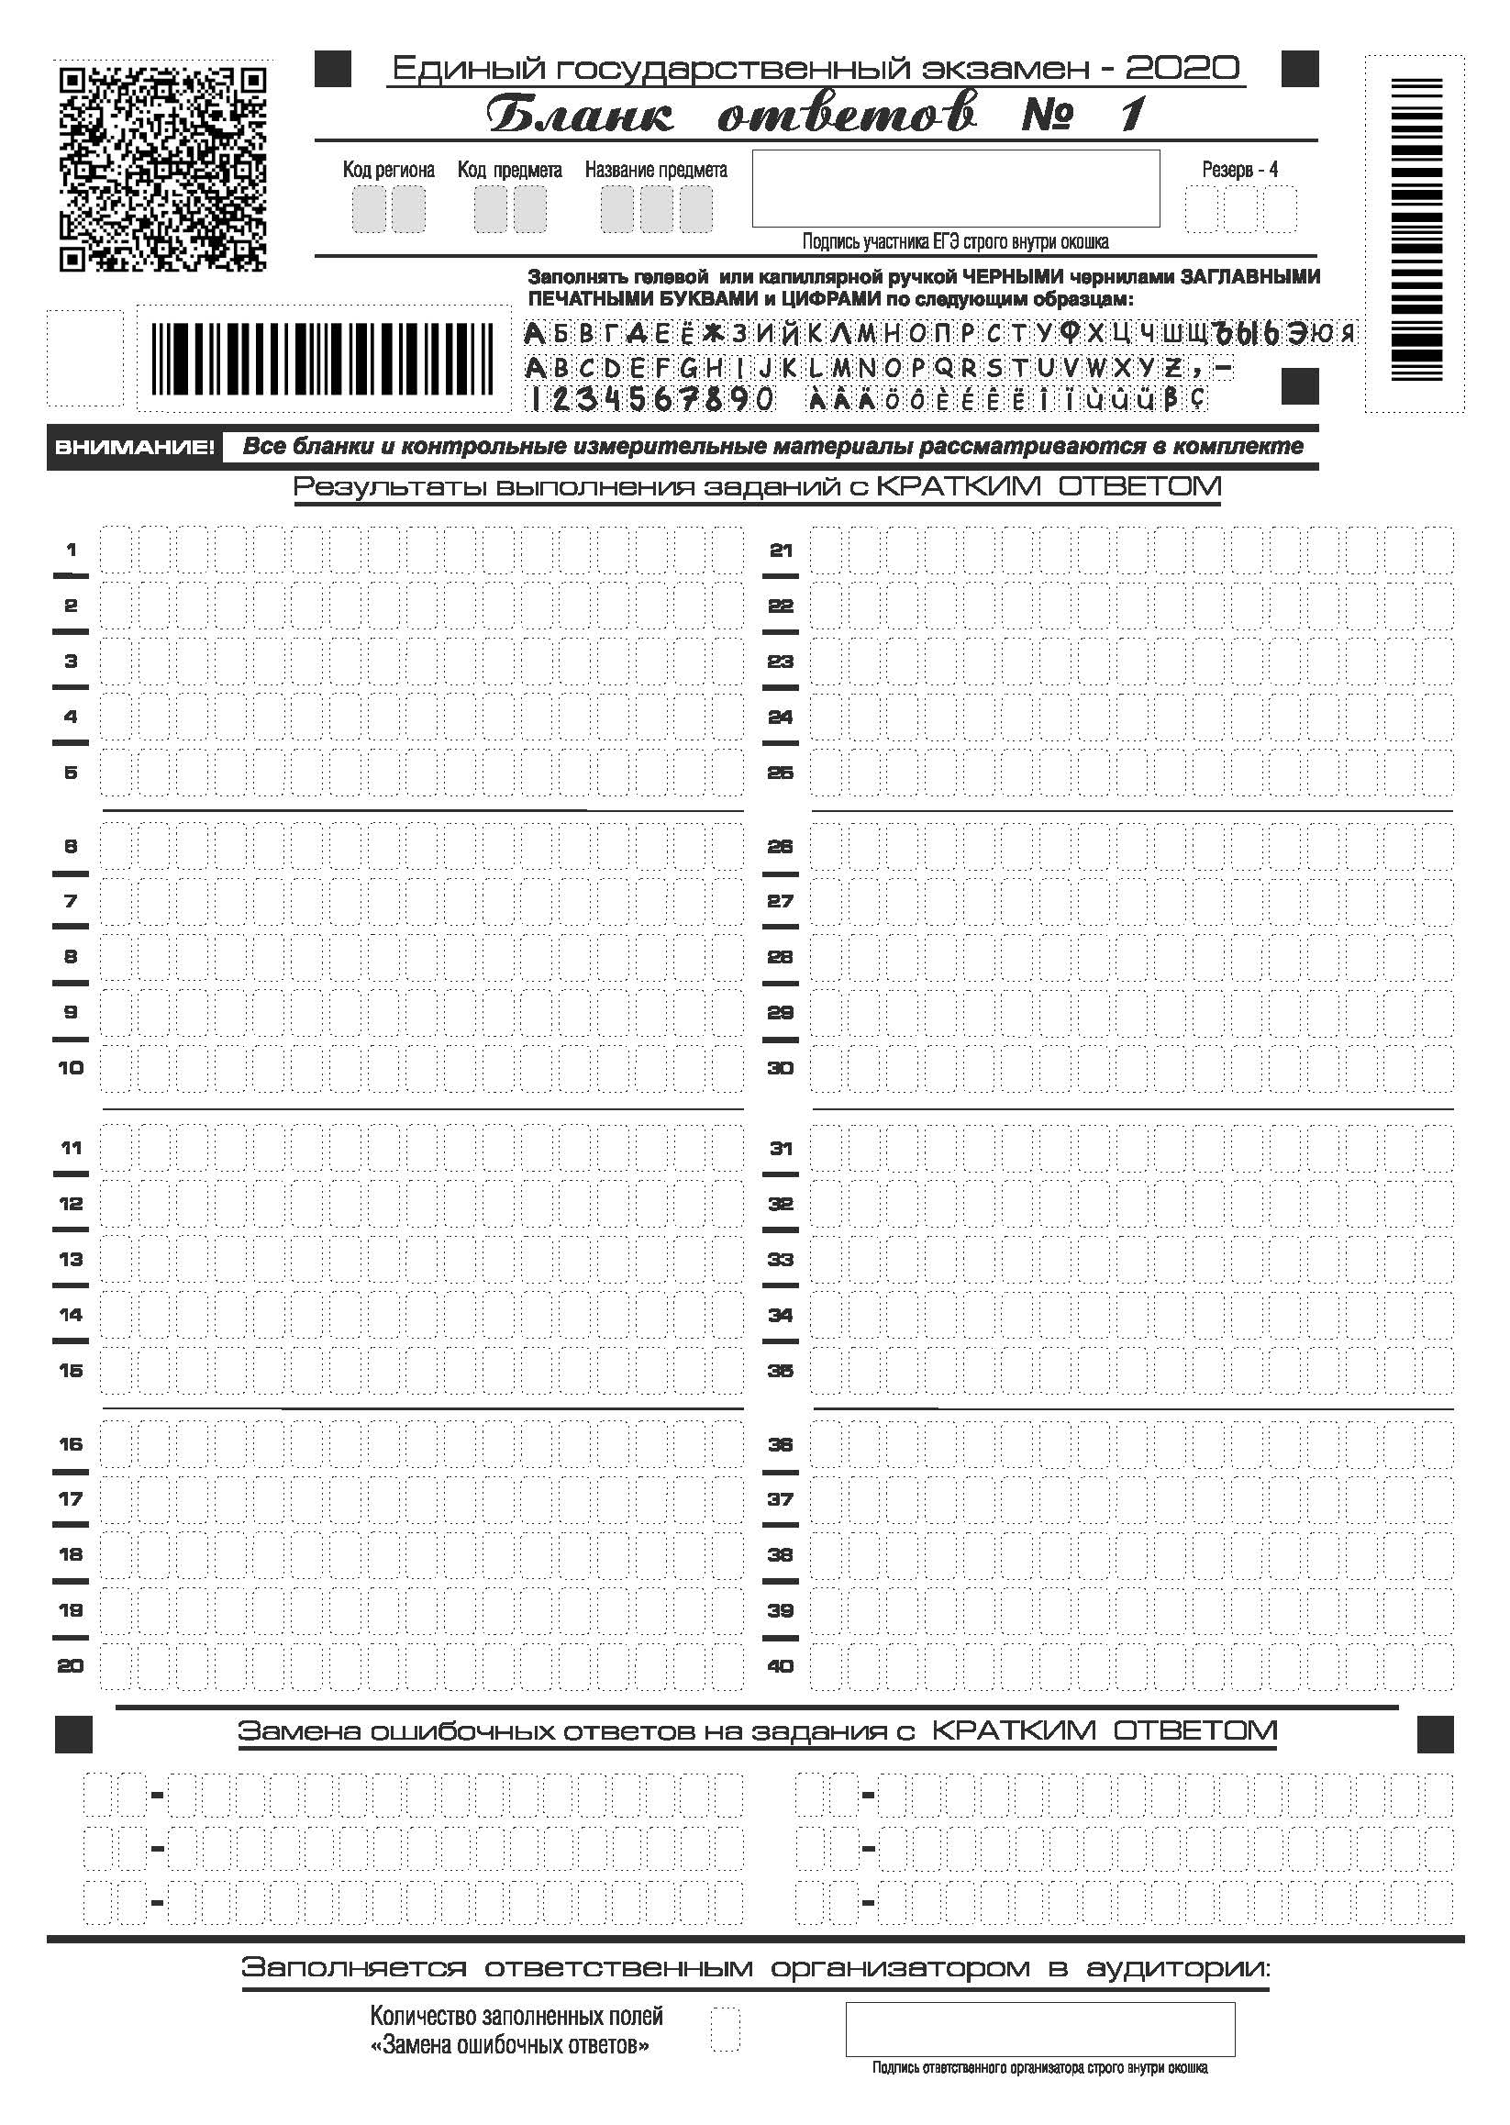

Slide 18
