Slide 1

ЕГЭ
английский язык
ВАРИАНТ 9
Время выполнения работы 3 часа 10 мин ( 190 минут)
Работа состоит из четырёх разделов: «Аудирование», «Чтение", "Грамматика и лексика», «Письменная речь». Раздел 1 («Аудирование») содержит 9 заданий. Рекомендуемое время на выполнение заданий раздела 1 составляет 30 минут. Раздел 2 («Чтение») содержит 9 заданий. Рекомендуемое время на выполнение заданий раздела 2 составляет 30 минут. Раздел 3 («Грамматика и лексика») содержит 20 заданий. Рекомендуемое время на выполнение заданий раздела 3 составляет 40 минут. Раздел 4 («Письменная речь») состоит из 2 заданий. Рекомендуемое время на выполнение заданий этого раздела работы – 90 минут.

Slide 2

Раздел 1. Аудирование
1
Задание 1
Прослушайте шесть высказываний. Установите соответствие между высказываниями каждого говорящего A–F и утверждениями, данными в списке 1–7. Используйте каждое утверждение, обозначенное соответствующей цифрой, только один раз. В задании есть одно лишнее утверждение. Занесите свои ответы в таблицу.
Childhood memories may be connected with food.
Childhood memories can be very chaotic.
Tales of your childhood are interesting to hear.
One can remember many details about childhood.
Childhood memories aren’t important.
One may feel bad because of the absence of early childhood memories.
Childhood memories are linked to holidays.
Говорящий | A | B | C | D | E | F
Утверждение

Slide 3
Задание 2
Вы услышите диалог. Определите, какие из приведённых утверждений А–G соответствуют содержанию текста (1 – True), какие не соответствуют (2 – False) и о чём в тексте не сказано, то есть на основании текста нельзя дать ни положительного, ни отрицательного ответа (3 – Not stated). Занесите номер выбранного Вами варианта ответа в таблицу. Вы услышите запись дважды.
A. Sally invited Bob to a concert with her.
B. Sally believes all rock music is good.
C. Bob doesn’t like jazz.
D. Sally agrees to try to listen to some classical music.
E. Bob often listens to classical music on his car radio.
F. Bob is sure nothing will make him change his opinion about rock music.
G. At the band’s last concert people were dressed in different kinds of clothes.
2
Говорящий | A | B | C | D | E | F | G
Соответствие диалогу

Slide 4

Задание 3
Вы услышите интервью. В заданиях 3–9 запишите в поле ответа цифру 1, 2 или 3, соответствующую выбранному Вами варианту ответа. Вы услышите запись дважды.
3
The presenter introduces Stan Shaff as a …
1) theatre designer.
2) sound artist.
3) talented musician.
4
Which of the following is TRUE about Stan’s latest performance?
1) It is based on a long term project.
2) The audience consisted of close friends.
3) The room was decorated in dark colours.
5
What did Stan and his partner try to achieve with their experiments?
1) The creation of new types of speakers.
2) The proper application of old-fashioned objects.
3) The effect of producing sound images.
6
Which of the following is NOT mentioned by Stan as an outcome of the experiments?
1) New methods of music recording.
2) New design of concert halls.
3) New types of DVDs.
7
The building housing the Audium once housed …
1) a coffee shop.
2) a bakery.
3) an office for National Endowment for the Arts.
8
What does Stan say about the Audium’s program?
1) It’s almost ten years old.
2) It’s a completely live performance.
3) It needs a change.
9
Stan says that while performing he …
1) misses his mother-in-law.
2) wishes to be dispassionate.
3) pays attention to who is in audience.

Slide 5
Раздел 2. Чтение
10
Установите соответствие между заголовками 1–8 и текстами A–G. Занесите свои ответы в таблицу. Используйте каждую цифру только один раз.
В задании один заголовок лишний.
Inspired by noble goals 5. Hard to see and to believe
Protected by law 6. Hard to explain how they could
Small size — great opportunities 7. Breathtaking just to watch
Little experience — big success 8. From travelling to discovery
A. Charles Darwin’s five-year voyage on H. M. S. Beagle has become legendary and greatly influenced his masterwork, the book, On the Origin of Species. Darwin didn’t actually formulate his theory of evolution while sailing around the world aboard the Royal Navy ship. But the exotic plants and animals he encountered challenged his thinking and led him to consider scientific evidence in new ways.
B. The 19th century was a remarkable time for exploration. Vast portions of the globe, such as the interior of Africa, were mapped by explorers and adventurers. It was the time when David Livingstone became convinced of his mission to reach new peoples in Africa and introduce them to Christianity, as well as free them from slavery.
C. Louis Pasteur’s various investigations convinced him of the Tightness of his germ theory of disease, which holds that germs attack the body from outside. Many felt that such tiny organisms as germs could not possibly kill larger ones such as humans. But Pasteur extended this theory to explain the causes of many diseases — including cholera, ТВ and smallpox — and their prevention by vaccination.

Slide 6
D. Frederick Law Olmsted, the architect who designed New York City’s Central Park, called the Yosemite Valley «the greatest glory of nature.» Californians convinced one of their representatives, Senator John Conness, to do something about its protection. In May 1864, Conness introduced legislation to bring the Yosemite Valley under the control of the state of California. President Abraham Lincoln signed the bill into law.
E. The Maya thrived for nearly 2,000 years. Without the use of the cartwheel or metal tools, they built massive stone structures. They were accomplished scientists. They tracked a solar year of 365 days and one of the few surviving ancient Maya books contains tables of eclipses. From observatories, like the one at Chichen Itza, they tracked the progress of the war star, Mars.
F. Bali has been a surfing hotspot since the early 20th century, and continues to attract surfers from all over the world. The island’s small size and unique geography provides wonderful surfing conditions, in all seasons, for surfers of any level of experience. Inexperienced surfers might like to try Kuta’s kind waves, while more able surfers will try Nusa Dua’s powerful waves.
G. Base jumping is an extreme sport, one which only very adventurous travelers enjoy. Some base jumpers leap off bridges, others off buildings and the most extreme off cliffs in Norway. Once a year, base jumpers in the US get to leap off the New River Bridge in West Virginia. During the annual Bridge Day, hundreds of jumpers can go off the bridge legally. Thousands of spectators show up to watch.
Текст | A | B | C | D | E | F | G
Заголовок

Slide 7
11
Прочитайте текст и заполните пропуски A–F частями предложений, обозначенными цифрами 1–7. Одна из частей в списке 1–7 — лишняя. Занесите цифры, обозначающие соответствующие части предложений, в таблицу.
Changing image
For more than 200 years Madame Tussaud’s has been attracting tourists from all over the world and it remains just as popular as it ever was. There are many reasons for this enduring success, but at the heart of it all is good, old-fashioned curiosity.
Madame Tussaud’s original concept has entered a brand new era of interactive entertainment (A) ______. Today’s visitors are sent on a breathtaking journey in black cabs through hundreds of years of the past. They have a unique chance to see the great legends of history, (В) ______ of politics.
Much of the figure construction technique follows the traditional pattern, beginning whenever possible with the subject (С) ______ and personal characteristics. The surprising likeliness of the wax portraits also owes much to many stars (D) ______, either by providing their stage clothes, or simply giving useful advice.
The museum continues constantly to add figures (E) ______ popularity. The attraction also continues to expand globally with established international branches in New York, Hong Kong, Amsterdam and many other cities. And they all have the same rich mix of interaction, authenticity and local appeal.
The museum provides a stimulating and educational environment for schoolchildren. Its specialists are working together with practicing teachers and educational advisors to create different programmes of activities, (F) ______.
that reflect contemporary public opinion and celebrity
as well as resources on art, technology and drama
ranging from special effects to fully animated figures
as well as the idols of popular music and the icons
who are eager to help in any possible way they can
ranging from all kinds of souvenirs to sports equipment
who is sitting to determine exact measurements
Пропуск | A | B | C | D | E | F
Часть предложения

Slide 8
Прочитайте рассказ и выполните задания 1–7. В каждом задании обведите букву A, B, C или D, соответствующую выбранному вами варианту ответа.
Whilst travelling in 2001, I had my first but definitely not last go at snowboarding. Rhona and I went to the Cardona ski resort, a couple of hours from Queenstown in New Zealand. We had been staying in Queenstown for a couple of weeks and had tried a couple of the local ski resorts. They had been so popular, that there was almost no room to stay. The problem for me with this was that with so many people moving around me, my eyes were constantly re-focusing. This meant that I couldn’t see a thing! As I had never snowboarded before, we decided that it was going to be a problem. A guy at one of the local ski rental shops recommended that we should try Cardona.
On arrival I went straight to the Ski Patrol and explained my situation. They suggested that I should wear a vest, that they supplied, with the words ‘BLIND SKIER’ on the front and back on top of my jacket. They told me that this was more for the benefit of the other skiers around me. I must admit, I wasn’t very keen to do this, but thought I would give it a try.
Once onto the slopes, I put my vest on and began to practise my limited skills. Because I have done some other board sports, i. e. skateboarding, surfing, etc., it wasn’t too hard to learn the basics. Once I was comfortable with this, I headed off for the ski lift and the big slopes. As I stood in the queue I could hear people talking about that ‘poor blind guy’. This niggled me a bit, but I decided to try to ignore it. At the top of the lift I stepped off and strapped my feet onto the board.
As we headed off I could hear more people talking about the vest. I was starting to get paranoid. Then as I gathered speed and Rhona would shout directions, I realized that the people who saw the vest were getting out of my way. Fantastic! This was better than a white stick in a crowd. We picked up speed turning left, then right, hitting a few bumps, but mainly going really well. I even managed to control the snowboard. Well, sort of control it. Before I knew it, we had zipped down a long straight slope and had come to the end of the run. The adrenaline was buzzing and I was ‘high as a kite’. What a feeling. I got back on the ski lift and headed back up. This time I was going to do the run solo!
I had memorized the slope from my first run and felt very confident. As I came off the lift, I rushed to get started. Again, I could hear people talking about me, but now it didn’t matter. The vest was a definite benefit for the novice snowboarder! I took the first stage at a steady pace, looking for my first left bend. No problems there. I found that easy enough. I was now looking for my fast approaching right bend. I missed this one completely and ended up in the safety netting at the edge of the run.

Slide 9
At this point, I decided I was not the world’s best snowboarder and would have to take things a little slower. As the day progressed, so did my skills. I had a great time. Even taking ‘air’ on quite a few occasions. However this was not deliberate! I was now very wary about that bend I had missed, so I started to take it a bit earlier. Unfortunately, this meant that I would leap about 2 metres into the air. And what was more surprising than being airborne, was the fact that on half a dozen occasions, (out of about 30), I landed on my feet and carried on downhill. The rest of the time I fell on my bottom. I heard some people comment on how brave ‘that blind guy’ was. Little did they know it was lack of skill rather than bravery.
We boarded at Cardona for two days and had a fantastic time. Because it is a bit of a drive away from most of the tourist places, it is not as busy as the other ski resorts. It is mostly visited by the locals and I think that says something. If you get the chance, I would definitely recommend Cardona. I would also like to thank the Ski Patrol for that great suggestion. Without the vest, I am sure there could have been some crashes, caused by me. But with the vest , everyone just got out of the way. However, I think that if I was to get a vest for myself, it would probably read “BLIND &DAFT”.
12
The narrator and his companion decided to choose the Cardona ski resort because
A) it was a short distance from Queenstown.
B) they couldn’t find a room at other resorts.
C) somebody said that it was worth going to.
D) it was popular with snowboarders.
13
The Ski Patrol suggested that the narrator should wear a vest in order to
A) make it easier for them to locate the narrator in case of an accident.
B) make the narrator feel more confident during his first go at snowboarding.
C) keep an eye on him on the slope.
D) prevent other people from colliding with him on the slopes.
14
When the narrator was standing in the queue he
A) felt annoyed by people’s comments.
B) felt comfortable in his vest.
C) tried to focus his eyes on the track.
D) tried to ignore his fear.

Slide 10
15
“This” in “This was better than a white stick in the crowd” refers to
A) the fact that people were getting out of the narrator’s way.
B) the narrator’s moving at a high speed down the slope.
C) the fact that Rhona was giving the narrator directions.
D) the narrator’s hearing more people talking about the vest.
16
The narrator did the second run solo and he
A) tried to memorize all the bends.
B) failed to go round one of the bends.
C) tried not to listen to Rhona’s directions.
D) fell down and was injured.
17
The narrator believes that his successful leaps into the air and landing on his feet were due to
A) his personal courage.
B) people’s encouragement.
C) his intensive practising.
D) pure chance.
18
The narrator recommends the Cardona ski resort because
A) of the Ski Patrol efficient service
B) skiers are supplied with vests there.
C) it is less crowded than other places.
D) there are few crashes on the slopes.

Slide 11
Раздел 3. Грамматика и лексика
Прочтите текст ниже. Преобразуйте слова, напечатанные заглавными буквами в конце строк, обозначенных цифрами 19-24, чтобы они грамматически соответствовали содержанию текста. Заполните пропуски словами, которые вы получили. Каждый проход соответствует отдельной задаче из группы 19-24.
A cup of coffee
Once I was travelling in Italy. It was a lovely day. I had been driving for two hours already. When I came to the next little town, I _____ help stopping for a cup of coffee.
I wandered along the street until I came upon some parasol-shaded tables which seemed to me very nice. I settled and opened my book. It was taking a long time for the waiter to arrive, but I was in no hurry. I was sure that the waiter ______ soon. But finally, becoming impatient, I turned to signal for service and saw the neon sign. That was the ______ moment … I discovered that I was sitting outside a store selling garden furniture.
Baghdad
Baghdad is the capital of Iraq. Located along historic trade routes, it _____ an important city in the Middle East for thousands of years. It is also the ______ city in the country. In 1991 and again in the early 2000s it was the scene of heavy fighting during U.S. led attacks on Iraq. Parts of the city ______.
19
NOT/CAN
20
COME
21
BAD
22
BE
23
LARGE
24
DESTROY

Slide 12
Преобразуйте, если необходимо, слова, напечатанные заглавными буквами, так чтобы они грамматически и лексически соответствовали содержанию текста. Каждый пропуск соответствует отдельному заданию из группы 25-29. Впишите слова в поле ответа.
Future population
The United Nations (UN) has published its prediction about the size and age of the world’s population three hundred years from now. This report can help environmental ________ and policy-makers to understand dramatic changes in the world’s population in the future. The report suggests that if the birth rates stay the same, there’ll be a huge expansion of the ______ population.
You may think it impossible but three centuries from now there may be over one hundred and thirty trillion people. The report says that the world’s population is likely to be ______ older. The average age will be fifty while today it is twenty six. Almost a quarter of all the ________ of the planet will live in Africa. _________ think that India, China and the United States will continue to be countries with the biggest population.
25
SCIENCE
26
GLOBE
27
SIGNIFICANT
28
INHABIT
29
RESEARCH

Slide 13
Прочитайте текст с пропусками, обозначенными номерами 30-36.
Эти номера соответствуют заданиям 30 – 36, в которых представлены возможные варианты ответов (А, B, C, D). Установите соответствие номера пропуска варианту ответа.
Searching for a New Programme
A healthy lifestyle can vastly improve your well-being. This is a lifestyle designed for those who wish to feel more certain about their health and more in control of what the present and future will bring them in that important (1) ______ of existence. None of us wants to be sick. None of us enjoys the idea that we may become a medical statistic. This is a simple, easy-to-follow health-style that can enable you to get cards very much in your (2) ______. The doctors were fortunate enough to come into (3) ______ with a field of study that brought them to healing and well-being that they so desperately needed. They personally have (4) ______ thousands of people improve their health using only a small part of information.
Many more people begin to improve their health now. Embracing the most current information from many health-related fields, the programme of healthy lifestyle gives you an understanding of the impact of exercise, breathing, sunshine, sleep and much more on your health. In order for this programme to work for you, you have to be willing to apply at least some part of it. Some change will be (5) ______. And as you make those first modest changes, you will get positive results that encourage you to do more. Changing is fun. And if you realize that your new healthy lifestyle (6) ______ the making of new habits, not the (7) ______ of old ones, you will feel very positive about what the future holds for you.
30
31
32
33
34
35
36
А) sector B) region C) area D) territory
А) benefit B) advantage C) privilege D) favour
A) touch B) contact C) view D) connection
А) confessed B) witnessed C) determined D) recognized
А) ordered B) commanded C) forced D) required
А) contains B) consists C) involves D) encloses
А) breaking B) damaging C) ruining D) destroying
30
31
32
33
34
35
36

Slide 14
37
Раздел 4. Письменная речь
You have received an email message from your English-speaking pen-friend Steve:
From: Steve @mail.uk
To: Russian_friend@ege.ru
Subject: Places for living
… My grandparents live far from Moscow in a beautiful rural area. It’s so peace and quiet there! We’re going to visit them soon… Did you grow up in the city or in the country? Why do young people tend to live in cities? What aspects of life in the area where you live would you complain about?... I’m learning Russian now and I’ve started reading a very interesting book in Russian …
Write an email to Steve. In your message: − answer his questions; − ask 3 questions about the book. Write 100–140 words. Remember the rules of email writing.
From: Russian_friend@ege.ru
To: Steve@uk.com
Subject: Places for living

Slide 15
Выберите только ОДНО из двух предложенных заданий (38.1 или 38.2), укажите его номер в БЛАНКЕ ОТВЕТОВ № 2 и выполните согласно данному плану. В ответе на задание 38 числительные пишите цифрами
Imagine that you are doing a project on what ecological problems are the most serious in Ecoland. You have found some data on the subject – the results of the opinion polls (see the table below). Comment on the data in the table and give your opinion on the subject of the project.
38.1
Problems | Number of respondents (%)
Air pollution | 59
Waste disposal | 18
Acid rain | 11
Overpopulation | 9
Deforestation | 3
Write 200–250 words. Use the following plan: – make an opening statement on the subject of the project; – select and report 2–3 facts; – make 1–2 comparisons where relevant and give your comments; – outline a problem that can arise with environmental pollution and suggest a way of solving it; – conclude by giving and explaining your opinion on ecological problems.

Slide 16
Imagine that you are doing a project on how teenagers in Zetland relax after school. You have found some data on the subject – the results of the opinion polls (see the pie chart below). Comment on the data in the pie chart and give your opinion on the subject of the project.
38.2
Ways to relax
Swimming
10%
Watching videos
43%
Martial arts
13%
Dancing
20%
Listening to music
14%
Write 200–250 words.
Use the following statement on the subject of the project;
– select and report 2–3 facts;
– make 1–2 comparisons where relevant and give your comments;
– outline a problem that one can face after school day and suggest a way of solving it;
– conclude by giving and explaining your opinion on the importance of relaxation after school.

Slide 17
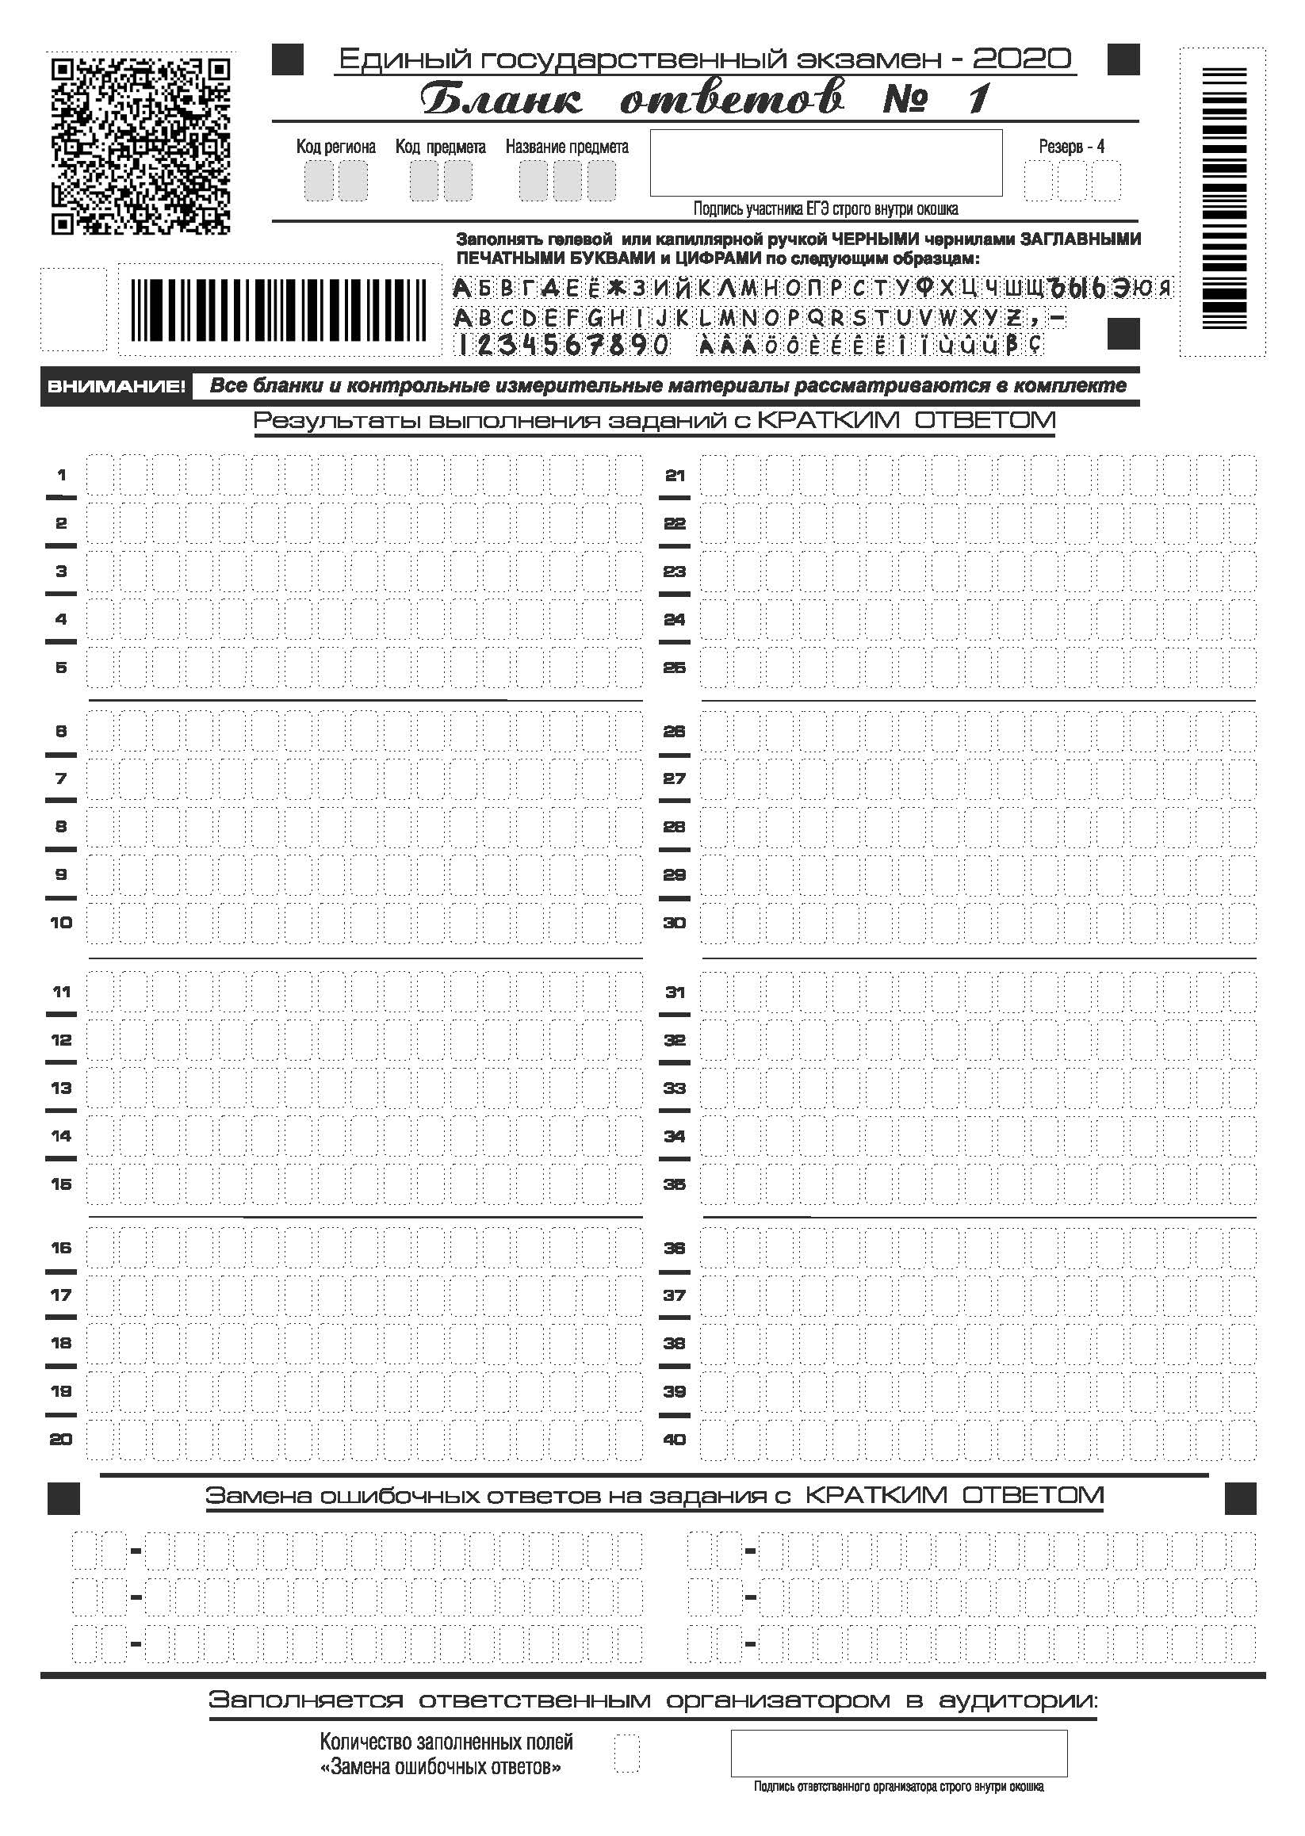

Slide 18
