Slide 1

ЕГЭ
английский язык
ВАРИАНТ 8
Время выполнения работы 3 часа 10 мин ( 190 минут)
Работа состоит из четырёх разделов: «Аудирование», «Чтение", "Грамматика и лексика», «Письменная речь». Раздел 1 («Аудирование») содержит 9 заданий. Рекомендуемое время на выполнение заданий раздела 1 составляет 30 минут. Раздел 2 («Чтение») содержит 9 заданий. Рекомендуемое время на выполнение заданий раздела 2 составляет 30 минут. Раздел 3 («Грамматика и лексика») содержит 20 заданий. Рекомендуемое время на выполнение заданий раздела 3 составляет 40 минут. Раздел 4 («Письменная речь») состоит из 2 заданий. Рекомендуемое время на выполнение заданий этого раздела работы – 90 минут.

Slide 2

Раздел 1. Аудирование
1
Задание 1
Прослушайте шесть высказываний. Установите соответствие между высказываниями каждого говорящего A–F и утверждениями, данными в списке 1–7. Используйте каждое утверждение, обозначенное соответствующей цифрой, только один раз. В задании есть одно лишнее утверждение. Занесите свои ответы в таблицу.
There are times when we need to accept change.
I’m thankful to my parents for their support.
I’d like to be like my parent.
A parent can make a true friend.
I’d like to become truly independent.
Sometimes it’s hard to find peace at home.
Family is not always about blood relation.
Говорящий | A | B | C | D | E | F
Утверждение

Slide 3
Задание 2
Вы услышите диалог. Определите, какие из приведённых утверждений А–G соответствуют содержанию текста (1 – True), какие не соответствуют (2 – False) и о чём в тексте не сказано, то есть на основании текста нельзя дать ни положительного, ни отрицательного ответа (3 – Not stated). Занесите номер выбранного Вами варианта ответа в таблицу. Вы услышите запись дважды.
A. Anna is looking forward to the family holiday.
B. Ben has watched all Disney cartoons.
C. Anna thinks that only parents with children go to the cinema to see cartoons.
D. Ben and his friends watch cartoons at Ben’s house.
E. Anna thinks that some cartoons are like feature films.
F. Anna thinks that Ben wouldn’t like going to Florida after all.
G. Ben would like to meet Mickey Mouse.
2
Говорящий | A | B | C | D | E | F | G
Соответствие диалогу

Slide 4
Задание 3
Вы услышите интервью. В заданиях 3–9 запишите в поле ответа цифру 1, 2 или 3, соответствующую выбранному Вами варианту ответа. Вы услышите запись дважды.
3
Samuel Jeffrey is NOT introduced by the presenter as …
1) a teacher.
2) a traveler.
3) a patriot.
4
Samuel Jeffery considers teaching abroad to be …
1) a way of getting to know the world.
2) a risky experience.
3) the best way to earn one’s living.
5
What encouraged Samuel Jeffrey to start teaching English?
1) The improvement of his teaching skills.
2) Desire to work abroad.
3) His work with Korean students.
6
Which of the following is TRUE about Samuel Jeffrey’s teaching English in Korea?
1) It was poorly paid.
2) The students were boring.
3) It left him time for other activities.
7
Which of the following does Samuel Jeffrey NOT mention as something the teacher’s salary depends on?
1) Teacher’s experience.
2) Teacher’s age.
3) Teacher’s qualifications.
8
According to Samuel Jeffrey, what advantage is unique to teaching abroad and not found by simply traveling?
1) An ability to save money.
2) A better study of a new culture.
3) Feeling of belonging in a local community.
9
What advice does Samuel Jeffrey give to those wishing to teach English abroad?
1) Try to learn everything there is to about the prospective school.
2) Stay away from ESL industry.
3) Learn how to recognize the tricky operators.

Slide 5
Раздел 2. Чтение
10
Установите соответствие между заголовками 1–8 и текстами A–G. Занесите свои ответы в таблицу. Используйте каждую цифру только один раз.
В задании один заголовок лишний.
Personal style in a uniform 5. A hobby that carries away
Old but dear 6. Meaning without words
Get a holiday spirit 7. The number is not guilty
Dance competition 8. Yes to school uniform
A. Dance is in my heart, in my blood and in my mind. I dance daily. The seldom-used dining room of my house is now an often-used ballroom. The CD-changer has five discs at the ready: waltz, rock-and-roll, swing, salsa, and tango. Tango is a complex and difficult dance. I take three dancing lessons a week, and I am off to Buenos Aires for three months to feel the culture of tango.
B. Clothes play an important role in my life. My passion for fashion began when I was in elementary school. I attended a private school with uniformed dress code. At first I felt bad that I could not wear what I wanted, but soon I learned to display my creativity and style through shoes and accessories. They can make each of us each of us unique, in a uniform or not.
C. I believe that music has a bigger place in our society than it is given credit for. The single word ‘music’ covers so many styles. Rock bands and classical musicians make listeners get the meaning from the music. Music tells stories about life and death, expresses feelings of love, sadness, anger, guilt, and pain without using words.

Slide 6
D. Even as an eighteen year old young adult, I still feel the magic of Christmas. I believe in a real Christmas tree. My family has had a real Christmas tree every year of my life. When you get home and smell the sweet pine needles, something magical goes into your soul, raises your spirits. Every year we buy a real tree to fully embrace the spirit of Christmas.
E. People often try to get rid of the number thirteen. Many hotels and office buildings across the world do not have a 13th floor! I believe that the number thirteen is not an unlucky number. I was born on January, 13 and do not consider myself unlucky in any way at all! I believe that this number should have all the rights and respect we give the rest of the numbers.
F. Many kids that go to public schools don’t wear a uniform. They like to show off the new expensive clothes and often have trouble picking out outfits for school in the morning. They are more worried about whether their shirt matches the belt, rather than if the homework is completed. I believe that this is a fault of our school system and only causes problems.
G. They say that the music of your youth is the soundtrack of your life. I am 50; I enjoy new artists and new music, but I still find words of wisdom in singles of sixties and seventies, still believe that «you can’t always get what you want, but sometimes, you get what you need,» that «all you need is love.» I like to listen to the songs I grew up with.
Текст | A | B | C | D | E | F | G
Заголовок

Slide 7
Прочитайте текст и заполните пропуски A–F частями предложений, обозначенными цифрами 1–7. Одна из частей в списке 1–7 — лишняя. Занесите цифры, обозначающие соответствующие части предложений, в таблицу.
11
Duration of life and its social implications
The world’s population is about to reach a landmark of huge social and economic importance, when the proportion of the global population over 65 outnumbers children under 5 for the first time. A new report by the US census bureau shows (A) ______, with enormous consequences for both rich and poor nations.
The rate of growth will shoot up in the next couple of years. The (В) ______ a combination of the high birth rates after the Second World War and more recent improvements in health that are bringing down death rates at older ages. Separate UN forecasts predict that the global population will be more than nine billion by 2050.
The US census bureau was the first to sound (С) ______. Its latest forecasts warn governments and international bodies that this change in population structure will bring widespread challenges at every level of human organization, starting with the structure of the family, which will be transformed as people live longer. This will in turn place new burdens on careers and social services providers, (D) ______ for health services and pensions systems.
“People are living longer and, in some parts of the world, healthier lives,” the authors conclude. “This represents one of the greatest achievements of the last century but also a significant challenge (E) ______ population.”
Ageing will put pressure on societies at all levels. One way of measuring that is to look at the older dependency ratio, (F) ______ that must be supported by them. The ODR is the number of people aged 65 and over for every 100 people aged 20 to 64. It varies widely, from just six in Kenya to 33 in Italy and Japan. The UK has an ODR of 26, and the US has 21.
change is due to
a huge shift towards an ageing population
as proportions of older people increase in most countries
while patterns of work and retirement will have huge implications
which recently replaced Italy as the world’s oldest major country
the alarm about these changes
which shows the balance between working-age people and the older
Пропуск | A | B | C | D | E | F
Часть предложения

Slide 8
Прочитайте рассказ и выполните задания 1–7. В каждом задании обведите букву A, B, C или D, соответствующую выбранному вами варианту ответа.
Mr. Sticky
No one knew how Mr. Sticky got in the fish tank.
«He’s very small,» Mum said as she peered at the tiny water snail. «Just a black dot.»
In the morning Abby jumped out of bed and switched on the light in her fish tank.
Gerry, the fat orange goldfish, was dozing inside the stone archway. It took Abby a while to discover Mr. Sticky because he was clinging to the glass near the bottom, right next to the gravel.
At school that day she wrote about the mysterious Mr. Sticky who was so small you could mistake him for a piece of gravel. Some of the girls in her class said he seemed an ideal pet for her and kept giggling about it.
«I think he’s grown a bit,» Abby told her Mum at breakfast the next day.
«Just as well if he’s going to be eaten up like that,» her Mum said, trying to put on her coat and eat toast at the same time. «But I don’t want him to get too huge or he won’t be cute anymore. Small things are cute aren’t they?»
«Yes they are. Now hurry up, I’m going to miss my train.»
At the weekend they cleaned out the tank. «There’s a lot of filth on the sides,» Mum said. «I’m not sure Mr. Sticky’s quite up to the job yet.»
They took the fish out and put them in a bowl while they emptied some of the water. Mr. Sticky stayed out of the way, clinging to the glass while Mum used the special ‘vacuum cleaner’ to clean the gravel. Abby cleaned the archway and the filter tube. Mum poured new water into the tank.
«Where’s Mr. Sticky?» Abby asked.
«On the side,» Mum said. She was busy concentrating on the water.
Abby looked on all sides of the tank. There was no sign of the water snail.
«He’s probably in the gravel then,» her mum said. She put the fish back in the clean water where they swam round and round, looking baffled.
That evening Abby went up to her bedroom to examine the tank. The water had settled and looked lovely and clear but there was no sign of Mr. Sticky. She went downstairs.
Her mum was in the study surrounded by papers. She looked impatient when she saw Abby in the doorway and even more impatient when she heard the bad news.
«He’ll turn up.» was all she said. «Now off to bed Abby. I’ve got masses of work to catch up on.»
Abby felt her face go hot and red. It always happened when she was furious or offended.
«You’ve poured him out, haven’t you,» she said. «You were in such a rush.»
«I have not. I was very cautious. But he is extremely small.»
«What’s wrong with being small?»
«Nothing at all. But it makes things hard to find.»
«Or notice,» Abby said and ran from the room.

Slide 9
The door to the bedroom opened and Mum’s face appeared. Abby tried to ignore her but it was hard when she walked over to the bed and sat next to her. She was holding her glasses in her hand. «These are my new pair,» she said. «Extra powerful, for snail hunting.» She smiled at Abby. Abby tried not to smile back.
«And I’ve got a magnifying glass,» Abby suddenly remembered and rushed off to find it.
They sat beside each other on the floor with the tank between them and peered into the water.
«Ah ha!» Mum suddenly cried.
There, perfectly hidden against the dark stone, sat Mr. Sticky. And right next to him was another water snail, even smaller than him.
«Mrs. Sticky!» Abby breathed.
They both laughed. Then Abby put her head on her mum’s chest and smiled.
12
Mr. Sticky was
A) a goldfish.
B) a piece of gravel.
C) a snail.
D) a turtle.
13
Abby didn’t want Mr. Sticky to grow too big because
A) there wouldn’t be enough space in the fish tank.
B) he would eat too much.
C) he would leave a lot of dirt on the walls of the fish tank.
D) she found small things to be very pretty.
14
When helping her mother to clean out the tank Abby
A) polished the walls of the tank.
B) used a vacuum cleaner.
C) poured fresh water into the tank.
D) cleaned the filter tube of the fish tank.

Slide 10
15
Abby came to her mother’s study
A) to tell her that Mr. Sticky hadn’t turned up.
B) when she had found Mr. and Mrs. Sticky.
C) because she didn’t want to go to bed.
D) to say goodnight.
16
Abby was angry with her Mum because
A) mother ignored her.
B) mother didn’t like Mr. Sticky.
C) she thought that her mother had poured out Mr. Sticky.
D) mother was very strict.
17
Mother came to Abby’s room to look for Mr. Sticky with
A) her new glasses.
B) a filter tube.
C) a magnifying glass.
D) a vacuum cleaner.
18
Abby felt happy and laughed because
A) mother came to help her look for Mr. Sticky.
B) they found Mr. Sticky in the fish tank.
C) the water in the fish tank was very clear and clean.
D) her mother was trying to make her laugh.

Slide 11
Раздел 3. Грамматика и лексика
Прочтите текст ниже. Преобразуйте слова, напечатанные заглавными буквами в конце строк, обозначенных цифрами 19-24, чтобы они грамматически соответствовали содержанию текста. Заполните пропуски словами, которые вы получили. Каждый проход соответствует отдельной задаче из группы 19-24.
Kid inventions
Becky Schroeder was only 10 years old when she came up with the idea of the glo-paper. Two years______, in 1974, her invention was patented. She became the ______ female to ever receive a patent in the United States. The idea came to her when she tried to do her homework in the family car, while her mother shopped for groceries. It ______ dark gradually, and she couldn’t see her notebook very well. She ______ a flashlight and imagined how nice it would be to have a paper that glows in the dark and allows you to write effortlessly without light. A year of research and experiment and she did it!
A white flag
It’s always a problem for me to find my car in a huge parking lot. After reading an article with a piece of advice for people like me, I decided to follow it one day. I attached a tissue to the car’s antenna with a rubber band. The little white flag waving in the breeze ______ to help me spot my car easily. So I went ______ .
19
LATE
20
YOUNG
21
GET
22
NOT/HAVE
23
SUPPOSE
24
SHOP

Slide 12
Преобразуйте, если необходимо, слова, напечатанные заглавными буквами, так чтобы они грамматически и лексически соответствовали содержанию текста. Каждый пропуск соответствует отдельному заданию из группы 25-29. Впишите слова в поле ответа.
Morse Code
Before phones, computers, and telegraphs were invented, messages would take months or even years to reach their destination. Samuel Morse was born in Charlestown, Massachusetts, in April 1791, not knowing that he would be a famous ______.
Since the age of four, Morse had been interested in ______ and he wanted to become a painter. Mr. and Mrs. Morse were afraid that he couldn’t make a living as a painter, so they made him a bookseller. He worked as a bookseller but at night he would paint. Finally, his parents realized how he loved art, so they found the money for Morse to study art in London.
After a ______ artistic career (first painting historical scenes and then portraits), Morse built the first American telegraph around 1835. Morse patented a working telegraph machine in 1837, with help from his ______ partners, Leonard Gale and Alfred Vail. Morse used a dots-and-spaces code for the letters of the alphabet and for numbers. It was later improved to use dashes with dots and spaces. Since then, it has proved its ______ many times.
25
INVENT
26
DRAW
27
SUCCESS
28
BUSY
29
EFFECTIVE

Slide 13
Прочитайте текст с пропусками, обозначенными номерами 30 – 36.
Эти номера соответствуют заданиям 30 – 36, в которых представлены возможные варианты ответов (А, B, C, D). Установите соответствие номера пропуска варианту ответа.
A Chinese Vase
When I was a child I loved visiting my grandmother. I thought her house was as beautiful as a palace. As I grew older the house and garden seemed smaller, but I still loved visiting the old lady. There were so many lovely things to look (1) ______ in the house.
I loved her paintings and the old clock, but (2) ______ all I loved a big Chinese vase which stood in the hall. It was (3) ______ than me, and I couldn’t see (4) ______ it. I walked round and round it looking at the beautiful ladies and the birds and flowers and trees, and Grandmother often (5) ______ me stories about these ladies. She said that her grandfather had brought the vase with him when he returned from a long (6) ______ to China.
We live in a modern house, and I’m afraid my husband and I often nag at the children. “Don’t make the new carpet dirty, Paul!” “Be careful with the new table, Philip!”
Before she died, Grandmother gave me the vase I loved so much. It (7) ______ beautiful in our modern hall.
One day I came home from the shop. The boys met me at the door. “I’m as strong as George Bes, Mummy,” said Paul. “I got a goal and I broke the vase.” Philip tried to be more diplomatic than Paul, “It doesn’t really matter, does it? You told us it wasn’t new. You aren’t cross, are you?”
30
31
32
33
34
35
36
А) out B) at C) into D) about
А) mostly B) great of C) greatly D) most of
А) higher B) larger C) taller D) greater
А) about B) around C) inside D) outside
А) said B) spoke C) talked D) told
А) voyage B) tour C) hike D) excursion
А) looked B) viewed C) appeared D) seemed
30
31
32
33
34
35
36

Slide 14
37
Раздел 4. Письменная речь
You have received an email message from your English-speaking pen-friend Alice:
From: Alice @mail.uk
To: Russian_friend@ege.ru
Subject: Healthy living
... I’ve decided to go on a diet – I want to lose a few pounds. What are the most efficient ways to lose weight, in your opinion? Why do many people try to follow a healthy lifestyle? How important is your family’s support if you choose a healthy lifestyle as your goal? Yesterday my friends and I went to the cinema to watch a new film …
Write an email to Alice. In your message: − answer her questions; − ask 3 questions about the new film. Write 100–140 words. Remember the rules of email writing.
From: Russian_friend@ege.ru
To: Alice@uk.com
Subject: Healthy living

Slide 15
Выберите только ОДНО из двух предложенных заданий (38.1 или 38.2), укажите его номер в БЛАНКЕ ОТВЕТОВ № 2 и выполните согласно данному плану. В ответе на задание 38 числительные пишите цифрами
Imagine that you are doing a project on what part-time jobs are popular among teenagers in Jobland. You have found some data on the subject – the results of the opinion polls (see the table below). Comment on the data in the table and give your opinion on the subject of the project.
38.1
Part-time jobs | Number of teenagers (%)
Waiter | 56
Shop assistant | 30
Office helper | 8
Package sorter | 4
Leaflet distributor | 2
Write 200–250 words. Use the following plan: – make an opening statement on the subject of the project; – select and report 2–3 facts; – make 1–2 comparisons where relevant and give your comments; – outline a problem that can arise with teenage employment and suggest a way of solving it; – conclude by giving and explaining your opinion on the importance of part-time job for teenagers.

Slide 16
Imagine that you are doing a project on what books teenagers in Zetland prefer to read. You have found some data on the subject – the results of the opinion polls (see the pie chart below). Comment on the data in the pie chart and give your opinion on the subject of the project.
38.2
Kinds of books
Comics
9%
Detective stories
30%
Romance
16%
Adventure
18%
Science fiction
27%
Write 200–250 words.
Use the following statement on the subject of the project;
– select and report 2–3 facts;
– make 1–2 comparisons where relevant and give your comments;
– outline a problem that one can face with reading books and suggest a way of solving it;
– conclude by giving and explaining your opinion on the role of reading books for teenagers.

Slide 17
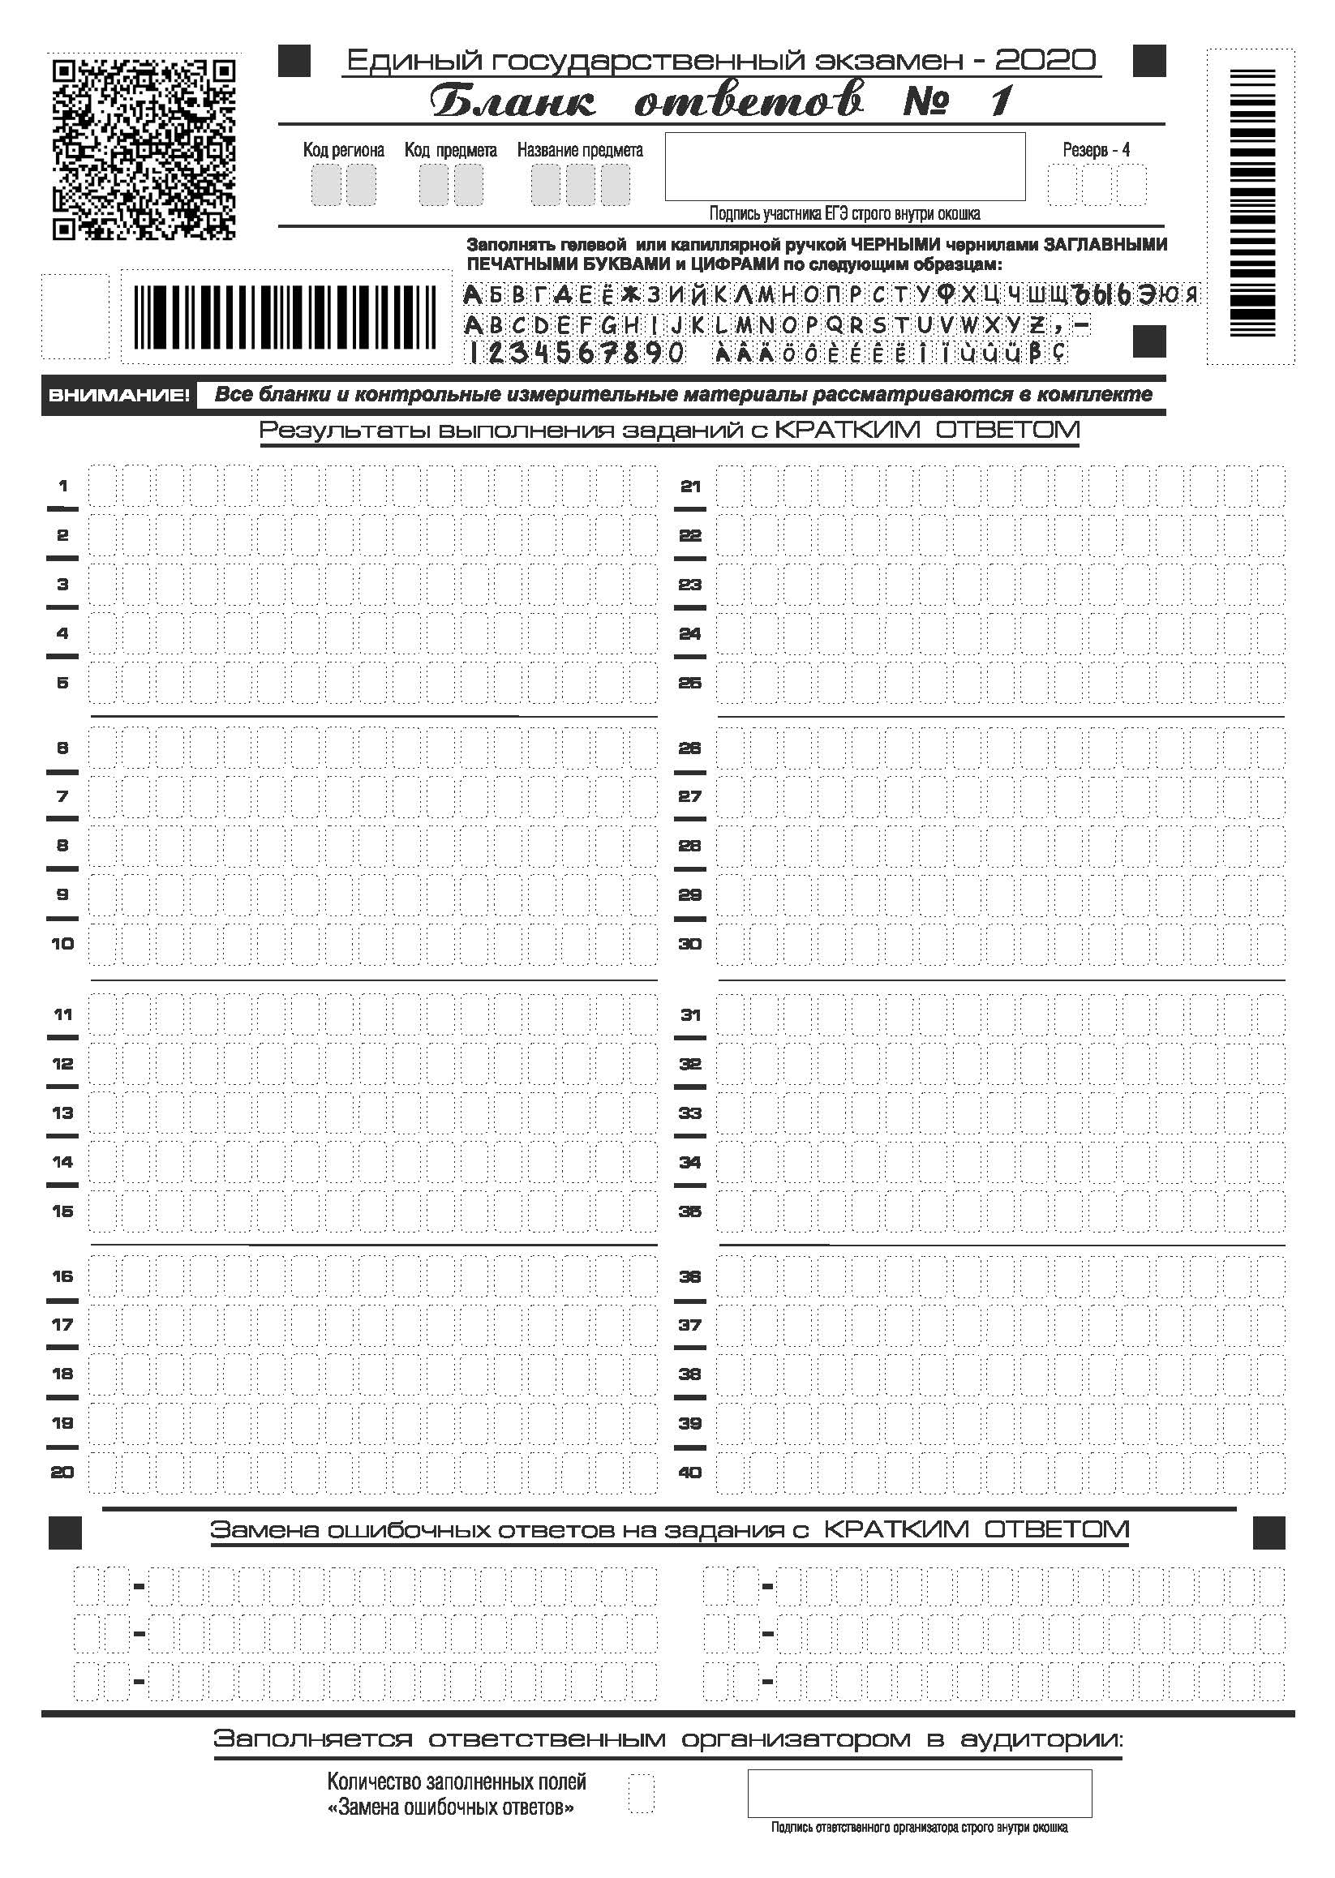

Slide 18
