Slide 1

ЕГЭ
английский язык
ВАРИАНТ 7
Время выполнения работы 3 часа 10 мин ( 190 минут)
Работа состоит из четырёх разделов: «Аудирование», «Чтение", "Грамматика и лексика», «Письменная речь». Раздел 1 («Аудирование») содержит 9 заданий. Рекомендуемое время на выполнение заданий раздела 1 составляет 30 минут. Раздел 2 («Чтение») содержит 9 заданий. Рекомендуемое время на выполнение заданий раздела 2 составляет 30 минут. Раздел 3 («Грамматика и лексика») содержит 20 заданий. Рекомендуемое время на выполнение заданий раздела 3 составляет 40 минут. Раздел 4 («Письменная речь») состоит из 2 заданий. Рекомендуемое время на выполнение заданий этого раздела работы – 90 минут.

Slide 2

Раздел 1. Аудирование
1
Задание 1
Прослушайте шесть высказываний. Установите соответствие между высказываниями каждого говорящего A–F и утверждениями, данными в списке 1–7. Используйте каждое утверждение, обозначенное соответствующей цифрой, только один раз. В задании есть одно лишнее утверждение. Занесите свои ответы в таблицу.
It’s good to learn more about your future profession before getting a degree.
Don’t show off and you won’t get into trouble.
Unpleasant accidents with your relatives can put you off traveling abroad.
There are always some ways to reduce your travel cost.
There are many ways to keep in touch with relatives and friends.
Some people don’t want to travel because they’re addicted to local food.
A gap year after school can ruin your career prospects.
Говорящий | A | B | C | D | E | F
Утверждение

Slide 3
Задание 2
Вы услышите диалог. Определите, какие из приведённых утверждений А–G соответствуют содержанию текста (1 – True), какие не соответствуют (2 – False) и о чём в тексте не сказано, то есть на основании текста нельзя дать ни положительного, ни отрицательного ответа (3 – Not stated). Занесите номер выбранного Вами варианта ответа в таблицу. Вы услышите запись дважды.
A. Both Mike and Jane enjoyed their prom.
B. Mike’s parents went to Peru for sightseeing.
C. Mike’s parents don’t like visiting Spain.
D. Jane thinks Peru is a safe place for visitors.
E. Mike got ill during his stay in Peru.
F. Mike is going to become a doctor.
G. Mike will have to study longer than Jane.
2
Говорящий | A | B | C | D | E | F | G
Соответствие диалогу

Slide 4
Задание 3
Вы услышите интервью. В заданиях 3–9 запишите в поле ответа цифру 1, 2 или 3, соответствующую выбранному Вами варианту ответа. Вы услышите запись дважды.
3
What does the presenter say about Jane Bliss?
1) She is in the movie industry.
2) She is not particularly rich.
3) She worked for the United Nations.
4
During her first visit to Cambodia Jane realized she …
1) knew little about the life of people there.
2) was risking her life all the time.
3) couldn’t walk on her own anywhere.
5
What does Jane say about people in Cambodia?
1) They have a rich culture and history.
2) Their life is very hard.
3) They are not very hospitable.
6
Why did Jane choose the United Nations to work with?
1) It was the only one working in Cambodia.
2) She trusted this organization very much.
3) They offered her a position.
7
What is Jane’s main purpose in her work in Cambodia?
1) To make people aware of how dangerous the situation is.
2) To attract money and investors to the area for helping the refugees.
3) To make Cambodian people free and less shy.
8
Which of the following is NOT true about life in Cambodia now?
1) There are no roads.
2) People earn very little.
3) Charities play important role there.
9
What does Jane say about her life in Cambodia?
1) It was difficult to find a bathroom.
2) She found a lot of landmines.
3) It was hard to be under permanent stress.

Slide 5
Раздел 2. Чтение
10
Установите соответствие между заголовками 1–8 и текстами A–G. Занесите свои ответы в таблицу. Используйте каждую цифру только один раз.
В задании один заголовок лишний.
Music from every corner of the world 5. Famous religious celebrations
From pig to pork 6. See them fly
Perfect time for a picnic 7. Animal races and shows
From a holiday to a sport 8. Diving into history
A. Diali is a five-day festival that is celebrated in October or November, depending on the cycle of the moon. It represents the start of the Hindu New Year and honors the victory of good over evil, and brightness over darkness. It also marks the start of winter. Diwali is actually celebrated in honor of Lord Rama and his wife Sita. One of the best places to experience Diwali is in the «pink city» of Jaipur, in Rajasthan. Each year there’s a competition for the best decorated and most brilliantly lit up market that attracts visitors from all over India.
B. The Blossom Kite Festival, previously named the Smithsonian Kite Festival, is an annual event that is traditionally a part of the festivities at the National Cherry Blossom Festival on the National Mall in Washington, DC. Kite enthusiasts show off their stunt skills and compete for awards in over 36 categories including aerodynamics and beauty. The Kite Festival is one of the most popular annual events in Washington, DC and features kite fliers from across the U.S. and the world.
C. The annual Ostrich Festival has been recognized as one of the «Top 10 Unique Festivals in the United States» with its lanky ostriches, multiple entertainment bands and many special gift and food vendors. It is truly a unique festival, and suitable for the entire family. The Festival usually holds Ostrich Races, an Exotic Zoo, Pig Races, a Sea Lion Show, a Hot Rod Show, Amateur Boxing and a Thrill Circus.

Slide 6
D. Iceland’s Viking Festival takes place in mid-June every year and lasts 6 days, no matter what the weather in Iceland may be. It’s one of the most popular annual events in Iceland where you can see Viking-style costumes, musical instruments, jewelry and crafts at the Viking Village. Visitors at the Viking Festival see sword fighting by professional Vikings and demonstrations of marksmanship with bows and muscle power. They can listen to Viking songs and lectures at the festival, or grab a bite at the Viking Restaurant nearby.
E. Dragon Boat Festival is one of the major holidays in Chinese culture. This summer festival was originally a time to ward off bad spirits, but now it is a celebration of the life of Qu Yuan, who was a Chinese poet of ancient period. Dragon boat festival has been an important holiday for centuries for Chinese culture, but in recent years dragon boat racing has become an international sport.
F. The Mangalica Festival is held in early February at Vajdahunyad Castle in Budapest. It offers the opportunity to experience Hungarian food, music, and other aspects of Hungarian culture. The festival is named for a furry pig indigenous to the region of Hungary and the Balkans. A mangalica is a breed of pig recognizable by its curly hair and known for its fatty flesh. Sausage, cheese and other dishes made with pork can be sampled at the festival.
G. Hanami is an important Japanese custom and is held all over Japan in spring. Hanami literally means «viewing flowers», but now it is a cherry blossom viewing. The origin of hanami dates back to more than one thousand years ago when aristocrats enjoyed looking at beautiful cherry blossoms and wrote poems. Nowadays, people in Japan have fun viewing cherry blossoms, drinking and eating. People bring home-cooked meals, do BBQ, or buy takeout food for hanami.
Текст | A | B | C | D | E | F | G
Заголовок

Slide 7
Прочитайте текст и заполните пропуски A–F частями предложений, обозначенными цифрами 1–7. Одна из частей в списке 1–7 — лишняя. Занесите цифры, обозначающие соответствующие части предложений, в таблицу.
11
Friendship and Love
A strong friendship takes a significant amount of time to develop. It will not just magically mature overnight. A friendship involves committing oneself to help another person (A) ______. I believe that, nothing can replace a true friend, not material objects, or money, and definitely not a boy.
I met this guy a couple summers ago who I ended up spending almost all of my free time with. His parents did not approve of our dating because of our age difference, (В) ______. He had told me the day we met that he had joined the air force and would leave for overseas that coming October. After three months had past, the time came when he had to leave. This left me feeling completely alone.
I turned to my friends for support, but to my surprise, (С) ______. I had spent so much time with this guy and so little time with them, that they did not feel sorry for me when he left. For so long they had become the only constant in my life, and I had taken them for granted over something (D) ______.
When my boyfriend came back, our relationship changed. I tried to fix all the aspects in my life that had gone so wrong in the previous six months.
This experience taught me that true friendships will only survive if one puts forth effort to make them last. Keeping friends close will guarantee that (E) ______. When a relationship falls apart, a friend will always do everything in their power to make everything less painful. As for me, I try to keep my friends as close as I can. I know they will always support me in whatever I do, and to them, (F) ______.
but we did anyway.
whenever a need arises.
they did not really care.
whenever they need your help.
I could not guarantee would even last.
I am eternally grateful for a second chance.
someone will always have a shoulder to cry on.
Пропуск | A | B | C | D | E | F
Часть предложения

Slide 8
Прочитайте рассказ и выполните задания 1–7. В каждом задании обведите букву A, B, C или D, соответствующую выбранному вами варианту ответа.
To Become Wealthy
As a kid, I always wanted to become wealthy. I knew if I could achieve this, I would be able to consider myself successful. At the time, I had no worries and felt my happiness would be based on whether I could fulfill all my needs and wants. My simple philosophy of that time was if I was rich, I would definitely be content with my life.
My father always stressed his belief that happiness includes much more than money. I can remember him lecturing me about how money does not make an individual happy; other things in life such as: health, family, friends, and memorable experiences make a person genuinely happy. At this time in my life, I took what my dad said for granted and did not give any thought to his words. All I could see was the great life my cousins had because they had everything a kid ever dreamed of.
At a young age, I noticed society was extremely materialistic. The media seemed to portray the wealthy as happy people who add value to our society. My opinions did not change; in high school I still sought a career that would eventually yield a high salary. I still felt that the possibility of living life from paycheck to paycheck would automatically translate into my unhappiness. However, things changed when I decided to take an internship in the accounting department for the summer after my second year of college.
Starting the first day on the job in the accounting department, I found myself extremely bored. I was forced to do monotonous work, such as audit eight thousand travel and expense reports for a potential duplicate. In addition, I had to relocate away from friends and family in order to accept the position. I was earning the money I always wanted; however, I noticed that having money to spend when you are by yourself was not satisfying.

Slide 9
I began to think back to what my dad always said. After a few months in the job, I truly realized that money does not bring happiness. A more satisfying experience for me would have been doing an ordinary summer job for far less money. For me to understand that concept, it took an experience as painful as this one. I often contemplated how much money it would take me to do this as my everyday job. I concluded, whatever the salary for this position I would never be capable of fulfilling a happy life and making a career out of this job.
As I looked forward to the summer to draw to a close, I truly comprehended the meaning of my dad’s words. Contrary to my prior beliefs, I firmly believe through experience that money cannot make a person happy. The term “wealth” is a broad term, and I believe the key to happiness is to become wealthy in great memories, friends, family, and health. This I believe.
12
In his childhood the narrator’s idea of happiness was to
А) get what he wanted.
B) live an interesting life.
C) be an influential person.
D) make other people happy.
13
The narrator heard what his father used to say, but did not
А) believe him.
B) agree with him.
C) understand him.
D) think over his words.
14
From his early childhood till he finished school the narrator was convinced that
А) society was extremely unfair.
B) media added value to society.
C) money was the only thing that ensured happiness.
D) the wealthy could not spend money properly.

Slide 10
15
After the second year in the college the narrator decided to
А) start to work.
B) quit his studies.
C) change the college.
D) take a summer course.
16
The narrator’s internship proved that
А) it was not a money-making job.
B) he had chosen the wrong job.
C) he could not cope with professional tasks.
D) he had to get rid of his family and friends to keep the position.
17
It became obvious to the narrator that he
А) needed to think of another career.
B) would like to work only in summer.
C) would like to have a higher position.
D) preferred ordinary non-professional work.
18
The summer for the narrator was
А) monotonous and lonely.
B) dragged out and boring.
C) dynamic and satisfying.
D) difficult but inspirational.

Slide 11
Раздел 3. Грамматика и лексика
Прочтите текст ниже. Преобразуйте слова, напечатанные заглавными буквами в конце строк, обозначенных цифрами 19-24, чтобы они грамматически соответствовали содержанию текста. Заполните пропуски словами, которые вы получили. Каждый проход соответствует отдельной задаче из группы 19-25.
Does it ever snow in Brazil?
During winter and sometimes even autumn and spring it snows in some cities of southern Brazil. There are several cities ______ for their snow, like Urupema and Urubici.
These cities are all in high areas, but even places at sea level can have snow, although in small amounts and not every year. Brazil ______ to be a “tropical paradise” which is very wrong. Foreigners who travel to southern Brazil during autumn or winter in search for some heat and beaches are often disappointed.
The North Pole is melting
Do you know how the global warming affects the Arctic? A survey by the Japan Agency for Science and Technology shows that Arctic ice is melting at a far _____ rate than anticipated. Today Arctic ice is melting at previously unseen rates.
The coastal ice in parts of Canada and Alaska has become quite brittle. Ice easily breaks away in large pieces and melts in the open ocean. Now there is also ______ sea ice in the Arctic Ocean. It happens because ice ______ into the Atlantic Ocean.
Scientists say that the lack of ice represents clear proof that the planet _____. Back in the past it could take three years to get through the waterway’s thick ice successfully, now – just a few weeks.
19
KNOW
20
THINK
21
QUICK
22
23
LITTLE
FLOAT
24
WARM

Slide 12
Преобразуйте, если необходимо, слова, напечатанные заглавными буквами, так чтобы они грамматически и лексически соответствовали содержанию текста. Каждый пропуск соответствует отдельному заданию из группы 25-29. Впишите слова в поле ответа.
Santorini
Santorini is a small group of Greek islands. They were formed due to a _____ eruption about 3,600 years ago. Volcanos are still very active in the area. Tourists can fly to Santorini or take a ferry and enjoy the natural beauty in summer, when the islands are crowded and busy. In winter Santorini seems ______ and ferry service is not regular. On one side of Santorini, ______ get a view of the local villages. This area is ______ developed and rich. On another side of the islands tourists can enjoy black sand beaches and swim near the volcano. The third part of Santorini displays ancient ruins. Although this section is not popular among tourists, it is a well-known site for ______. In fact, legends say that Santorini is the place where the lost civilization of Atlantis was once located.
25
VOLCANO
26
POPULATED
27
VISIT
28
HIGH
29
ARCHEYOLOGY

Slide 13
Прочитайте текст с пропусками, обозначенными номерами 30 – 36.
Эти номера соответствуют заданиям 30 – 36, в которых представлены возможные варианты ответов (А, B, C, D). Установите соответствие номера пропуска варианту ответа.
Pierre and Faniry
At the age of twenty-one, Pierre – that was the name of the winegrower – had been sent by his father to spend some time with his uncle in Madagascar. He (1) ______ at the island and within two weeks he fell for a local girl called Faniry, or «Desire» in Malagasy. You could not blame him. At seventeen she was ravishing. In the Malagasy sunlight her skin was golden. Her black, waist-length hair, which hung straight beside her cheeks, framed large, fathomless eyes. It was a genuine love at first (2) ______, for both of them. Within five months they were married. Faniry had no family, but Pierre’s parents came out from France for the wedding, even though they did not strictly (3) ______of it, and for three years the young couple lived very happily on the island of Madagascar.
Then, one day, a telegram came from France. Pierre’s parents and his only brother had been killed in a car crash. Pierre took the next flight home to (4) ______ the funeral and manage the vineyard left by his father. Faniry followed two weeks later. Pierre was grief-stricken, but with Faniry he (5) ______ down to running the vineyard. His family, and the lazy, idyllic days under a tropical sun, were gone forever. But he was very happily married, and he was very well-off. Perhaps, he reasoned, life in Bordeaux would not be so bad. Pierre thought he had married an angel, but soon he found (6) ______ that he was wrong. He had (7) ______ a fatal mistake in marrying Faniry.
30
31
32
33
34
35
36
30
A) reached B) arrived C) got D) came
A) sight B) view C) look D) gaze
A) admit B) agree C) approve D) accept
A) attain B) attend C) appear D) apply
A) stayed B) lodged C) dwelled D) settled
A) out B) over C) of D) in
A) done B) set C) made D) put
31
32
33
34
35
36

Slide 14
Раздел 3. Письмо
37
You have received an email message from your English-speaking pen-friend Mike:
From: Mike @mail.uk
To: Russian_friend@ege.ru
Subject: Hobby
… I’ve got new hobbies – recording birds’ songs and taking pictures of wildlife. What hobby do you have? How much time do you spend on it? What do your parents and friends think of your hobby? Hooray! My elder brother promised to be back home from college on my birthday …
Write an email to Mike. In your message: − answer his questions; − ask 3 questions about his elder brother. Write 100–140 words. Remember the rules of email writing.
From: Russian_friend@ege.ru
To: Mike@uk.com
Subject: Hobby

Slide 15
Выберите только ОДНО из двух предложенных заданий (38.1 или 38.2), укажите его номер в БЛАНКЕ ОТВЕТОВ № 2 и выполните согласно данному плану. В ответе на задание 38 числительные пишите цифрами
Imagine that you are doing a project on what sports clothing brands are popular among teenagers in Zetland. You have found some data on the subject – the results of the opinion polls (see the table below). Comment on the data in the table and give your opinion on the subject of the project.
38.1
Brands | Number of teenagers (%)
Nike | 48
Fila | 24
Puma | 13
Asics | 8
Jordan | 7
Write 200–250 words. Use the following plan: – make an opening statement on the subject of the project; – select and report 2–3 facts; – make 1–2 comparisons where relevant and give your comments; – outline a problem that can arise with following fashion trends in sports and suggest a way of solving it; – conclude by giving and explaining your opinion on the role of fashion in teenager’s life.

Slide 16
Imagine that you are doing a project on where young people in Zetland prefer to celebrate birthdays. You have found some data on the subject – the results of the opinion polls (see the pie chart below). Comment on the data in the pie chart and give your opinion on the subject of the project.
38.2
Places for celebrating birthdays
Travelling to another country
2%
Going to a karaoke bar
4%
Having dinner in a cafe
48%
Going to an amusement park
21%
Going on a picnic
25%
Write 200–250 words.
Use the following statement on the subject of the project;
– select and report 2–3 facts;
– make 1–2 comparisons where relevant and give your comments;
– outline a problem that one can face choosing a place for celebrating birthday and suggest a way of solving it;
– conclude by giving and explaining your opinion on the best place for celebrating birthday for you.

Slide 17
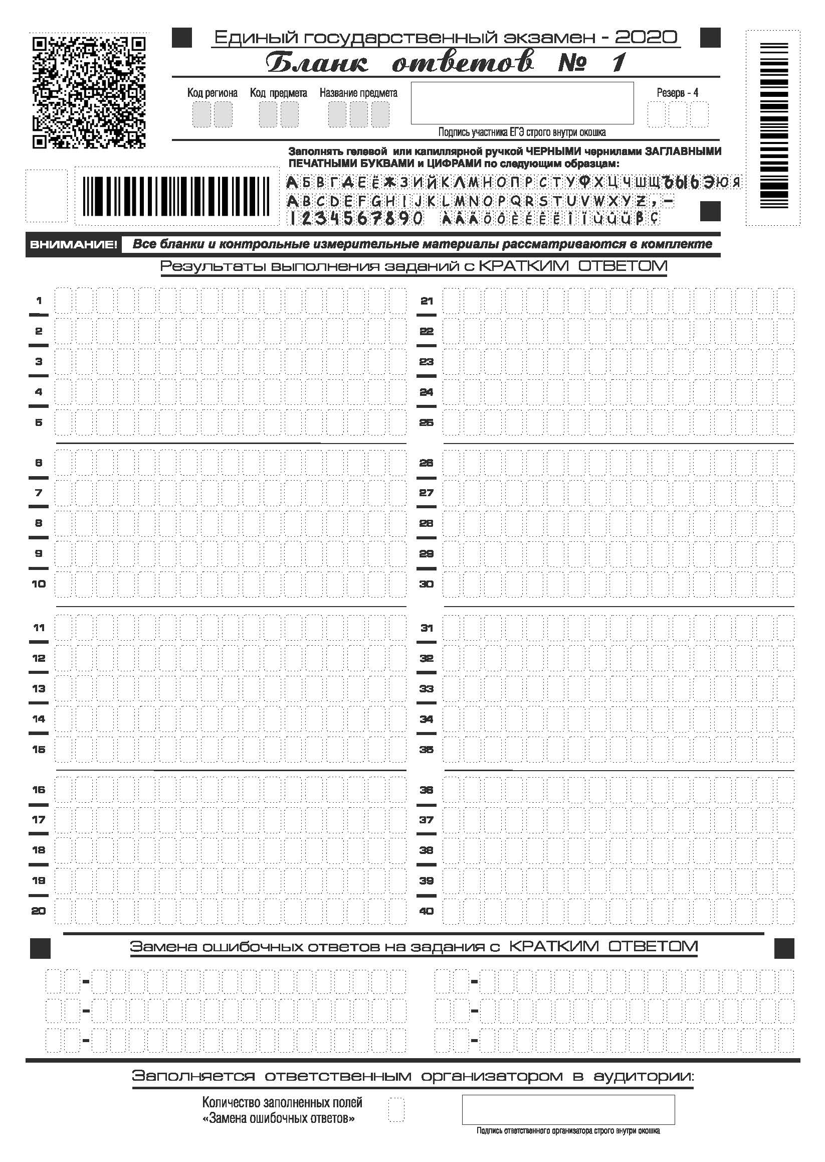

Slide 18
