Slide 1

ЕГЭ
английский язык
ВАРИАНТ 4
Время выполнения работы 3 часа 10 мин ( 190 минут)
Работа состоит из четырёх разделов: «Аудирование», «Чтение", "Грамматика и лексика», «Письменная речь». Раздел 1 («Аудирование») содержит 9 заданий. Рекомендуемое время на выполнение заданий раздела 1 составляет 30 минут. Раздел 2 («Чтение») содержит 9 заданий. Рекомендуемое время на выполнение заданий раздела 2 составляет 30 минут. Раздел 3 («Грамматика и лексика») содержит 20 заданий. Рекомендуемое время на выполнение заданий раздела 3 составляет 40 минут. Раздел 4 («Письменная речь») состоит из 2 заданий. Рекомендуемое время на выполнение заданий этого раздела работы – 90 минут.

Slide 2

Раздел 1. Аудирование
1
Задание 1
Прослушайте шесть высказываний. Установите соответствие между высказываниями каждого говорящего A–F и утверждениями, данными в списке 1–7. Используйте каждое утверждение, обозначенное соответствующей цифрой, только один раз. В задании есть одно лишнее утверждение. Занесите свои ответы в таблицу.
Housecleaning is useless if there are young kids in the family.
Housecleaning may positively influence your mental health.
Your house doesn’t have to be in perfect order all the time.
There are more pluses than minuses about housecleaning.
Organizing yourself is a good way to keep your place clean.
Housecleaning is good for many reasons.
Keeping your house clean means not having too many things.
Говорящий | A | B | C | D | E | F
Утверждение

Slide 3
Задание 2
Вы услышите диалог. Определите, какие из приведённых утверждений А–G соответствуют содержанию текста (1 – True), какие не соответствуют (2 – False) и о чём в тексте не сказано, то есть на основании текста нельзя дать ни положительного, ни отрицательного ответа (3 – Not stated). Занесите номер выбранного Вами варианта ответа в таблицу. Вы услышите запись дважды.
A. The young man thinks he can choose a present himself.
B. The man is choosing a present for his mother’s birthday.
C. The man doesn’t want to spend too much on the present.
D. The man doesn’t think a gift certificate is a good idea.
E. The shop assistant thinks a present would be better than an experience.
F. The young man’s girlfriend has a profile in Instagram.
G. The young man often buys flowers to his girlfriend.
2
Говорящий | A | B | C | D | E | F | G
Соответствие диалогу

Slide 4

Задание 3
Вы услышите интервью. В заданиях 3–9 запишите в поле ответа цифру 1, 2 или 3, соответствующую выбранному Вами варианту ответа. Вы услышите запись дважды.
3
What do we learn about Harry at the beginning of the interview?
1) He’s still a very young person.
2) He became famous a long time ago.
3) He loves watching TV programmes about himself.
4
Why, according to Harry, was his first show successful?
1) It was positive and optimistic.
2) It appealed to various viewers.
3) It revealed people’s secrets.
5
What does Harry have in common with the Steve character?
1) They are faithful.
2) They are trustworthy.
3) They are rather skeptical.
6
How did the show change Harry, in his opinion?
1) He now has more questions than answers.
2) He has become more open to new things.
3) He now tends to accept any script offered to him.
7
Which of the genres is NOT to Harry’s liking?
1) Romantic comedy.
2) Thriller.
3) Period drama.
8
What kind of characters does Harry say he prefers to play?
1) Good guys.
2) Bad guys.
3) Anybody.
9
How does Harry feel about getting older?
1) It’s horrible.
2) It’s natural.
3) It’s important.

Slide 5
Раздел 2. Чтение
10
Установите соответствие между заголовками 1–8 и текстами A–G. Занесите свои ответы в таблицу. Используйте каждую цифру только один раз.
В задании один заголовок лишний.
A taste of everything 5. Activities for the adventurous and hardy
Shop till you drop 6. On the crossroads of religions
City’s tourist attractions 7. For the body, mind and soul
Ancient traditions live on 8. From the high peaks to the deep seas
A. Today Jakarta has much to offer, ranging from museums, art and antique markets, first class shopping to accommodations and a wide variety of cultural activities. Jakarta’s most famous landmark, the National Monument or Monas is a 137m obelisk topped with a flame sculpture coated with 35 kg of gold. Among other places one can mention the National museum that holds an extensive collection of ethnographic artifacts and relics, the Maritime Museum that exhibits Indonesia’s seafaring traditions, including models of sea going vessels.
B. Sumatra is a paradise for nature lovers, its national parks are the largest in the world, home to a variety of monkeys, tigers and elephants. Facing the open sea, the western coastline of Sumatra and the waters surrounding Nias Island have big waves that make them one of the best surfer’s beaches in Indonesia. There are beautiful coral reefs that are ideal for diving. For those who prefer night dives, the waters of Riau Archipelago offer a rewarding experience with marine scavengers of the dark waters.
C. Various establishments offer professional pampering service with floral baths, body scrubs, aromatic oils, massages and meditation; rituals and treatments that use spices and aromatic herbs to promote physical and mental wellness. Various spa hotels are extremely popular. Indonesians believe that when treating the body you cure the mind.

Slide 6
D. Jakarta has a distinctly cosmopolitan flavor. Tantalize your taste buds with a gastronomic spree around the city’s many eateries. Like French gourmet dining, exotic Asian cuisine, American fast food, stylish cafes, restaurants all compete to find a way into your heart through your stomach. The taste of Indonesia’s many cultures can be found in almost any corner of the city: hot and spicy food from West Sumatra, sweet tastes of Dental Java, the tangy fish dishes of North Sulawesi.
E. In the face of constant exposure to modernization and foreign influences, the native people still faithfully cling to their culture and rituals. The pre-Hindu Bali Aga tribe still maintains their own traditions of architecture, pagan religion, dance and music, such as unique rituals of dances and gladiator-like battles between youths. On the island of Siberut native tribes have retained their Neolithic hunter-gathering culture.
F. Whether you are a serious spender or half hearted shopper, there is sure to be something for everybody in Jakarta. Catering to diverse tastes and pockets, the wide variety of things you can buy in Jakarta is mind boggling from the best of local handicrafts to haute couture labels. Modern super and hyper markets, multi-level shopping centers, retail and specialty shops, sell quality goods at a competitive price. Sidewalk bargains range from tropical blooms of vivid colors and scents in attractive bouquets to luscious fruits of the seasons.
G. The land’s long and rich history can’t be separated from the influence of Hinduism, Buddhism, Islam and Christianity. There is one of the oldest Hindu temples in Java, the majestic Buddhist ‘monastery on the hill’, Borobudur, the largest Buddhist monument in the world. About 17 km away from this monastery is a 9th century temple complex built by the Sanjaya dynasty. Prambanan complex is dedicated to the Hindu trinity: Ciwa, Vishnu and Brahma. The spread of Islam also left interesting monuments such as the 15th century Minaret Mosque in Kudus.
Текст | A | B | C | D | E | F | G
Заголовок

Slide 7
Прочитайте текст и заполните пропуски A–F частями предложений, обозначенными цифрами 1–7. Одна из частей в списке 1–7 — лишняя. Занесите цифры, обозначающие соответствующие части предложений, в таблицу.
11
Tourism in Kamchatka
The range of tourist activities in Kamchatka is really wide. The most wide-spread type of tourism is ecotourism, (A) ______ and resources of Kamchatka. Fishing, medicinal, cultural and ethnographical tourism are popular as well. Kamchatka offers almost unlimited possibilities for those (B) ______ and gives the chance to climb not only mountains, but volcanoes as well.
Moreover, many rivers in Kamchatka are good for rafting. In winter one should be prepared for heli-skiing and skiing. In summer trekking, diving, photo safari and bird watching are at one’s service. Besides, this region has a good recreational potential, (C) ______ take some rest and improve health, thanks to the presence of almost every kind of mineral curative water. Visitors should not forget to try famous Kamchatka dishes, (D) _______ and other seafood, for example of salmon, which Kamchatka is really famous for.
Many tourist camps were built in Kamchatka in the past few years. Tourist infrastructure is getting better and better nowadays. As for natural wonders, tourists should not miss the famous rock “three brothers” protecting the city of Petropavlovsk-Kamchatsky. The city is located on the bank of the bay, (E) ______ bays in the world. There is only one way to get there by plane from the European part of Russia – from Moscow. The ticket price is quite high, (F) ______ as possible.
who are fond of extreme tourism
and tourists may just go there to
which are often made of local fish
who wants to enjoy the nature as long
so one should plan for the journey as early
and it is clearly explained by the unique nature
which is considered to be one of the most beautiful
Пропуск | A | B | C | D | E | F
Часть предложения

Slide 8
Прочитайте рассказ и выполните задания 1–7. В каждом задании обведите букву A, B, C или D, соответствующую выбранному вами варианту ответа.
The culture shock of being an international student
For any student, moving away from home can be a bit scary. But I did not expect student life in Scotland to be all that different from my home of the Netherlands. After all, we get the same news and TV shows online. Many students find the northwest climate can affect them a lot. You may find the grayness and dampness, especially during the winter months, difficult to get used to. However, when I moved from Amsterdam to study at the University of Stirling, I began to realise that a few minor issues were catching me off balance. I was suffering a minor cultural shock.
In my first year, I quickly found out my English was not as good as I had assumed. Most of my roommates were born and raised in Scotland, and I constantly found myself having to ask people to repeat themselves. Their Scottish accents did not help and I was mispronouncing names and places all the time. I also got confused about minor cultural things. Much to my flatmates’ amusement, it took me two Christmases to figure out that mince pies are not actually filled with minced beef.
The linguistic barrier meant that public transport was tricky at first. I found the lack of information about bus prices and how and where to get tickets really surprising. It turned a simple 15-minute journey into a daunting task.
Then I had to adjust to a new social life. I was surprised by the campus culture in the UK – in the Netherlands, most universities don’t have one main campus where you can attend university, as well as live and exercise all in the same place. But here, you never have to leave campus if you don’t want to. I had to adapt to everyone being so close to each other all the time.
Parties are different here too. In the Netherlands, the less effort you put into getting ready, the better. I’d normally slip on my trusty Converse shoes, along with some clothes I could get away with wearing to class tomorrow, and wear minimal make-up. But, in my experience, partying is more formal in the UK. Your make-up needs to be flawless and your hair needs to be immaculate. You’ll preferably be wearing a dress and heels, too. I was constantly having to borrow clothes off my friends just to fit in. Parties finish early and everyone just wanders off, whereas in my country that would be the time I’d leave the house.

Slide 9
But it is not all early closing times and strange pastries. Social behaviours may also confuse, surprise or offend you. For example, you may find people appear cold, distant or always in a hurry. Cultures are built on deeply-embedded sets of values, norms, assumptions and beliefs. It can be surprising and sometimes distressing to find that people do not share some of your most deeply held ideas, as most of us take our core values and beliefs for granted and assume they are universally held.
However, I have found lots of pleasant surprises in the UK too – and so have many other international students I know. My friend Agnes was taken aback by how sociable people are. She says she was shocked when complete strangers started talking to her at the bus stop. I, personally, was surprised by how smartly male students in Sterling dress compared to my home country.
Culture shock can knock your confidence in the beginning. But you are not alone in taking time to adapt, and soon you start to come to grips with all experiences. Studies suggest that taking a gap year or studying abroad can positively influence your brain to make you more outgoing and open to new ideas. Looking back, most of the ones I experienced made good stories to tell my friends.
12
When she moved to Scotland, the student was mostly confused by …
A) small unexpected things.
B) television shows.
C) the weather.
D) the local food.
13
Which of the following was NOT mentioned as a reason for author’s culture shock?
A) Language problems.
B) Local food.
C) Living on campus.
D) Traffic jams.
14
The word “daunting” in “ … a daunting task” (paragraph 3) is closest in meaning to …
A) extremely easy.
B) impossible.
C) discouraging.
D) comfortable.

Slide 10
15
In paragraph 4 “Then I had to adjust to …” the author stresses that it was difficult for her to get used to …
A) living in the same place all the time.
B) doing sports where she lived.
C) always being around the same people.
D) having few social activities.
16
According to the author, parties she got used to in the Netherlands …
A) made her feel uncomfortable.
B) required greater expenses.
C) started and finished earlier.
D) allowed for casual clothing.
17
Which of the following statements, according to the author, is TRUE about international students in Stirling?
A) They don’t dress up as well as locals.
B) They may experience many positive cultural surprises.
C) They don’t talk to strangers.
D) Their eating habits are different.
18
The expression “the ones” in “… most of the ones I experienced …” (paragraph 8) refers to …
A) culture shocks.
B) gap years.
C) studies abroad.
D) feelings about friends.

Slide 11
Раздел 3. Грамматика и лексика
Прочтите текст ниже. Преобразуйте слова, напечатанные заглавными буквами в конце строк, обозначенных цифрами 19-24, чтобы они грамматически соответствовали содержанию текста. Заполните пропуски словами, которые вы получили. Каждый проход соответствует отдельной задаче из группы 19-24.
Antiseptics
We cannot imagine our life without antiseptics. This invention _________ in 1850 by a Hungarian physician. He was the ______ prominent doctor to make a strong link between the use of antiseptics and improving survival rates of wounded people.
His work was taken up by others, such as Joseph Lister, who ___________a pioneer of antiseptic surgery.
Living octopus
In countries which are located near sea coasts, sea food is an important part of national cuisine. Since ancient times, different kinds of fish and seafood _____ staple diets near the coast or near certain rivers and lakes.
From Indonesia to India, seafood _____ throughout the region both as foodstuffs and as seasonings. It’s important to eat seafood fresh as people _________to risk food poisoning.
Many people think that exotic seafood dishes are the best.
19
INTRODUCE
20
ONE
21
BECOME
22
BE
23
USE
24
NOT/WANT

Slide 12
Преобразуйте, если необходимо, слова, напечатанные заглавными буквами, так чтобы они грамматически и лексически соответствовали содержанию текста. Каждый пропуск соответствует отдельному заданию из группы 25-29. Впишите слова в поле ответа.
Sakhalin
The island of Sakhalin is situated in the Far East of Russia in the North Pacific, between the Sea of Okhotsk and the Sea of Japan. ______ say that it is the largest island in Russia with a length of 948 km, and a width of 25 to 170 km, and a total area of about 78,000 square kilometers. Nearly two-thirds of Sakhalin is mountainous. Two parallel ranges of ______ mountains separate the island from north to south.
The ______ of Sakhalin region is in Yuzhno-Sakhalinsk, which was founded in 1882. It is located in the southern part of the island and the ______ of the modern city comes to about 180 thousand people. Visitors to the area can enjoy watching gorgeous nature as well as go fishing and rock climbing. It may take you long to get there, but this will ______ be an unforgettable experience.
25
SCIENCE
26
BEAUTY
27
GOVERN
28
POPULATE
29
CERTAIN

Slide 13
Прочитайте текст с пропусками, обозначенными номерами 30 – 36.
Эти номера соответствуют заданиям 30 – 36, в которых представлены возможные варианты ответов (А, B, C, D). Установите соответствие номера пропуска варианту ответа.
A special lunch
Dotty came to meet the editor Jerry Green in his London office. He praised her work and (1) ______ to publish her stories in his magazine. After discussing the contract Jerry invited Dotty for lunch. It was her first visit to a big city, so the young lady was really excited.
A shiny black cab stopped next to the beautiful building and Jerry took Dotty into the restaurant. A smart waiter in a black suit took their coats and escorted them to a table by the window.
“Please order (2) ______ you like,” Jerry told her as the waiter handed her a menu, and Dotty got lost. She had been (3) ______ up on very plain food and everything on the menu looked so fancy and expensive. Jerry saw her discomfort. (4) ______, he asked after a while if he could order for her. Dotty gratefully agreed. The meal was like nothing she had ever eaten before, and as one delicious course followed another she began to relax a little as she found that Jerry was good company and very easy to talk to. He (5) ______ Dotty of her elder brother.
“Thank you so much for a lovely day and a lovely meal,” Dotty said when the lunch was over. She was so full that she was sure she wouldn’t be able to eat another thing for at least a month.
“It was my pleasure,” he assured her. “I’ve really enjoyed today. And I hope this will be the start of a long working relationship. I’ll be (6) ______ touch soon.” Then she (7) ______ goodbye and caught a cab to the railway station. It had been a truly unforgettable day.
30
31
32
33
34
35
A) suggested B) provided C) proposed D) offered
A) whenever B) wherever C) whoever D) whatever
A) grown B) raised C) brought D) risen
A) However B) Therefore C) Although D) Otherwise
A) reminded B) remembered C) revised D) reviewed
A) at B) in C) on D) by
A) spoke B) told C) said D) talked
35
30
31
32
33
34
35
36

Slide 14
37
Раздел 4. Письменная речь
You have received an email message from your English-speaking pen-friend Jane:
From: Jane @mail.uk
To: Russian_friend@ege.ru
Subject: Shopping
… I went shopping with my parents yesterday. Do you prefer to shop online or in regular stores? Why do you think many people like to spend their week-ends in big shopping malls? Do you like to go shopping on your own or with friends and why? You know, I celebrated my birthday last week …
Write an email to Jane. In your message: − answer his questions; − ask 3 questions about her birthday celebration. Write 100–140 words. Remember the rules of email writing.
From: Russian_friend@ege.ru
To: Jane@uk.com
Subject: Shopping

Slide 15
Выберите только ОДНО из двух предложенных заданий (38.1 или 38.2), укажите его номер в БЛАНКЕ ОТВЕТОВ № 2 и выполните согласно данному плану. В ответе на задание 38 числительные пишите цифрами
Imagine that you are doing a project on what pets are popular among teenagers in Zetland. You have found some data on the subject – the results of the opinion polls (see the table below). Comment on the data in the table and give your opinion on the subject of the project.
38.1
Pet animals | Pet ownership (%)
Dogs | 35
Cats | 25
Fish | 20
Hamsters | 16
Guinea pigs | 4
Write 200–250 words. Use the following plan: – make an opening statement on the subject of the project; – select and report 2–3 facts; – make 1–2 comparisons where relevant and give your comments; – outline a problem that can arise with keeping pets and suggest a way of solving it; – conclude by giving and explaining your opinion on the role of keeping pets in teenagers’ life.

Slide 16
Imagine that you are doing a project on why young people in Zetland do sports. You have found some data on the subject – the results of the opinion polls (see the pie chart below). Comment on the data in the pie chart and give your opinion on the subject of the project.
38.2
Reasons
Fun
3%
Popularity
15%
Health
47%
Friendship
16%
Love for sports
19%
Write 200–250 words.
Use the following statement on the subject of the project;
– select and report 2–3 facts;
– make 1–2 comparisons where relevant and give your comments;
– outline a problem that one can face doing sports and suggest a way of solving it;
– conclude by giving and explaining your opinion on the role of sports in the life of young people.

Slide 17
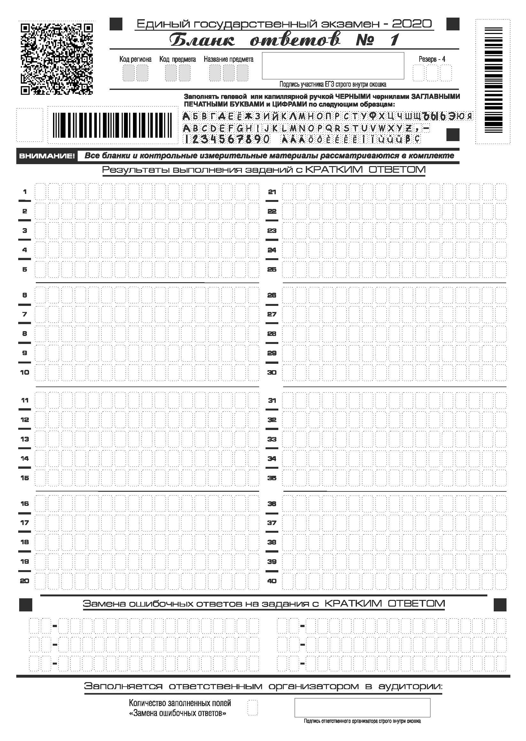

Slide 18
