Slide 1

ЕГЭ
английский язык
ВАРИАНТ 10
Время выполнения работы 3 часа 10 мин ( 190 минут)
Работа состоит из четырёх разделов: «Аудирование», «Чтение", "Грамматика и лексика», «Письменная речь». Раздел 1 («Аудирование») содержит 9 заданий. Рекомендуемое время на выполнение заданий раздела 1 составляет 30 минут. Раздел 2 («Чтение») содержит 9 заданий. Рекомендуемое время на выполнение заданий раздела 2 составляет 30 минут. Раздел 3 («Грамматика и лексика») содержит 20 заданий. Рекомендуемое время на выполнение заданий раздела 3 составляет 40 минут. Раздел 4 («Письменная речь») состоит из 2 заданий. Рекомендуемое время на выполнение заданий этого раздела работы – 90 минут.

Slide 2

Раздел 1. Аудирование
1
Задание 1
Прослушайте шесть высказываний. Установите соответствие между высказываниями каждого говорящего A–F и утверждениями, данными в списке 1–7. Используйте каждое утверждение, обозначенное соответствующей цифрой, только один раз. В задании есть одно лишнее утверждение. Занесите свои ответы в таблицу.
This ingredient of a sweet treat has a long history.
Candy from our childhood has a very special taste.
This shop has an unusual mix of goods.
Every candy cane has its own sweet secret.
Special sweets can be decorations for special occasions.
It was impossible to eat alone all the sweets needed.
I didn’t regret spending money for those sweets.
Говорящий | A | B | C | D | E | F
Утверждение

Slide 3
2
Задание 2
Вы услышите диалог. Определите, какие из приведённых утверждений А–G соответствуют содержанию текста (1 – True), какие не соответствуют (2 – False) и о чём в тексте не сказано, то есть на основании текста нельзя дать ни положительного, ни отрицательного ответа (3 – Not stated). Занесите номер выбранного Вами варианта ответа в таблицу. Вы услышите запись дважды.
A. Jackie and her boyfriend have purchased an accommodation.
B. Jackie and Simon seem to split up soon.
C. Jackie teaches economics at the University.
D. David rents a flat.
E. Jackie’s flat was quite expensive.
F. Jackie’s boyfriend works in a bank.
G. The two couples will have lunch out of town.
Говорящий | A | B | C | D | E | F | G
Соответствие диалогу

Slide 4

Задание 3
Вы услышите интервью. В заданиях 3–9 запишите в поле ответа цифру 1, 2 или 3, соответствующую выбранному Вами варианту ответа. Вы услышите запись дважды.
3
Which of the following is TRUE about scuba diving?
1) You can do it only in the sea.
2) It involves use of special breathing equipment.
3) It requires three years of training.
4
Which of the following is NOT true about scuba diving?
1) You can hear a lot of sea sounds.
2) You can look at a lot of different fish.
3) One usually wants to repeat the experience.
5
Which part of a diver’s equipment is NOT absolutely necessary?
1) Mask.
2) Scuba fins.
3) Wetsuit.
6
A buoyancy control device helps the diver to …
1) control distance and depth.
2) fight decompression sickness.
3) regulate the air tank level.
7
According to Barbara, why is it better to go to a dive school?
1) You get a certificate.
2) You learn more about safety underwater.
3) Self-teaching is illegal.
8
What is the purpose of the ‘buddy’ system in diving?
1) Not to feel lonely underwater.
2) Not to be alone in a difficult situation.
3) Not to depend on one’s instructor.
9
According to Barbara, what should a diver do?
1) Avoid contact with sea life.
2) Swim near coral reefs.
3) Encourage tourists to dive.

Slide 5
Раздел 2. Чтение
10
Установите соответствие между заголовками 1–8 и текстами A–G. Занесите свои ответы в таблицу. Используйте каждую цифру только один раз.
В задании один заголовок лишний.
Places to stay in 5. Different landscapes
Arts and culture 6. Transport system
New country image 7. National languages
Going out 8. Eating out
A. Belgium has always had a lot more than the faceless administrative buildings that you can see in the outskirts of its capital, Brussels. A number of beautiful historic cities and Brussels itself offer impressive architecture, lively nightlife, first-rate restaurants and numerous other attractions for visitors. Today, the old-fashioned idea of ‘boring Belgium’ has been well and truly forgotten, as more and more people discover its very individual charms for themselves.
B. Nature in Belgium is varied. The rivers and hills of the Ardennes in the southeast contrast sharply with the rolling plains which make up much of the northern and western countryside. The most notable features are the great forest near the frontier with Germany and Luxembourg and the wide, sandy beaches of the northern coast.
C. It is easy both to enter and to travel around pocket- sized Belgium which is divided into the Dutch speaking north and the French-speaking south. Officially the Belgians speak Dutch, French and German. Dutch is slightly more widely spoken than French, and German is spoken the least. The Belgians, living in the north, will often prefer to answer visitors in English rather than French, even if the visitor’s French is good.

Slide 6
D. Belgium has a wide range of hotels from 5-star luxury to small family pensions and inns. In some regions of the country, farm holidays are available. There visitors can (for a small cost) participate in the daily work of the farm. There are plenty of opportunities to rent furnished villas, flats, rooms, or bungalows for a holiday period. These holiday houses and flats are comfortable and well-equipped.
E. The Belgian style of cooking is similar to French, based on meat and seafood. Each region in Belgium has its own special dish. Butter, cream, beer and wine are generously used in cooking. The Belgians are keen on their food, and the country is very well supplied with excellent restaurants to suit all budgets. The perfect evening out here involves a delicious meal, and the restaurants and cafes are busy at all times of the week.
F. As well as being one of the best cities in the world for eating out (both for its high quality and range), Brussels has a very active and varied nightlife. It has 10 theatres which produce plays in both Dutch and French. There are also dozens of cinemas, numerous discos and many night-time cafes in Brussels. Elsewhere, the nightlife choices depend on the size of the town, but there is no shortage of fun to be had in any of the major cities.
G. There is a good system of underground trains, trams and buses in all the major towns and cities. In addition, Belgium’s waterways offer a pleasant way to enjoy the country. Visitors can take a one-hour cruise around the canals of Bruges (sometimes described as the Venice of the North) or an extended cruise along the rivers and canals linking the major cities of Belgium and the Netherlands.
Текст | A | B | C | D | E | F | G
Заголовок

Slide 7
11
Прочитайте текст и заполните пропуски A–F частями предложений, обозначенными цифрами 1–7. Одна из частей в списке 1–7 — лишняя. Занесите цифры, обозначающие соответствующие части предложений, в таблицу.
Australia
Australia is one of the world’s most ethnically diverse nations. Nearly a quarter of the people who live in Australia (A) ______. They come from the United Kingdom and other European countries, but also from China, Vietnam, North Africa, and the Middle East.
First people arrived in Australia about 50,000 years ago. They (B) ______ land bridges when sea levels were lower. The next to land in Australia were Dutch explorers. They came in 1606. In 1788 the British began to settle there. Many settlers (C) ______ as punishment. For a short time, the newcomers lived peacefully with the Aboriginal people.
In 1851, gold was discovered in Australia. A rush to find riches brought (D) ______ 1859, six separate colonies were created which later became part of the British Commonwealth.
Australian culture is founded on stories of battlers, bushrangers and brave soldiers. Today (Е) ______ its Aboriginal heritage, vibrant mix of cultures, innovative ideas and a thriving ecosystem.
Australia’s ecosystem is an unusual one because of its remote location. As a result, there are (F) ______ and nowhere else in the world, such as kangaroo and koala.
One of Australia’s most amazing sites rises like an enormous whale’s back from a flat desert called the Red Center. It is a sacred natural formation at the heart of the country and the largest rock in the world!
Australia is one of the most
were born in other countries
Australia also defines itself by
many animal species that occur here
may have travelled from Asia across
thousands of new immigrants, and by
were criminals sent to live in Australia
Пропуск | A | B | C | D | E | F
Часть предложения

Slide 8
Прочитайте рассказ и выполните задания 1–7. В каждом задании обведите букву A, B, C или D, соответствующую выбранному вами варианту ответа.
The London Marathon celebrates its 23rd birthday. That is 23 years of stresses and strains, blisters and sore bits, and incredible tales. Somehow, yours truly has managed to run four of them. And I have medals to prove it. It seemed like a good idea at the time. I watched the inaugural London Marathon on March 29th, 1981. It seemed extraordinary that normal people would want to run 26 miles and 385 yards. And, it must be said, they looked strange and not quite steady at the end of it all. There are, indeed, terrible tales of people losing consciousness by the time they reach that glorious finishing line. But I was captivated. I knew I had to do it.
Three years later I was living in London, not far from Greenwich where the event begins, and it seemed the perfect opportunity to give it a go. I was only a short train ride from the starting line, but more than 26 miles from the finish. “Who cares?” I thought. By the end I did. The moment I crossed that finishing line, and had that medal placed around my neck, was one of the finest in my life. The sense of achievement was immense. It was a mad thing to do, and ultimately pointless. But knowing that I’d run a Marathon – that most historic of all distant races – felt incredible.
London provides one of the easiest of all the officially sanctioned marathons because most of it is flat. Yes, there are the cobblestones while running through the Tower of London, and there are the quiet patches where crowds are thin and you are crying out for some encouragement – those things matter to the alleged “fun” runners like myself, the serious runners don’t think of such things.
This year London will attract unprecedented number of athletes, a lot of title holders among them. It is set to witness what is probably the greatest field ever for a marathon. In the men’s race, for example, among numerous applicants there’s the holder of the world’s best time, Khalid Khannouchi of the USA; the defending champion El Mouriz of Morocco; Ethiopia’s Olympic bronze-medallist Tesfaye Tola. And, making his marathon debut, is one of the finest long distance runners of all time Haile Gebrselassie.

Slide 9
Since 1981, almost half a million people have completed the London Marathon, raising more than $125 million for charity. For the majority of the runners, this is what it is all about. It is for charity, for fun, for self-development. It is a wonderful day. I have run it with poor training, with proper training. And I have always loved it.
It’s crazy, and it’s one of the greatest things I’ve ever done. If you want to feel as though you’ve achieved something, run a marathon.
12
Participation in the London Marathon resulted for the author in
A) stresses and strains.
B) blisters and sore bits.
C) memorable medals.
D) incredible tales.
13
When the author watched the end of the first marathon he saw people who were
A) extraordinary steady.
B) feeling weak and exhausted.
C) losing consciousness.
D) having a glorious time.
14
The reason for the author’s participation in the marathon was the fact that he
A) was fascinated by it.
B) lived not far from its finishing line.
C) wanted to receive a medal.
D) wanted to do something incredible.
15
“By the end I did” means that the author
A) found the distance suitable.
B) found the distance challenging.
C) decided to take part in the marathon.
D) eventually took a train to the finish.

Slide 10
16
According to the author, the London Marathon is one of the easiest because
A) it goes through the Tower of London.
B) there are quiet patches without crowds.
C) many “fun” runners participate in it.
D) its course does not slope up or down.
17
“… the greatest field ever for a marathon” means that the marathon
A) will take place on a big field.
B) is to be run by the famous runners only.
C) will be witnessed by more people.
D) will welcome a huge number of sportsmen.
18
According to the author, one should run the London Marathon to
A) raise money for charity.
B) get some training.
C) feel self-fulfillment.
D) have fun in a crazy way.

Slide 11
Раздел 3. Грамматика и лексика
Прочтите текст ниже. Преобразуйте слова, напечатанные заглавными буквами в конце строк, обозначенных цифрами 19-24, чтобы они грамматически соответствовали содержанию текста. Заполните пропуски словами, которые вы получили. Каждый проход соответствует отдельной задаче из группы 19-24.
Singing in the car
My elder brother likes all kinds of music. He prefers jazz but also listens to pop music and sometimes goes to classical music concerts. But when driving _____ in his car, he insists on listening to heavy-metal music.
For a long time I _____ understand why he was doing it. He knew very well that for me it was the _____ kind of music.
One day I decided to ask him why he always chooses this type while driving. “Well, sister,” he reluctantly replied, “to be frank, it’s mainly so you can’t sing along.” He added that he ______ to anything else if only I promised not to sing along.
The Beatles
The Beatles were one of the most successful pop-music groups of the 1960s. Also _____ the Fab Four, this quartet of British musicians created songs and recordings that many people still enjoy. The group ______ in the working-class neighbourhoods of Liverpool. The Beatles’ first recorded song was ‘Love Me Do’ (1962).
19
I
20
NOTCAN
21
BAD
22
LISTEN
23
CALL
24
BEGIN

Slide 12
Преобразуйте, если необходимо, слова, напечатанные заглавными буквами, так чтобы они грамматически и лексически соответствовали содержанию текста. Каждый пропуск соответствует отдельному заданию из группы 25-29. Впишите слова в поле ответа.
Ray Bradbury
Ray Douglas Bradbury is a US writer of fantasy, horror, science fiction and mystery. He is ______ considered to be one of the 20th century’s greatest and most popular writers of science fiction. His works have been translated into more than 40 languages and have sold tens of millions of copies in different countries.
During his long writing career, Bradbury has written almost 600 short stories, eleven novels, as well as ______ poems and plays. He first became famous for his Martian Chronicles, a collection of short stories concerning colonization of the planet Mars. In it, Bradbury portrayed the strengths and ______ of human beings as they encountered a new world.
Bradbury won ________ literary awards, the most important of them coming from the National Institute of Arts and Letters. Millions of science fiction readers all over the world are grateful to Ray Bradbury for his outstanding _________ in the field of fantasy and science fiction.
25
WIDE
26
VARY
27
WEAK
28
COUNT
29
ACHIEVE

Slide 13
Прочитайте текст с пропусками, обозначенными номерами 30 – 36.
Эти номера соответствуют заданиям 30 – 36, в которых представлены возможные варианты ответов (А, B, C, D). Установите соответствие номера пропуска варианту ответа.
The First Day at School
Do you remember your first day at school? It was probably (1) ______ confusing. Now, to (2) ______ this confusion, many primary schools in England have a special teacher who welcomes new pupils. She is (3) ______ a reception class teacher. The children are (4) ______ with the idea of school and if they have been good, they can’t understand why they have to go to school. They imagine that school is optional. When the child goes to school on his first day and watches his mother leaving he thinks that she is deserting him. The teacher must (5) _______ him that at the end of the day his mother will be back and take him home. The children are not the only people that are disturbed by going to school. The teacher sometimes has as much difficulty in (6) ______ with the mothers. They hang around and dislike leaving the child without their protection.
The best way to (7) ______ with the situation is to get the child used to the idea of school. Before the beginning of term, the mother should take her child to see the teacher and to look round the school. The first day should be something to emphasize the regularity of school.
30
31
33
32
34
35
36
30
А. enough B. rarely C. rather D. equally
A. escape B. defeat C. beat D. avoid
A. named B. called C. said D. told
A. afraid B. threatened C. endangered D. risked
A. convince B. prove C. explain D. announce
A. managing B. guiding C. coping D. handling
A. face B. deal C. touch D. consider
31
32
33
34
35
36

Slide 14
37
Раздел 4. Письменная речь
You have received an email message from your English-speaking pen-friend Susan:
From: Susan @mail.uk
To: Russian_friend@ege.ru
Subject: Sports
… I wish I had gone to Sochi for the Winter Olympics. It seemed to be such an exciting sports festival! What kind of international event would you like to visit and why? What sports are you fond of? Have you ever tried any extreme sports? I got a new camera for my birthday this year!…
Write an email to Susan. In your message: − answer her questions; − ask 3 questions about the camera. Write 100–140 words. Remember the rules of email writing.
From: Russian_friend@ege.ru
To: Susan@uk.com
Subject: Sports

Slide 15
Выберите только ОДНО из двух предложенных заданий (38.1 или 38.2), укажите его номер в БЛАНКЕ ОТВЕТОВ № 2 и выполните согласно данному плану. В ответе на задание 38 числительные пишите цифрами
Imagine that you are doing a project on what ways to stay healthy are popular among young people in Goodland. You have found some data on the subject – the results of the opinion polls (see the table below). Comment on the data in the table and give your opinion on the subject of the project.
38.1
Ways to stay healthy | Number of respondents (%)
Healthy food | 36
Sport | 35
Sleeping hygiene | 17
Stress management | 10
Regular checkups | 2
Write 200–250 words. Use the following plan: – make an opening statement on the subject of the project; – select and report 2–3 facts; – make 1–2 comparisons where relevant and give your comments; – outline a problem that can arise with unhealthy eating habits and suggest a way of solving it; – conclude giving and explaining your opinion on the importance of maintaining a healthy lifestyle.

Slide 16
Imagine that you are doing a project on how teenagers in Zetland receive pocket money. You have found some data on the subject – the results of the opinion polls (see the pie chart below). Comment on the data in the pie chart and give your opinion on the subject of the project.
38.2
How teenagers receive pocket money
Selling needless things
3%
Getting experience of
a part-time job
9%
From parents
43%
Doing household chores
18%
Getting as a present
27%
Write 200–250 words.
Use the following statement on the subject of the project;
– select and report 2–3 facts;
– make 1–2 comparisons where relevant and give your comments;
– outline a problem that one can face getting pocket money and suggest a way of solving it;
– conclude by giving and explaining your opinion on the importance of pocket money for teenagers.

Slide 17
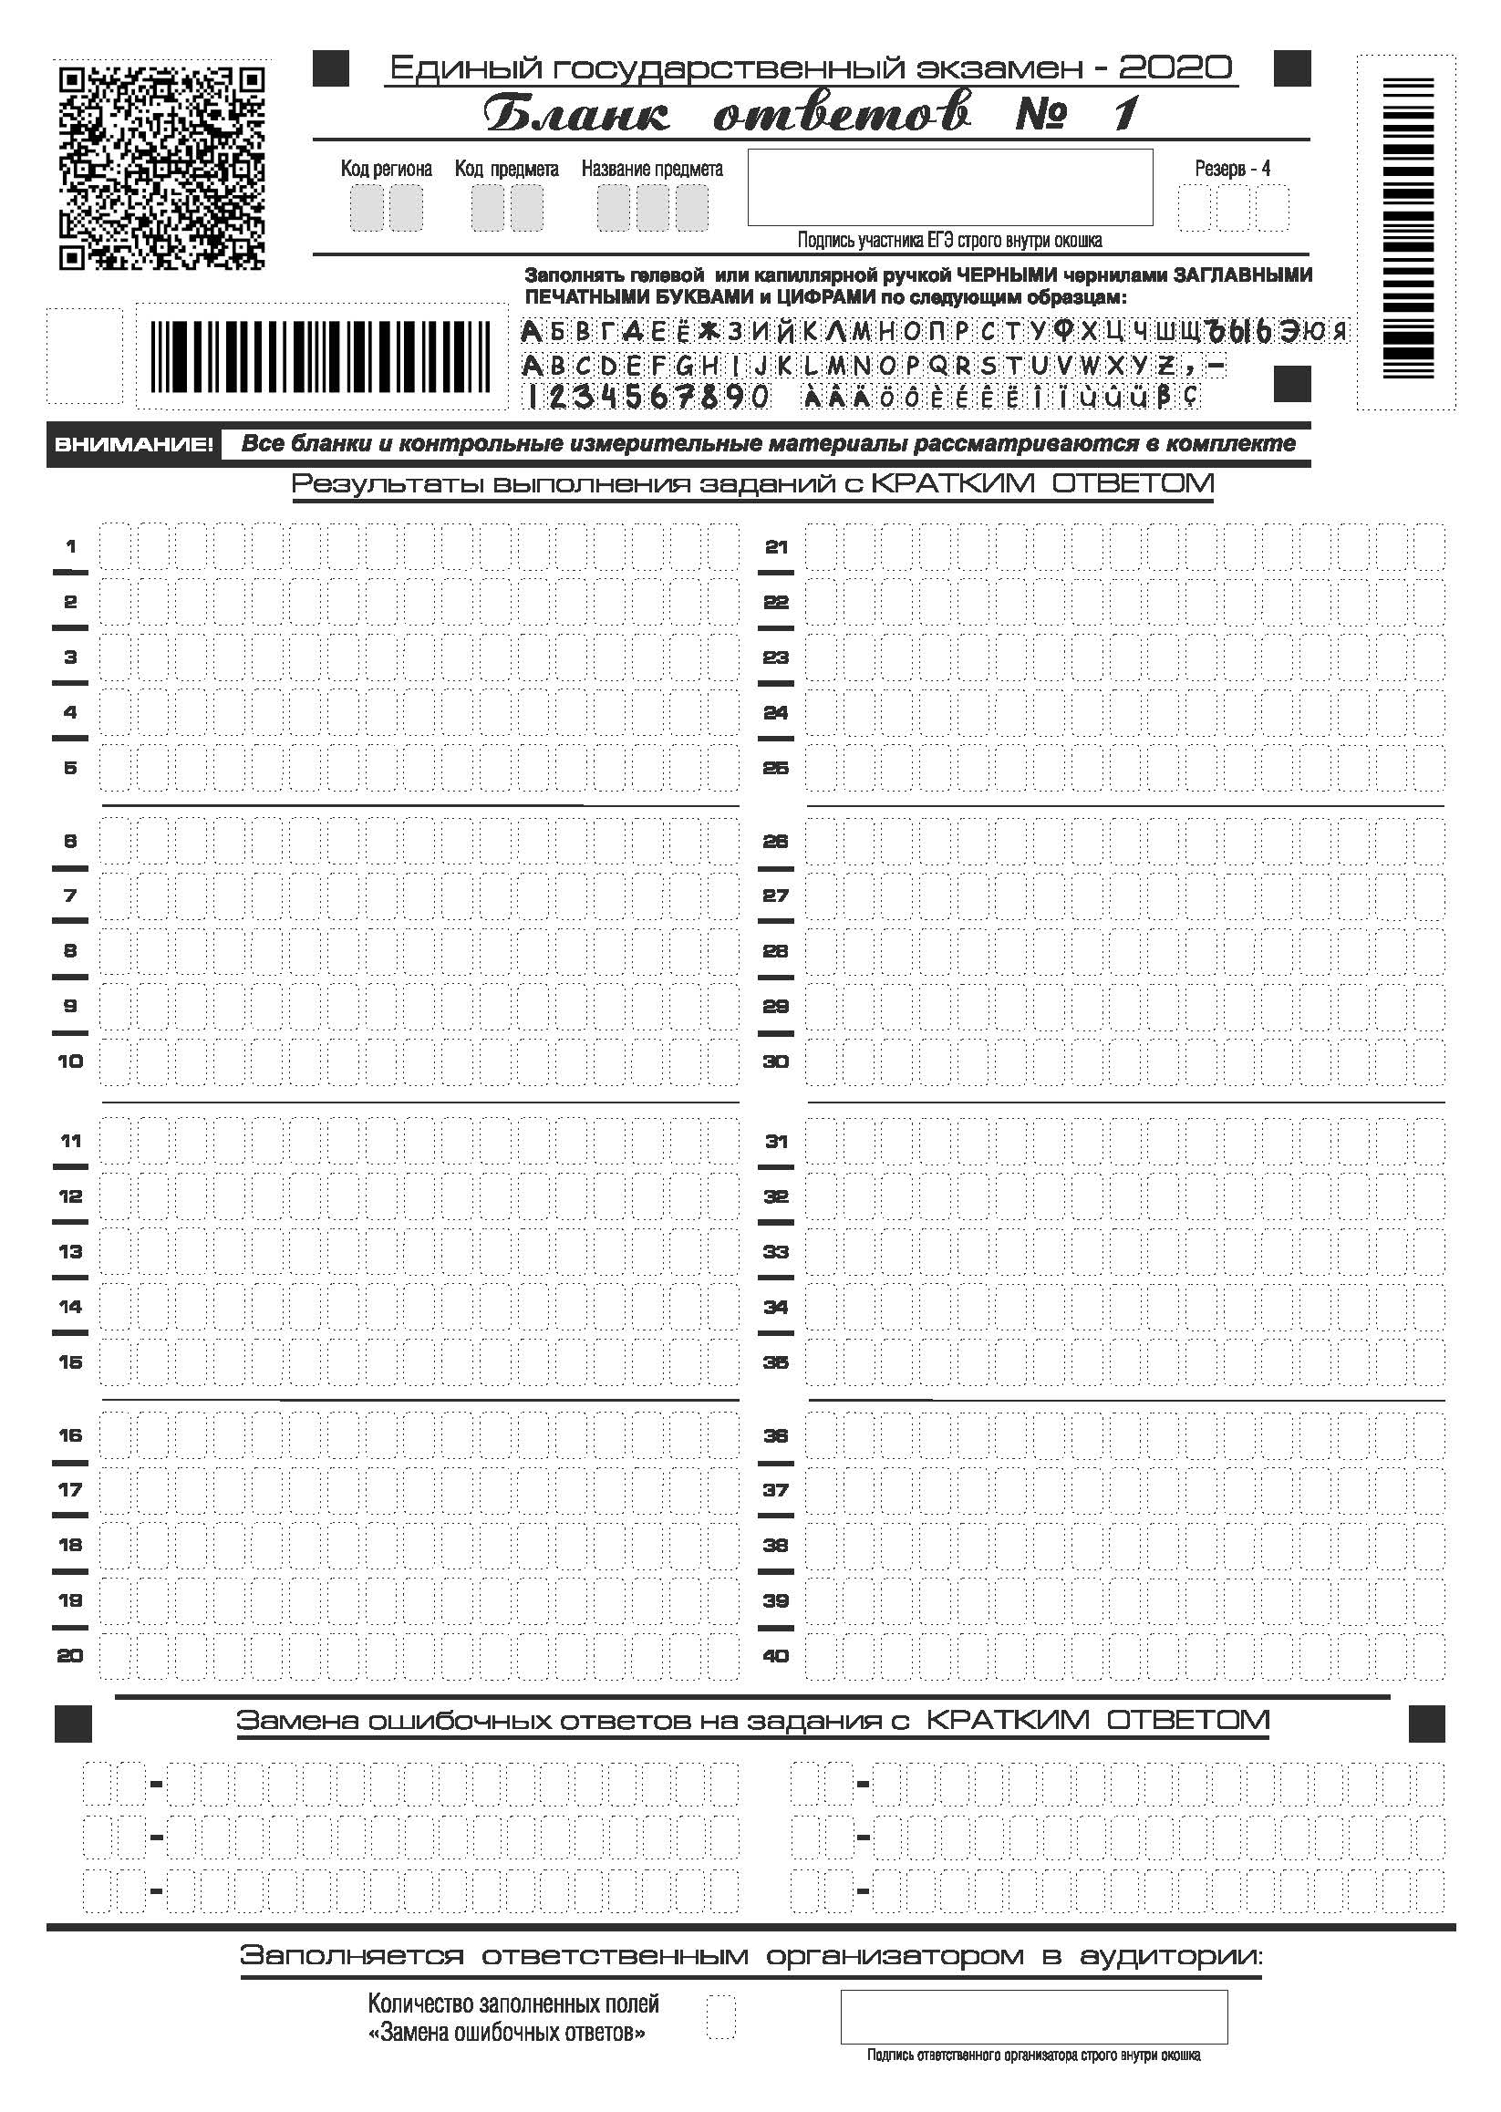

Slide 18
