Slide 1

ЕГЭ
английский язык
ВАРИАНТ 2
Время выполнения работы 3 часа 10 мин ( 190 минут)
Работа состоит из четырёх разделов: «Аудирование», «Чтение", "Грамматика и лексика», «Письменная речь». Раздел 1 («Аудирование») содержит 9 заданий. Рекомендуемое время на выполнение заданий раздела 1 составляет 30 минут. Раздел 2 («Чтение») содержит 9 заданий. Рекомендуемое время на выполнение заданий раздела 2 составляет 30 минут. Раздел 3 («Грамматика и лексика») содержит 20 заданий. Рекомендуемое время на выполнение заданий раздела 3 составляет 40 минут. Раздел 4 («Письменная речь») состоит из 2 заданий. Рекомендуемое время на выполнение заданий этого раздела работы – 90 минут.

Slide 2

Раздел 1. Аудирование
1
Задание 1
Прослушайте шесть высказываний. Установите соответствие между высказываниями каждого говорящего A–F и утверждениями, данными в списке 1–7. Используйте каждое утверждение, обозначенное соответствующей цифрой, только один раз. В задании есть одно лишнее утверждение. Занесите свои ответы в таблицу.
Russian nature really attracts foreign tourists.
Practicing Russian is a reason to visit the country.
Russia can offer green style holidays for tourists.
Small towns in Russia are as good as big cities.
Visiting Russia can help me with my future career.
You can do many sports while on holiday in Russia.
Tourists visit Russia because of its cultural heritage.
Говорящий | A | B | C | D | E | F
Утверждение

Slide 3
Задание 2
Вы услышите диалог. Определите, какие из приведённых утверждений А–G соответствуют содержанию текста (1 – True), какие не соответствуют (2 – False) и о чём в тексте не сказано, то есть на основании текста нельзя дать ни положительного, ни отрицательного ответа (3 – Not stated). Занесите номер выбранного Вами варианта ответа в таблицу. Вы услышите запись дважды.
A. The tourist has visited England before.
B. There is a number of sightseeing attractions in Windsor besides Windsor Castle.
C. The tourist hopes to see the Queen in Windsor.
D. The Household Cavalry Museum occupies a part of Windsor Castle.
E. The tourist wants to see Windsor Great Park on a separate day.
F. The receptionist claims that most tourists need more than one day to spend in Windsor.
G. The tourist wants to buy postcards with the town views.
2
Говорящий | A | B | C | D | E | F | G
Соответствие диалогу

Slide 4

Задание 3
Вы услышите интервью. В заданиях 3–9 запишите в поле ответа цифру 1, 2 или 3, соответствующую выбранному Вами варианту ответа. Вы услышите запись дважды.
3
Maggie says that an actor must …
1) plunge into the person he plays.
2) be aware of other people’s opinion of him.
3) communicate with people as much as possible.
4
In Maggie’s opinion, Instagram could be …
1) addictive.
2) destructive.
3) discouraging.
5
Why does Maggie think she’s good at her job?
1) She can do what is required in profession.
2) She is never vulnerable or insecure.
3) She studied culture.
6
Which of the following is TRUE about Maggie’s current project?
1) It’s set in a haunted house.
2) It’s based on a reality show.
3) It brought the actors closer together.
7
Why, according to Maggie, are most actors’ friends also actors?
1) They never compete with each other.
2) They quickly get intimate with each other.
3) They are bound to spend a lot of time together.
8
Why does Maggie like working with Steven Spielberg?
1) He allows her to repeat scenes.
2) He is very famous.
3) Because of his behaviour with actors.
9
Why does Maggie agree to work with young directors?
1) They have unlimited budgets.
2) Their work could be very original.
3) She feels that she has to sacrifice some of her time.

Slide 5
Раздел 2. Чтение
10
Установите соответствие между заголовками 1–8 и текстами A–G. Занесите свои ответы в таблицу. Используйте каждую цифру только один раз.
В задании один заголовок лишний.
Don’t forget to rest 5. Set realistic targets
Write down and revise 6. Study plans per week
Information and technology 7. Find a place to your liking
Never put off till tomorrow 8. More important at college
A. Today’s young generation will also need to master a new skill – digital literacy. Digital literacy can be defined as “the ability to find, evaluate, utilize, share, and create content using information technologies and the Internet”. Digital literacy, by this definition, encompasses a wide range of skills, all of which are necessary to succeed in an increasingly digital world. Students who lack digital literacy skills may soon find themselves at a disadvantage. As technology changes, students also need to keep updated.
B. The key to becoming an effective student is learning how to study smarter, not harder. This becomes more and more true as you advance in your education. An hour or two of studying a day is usually sufficient to make it through high school with satisfactory grades, but when college arrives, there aren’t enough hours in the day to squeeze all your studying in if you don’t know how to make your study efficient without skipping sleep or meals. The vast majority of successful college students achieve their success by developing and applying effective study habits.
C. Ever find yourself up late at night expending more energy trying to keep your eyelids open than you are studying? If so, it’s time for a change. Successful students typically space their work out over shorter periods of time and rarely try to cram all of their studying into just one or two sessions. If you want to become a successful student, then you need to learn to be consistent in your studies and to have regular, yet shorter, study sessions, with periods of rest in between. That will give your brain time to process the new information.

Slide 6
D. Successful students schedule specific times throughout the week when they are going to study – and then they stick with their schedule. Students who study sporadically and whimsically typically do not perform as well as students who have a set study schedule. Сreating a weekly routine, where you set aside a period of time a few days a week, to review your courses will ensure you develop habits that will enable you to succeed in your education long term. You won’t get stressed or overwhelmed by portioning your workload.
E. It is very easy, and common, to put off your study session because of lack of interest in the subject, because you have other things you need to get done, or just because the assignment is hard and needs effort and perseverance. Successful students do not procrastinate studying. If you procrastinate your study session, your studying will become less effective and you may not get everything accomplished that you need to. Procrastination also leads to rushing, and rushing is the number one cause of errors.
F. Always make sure to take good notes in class. Before you start each study session, and before you start a particular assignment, review your notes thoroughly to make sure you know how to complete the assignment correctly. Reviewing before each study session will help you remember important subject matter learned during the day, and make sure your studying is targeted and effective. Successful students also look through what they have written down at their lectures and seminars during the week over the weekend.
G. Everyone gets distracted by something: TV, or maybe family. Some people actually study better with a little background noise. When you’re distracted while studying you lose your train of thought and are unable to focus – both of which will lead to very ineffective studying. Before you start, find a place where you won’t be disturbed. For some people this is a quiet cubical in the recesses of the library. For others it is in a common area where there is little background noise. For some it may be a park or a garden – there are so many options to choose from!
Текст | A | B | C | D | E | F | G
Заголовок

Slide 7
Прочитайте текст и заполните пропуски A–F частями предложений, обозначенными цифрами 1–7. Одна из частей в списке 1–7 — лишняя. Занесите цифры, обозначающие соответствующие части предложений, в таблицу.
11
Chinese tea house in Moscow
The bright building on Myasnitskaya Street in Moscow stands out among others and attracts the attention of passers-by with its non-typical elements for Russian architecture. The tea house resembles a Chinese pagoda and it is considered to be the real office of a company that was involved in tea trade.
This house in the Chinese style was built for the tea merchant Sergei Vasilievich Perlov (A) ______ in order to establish his own business. He bought the land on Myasnitskaya Street in the centre of Moscow in 1875, (B) ______ in 1891. The construction was finished by 1893. The first floor was for Perlov’s tea shop, (C) ______ profitable apartments for rent and the host’s own family.
The front side of the newly built house was redecorated in the Chinese style after several years. A little tower in the form of a pagoda appeared (D) ______ molded dragons, snakes, Chinese umbrellas and lanterns. Some materials for decoration were even brought directly from China. It was made before the visit of the Chinese Ambassador Li Hongzhang, (E) ______ Nikolai II and Alexandra Fyodorovna coronation. The merchant Perlov thought that it might be useful for his tea business (F) ______ at this house. He preferred the house of Perlov’s brother and competitor. But thanks to this case now there is a beautiful exotic building right in the city centre, as if it came right from another part of the world.
who was going to visit Moscow for
who left the family tea trade company
and the other two floors were used for
and began to build the new house on it
and the front side was decorated with
which was imported mainly from China
but the Ambassador did not in fact stay
Пропуск | A | B | C | D | E | F
Часть предложения

Slide 8
Прочитайте рассказ и выполните задания 1–7. В каждом задании обведите букву A, B, C или D, соответствующую выбранному вами варианту ответа.
iGeneration: teenagers affected by phones
One day last summer, around noon, I called Athena, a 13-year-old who lives in Houston, Texas. She answered her phone – she has had an iPhone since she was 11 – sounding as if she’d just woken up. We chatted about her favorite songs and TV shows, and I asked her what she likes to do with her friends. “We go to the mall,” she said. “Do your parents drop you off?” I asked, recalling my own middle-school days, in the 1980s, when I’d enjoy a few parent-free hours shopping with my friends. “No – I go with my family,” she replied. “We’ll go with my mom and brothers and walk a little behind them. I just have to tell my mom where we are going. I have to check in every hour or every 30 minutes.”
Those mall trips are infrequent – about once a month. More often, Athena and her friends spend time together on their phones, unchaperoned. Unlike the teens of my generation, who might have spent an evening tying up the family landline with gossip, they talk on Snapchat, a smartphone app that allows users to send pictures and videos that quickly disappear. They make sure to keep up their Snapstreaks, which show how many days in a row, they have Snapchatted with each other. She told me she had spent most of the summer hanging out alone in her room with her phone. That is just the way her generation is, she said. “We didn’t know any life other than with iPads or iPhones. I think we like our phones more than we like actual people.”
Some generational changes are positive, some are negative, and many are both. More comfortable in their bedrooms than in a car or at a party, today’s teens are physically safer than teens have ever been. They are markedly less likely to get into a car accident and, having less of a taste for alcohol than their predecessors, are less susceptible to drinking’s attendant ills.
Psychologically, however, they are more vulnerable than Millennials were: rates of teen depression and suicide have skyrocketed since 2011. It is not an exaggeration to describe iGen as being on the brink of the worst mental-health crisis in decades. Much of this deterioration can be traced to their phones.

Slide 9
However, in my conversations with teens, I saw hopeful signs that kids themselves are beginning to link some of their troubles to their ever-present phone. Athena told me that when she does spend time with her friends in person, they are often looking at their device instead of at her. “I’m trying to talk to them about something, and they don’t actually look at my face,” she said. “They’re looking at their phone, or they’re looking at their Apple Watch.” “What does that feel like, when you’re trying to talk to somebody face-to-face and they’re not looking at you?” I asked. “It kind of hurts,” she said. “It hurts. I know my parents’ generation didn’t do that. I could be talking about something super important to me, and they wouldn’t even be listening.”
Once, she told me, she was hanging out with a friend who was texting her boyfriend. “I was trying to talk to her about my family, and what was going on, and she was like, ‘Uh-huh, yeah, whatever.’ So I took her phone out of her hands and I threw it at the wall.”
Though it is aggressive behavior that I don’t support, on the other hand – it is a step towards a life with limited phone use. So, if I were going to give advice for a happy adolescence, it would be straightforward: put down the phone, turn off the laptop, and do something – anything – that does not involve a screen.
12
According to the author, in her childhood she used to …
A) do the shopping with her friends.
B) go to the mall with her family.
C) call her mother every half an hour.
D) watch TV a lot.
13
Which of the following does Athena do monthly?
A) Invites friends to her place.
B) Uses the Snapchat.
C) Goes to the mall with her family.
D) Changes her iPhone.
14
For Athena’s peers spending time alone in their rooms seems …
A) natural.
B) difficult.
C) awkward.
D) soothing.

Slide 10
15
Which of the following is NOT true about iGen teenagers, according to the author?
A) They prefer loneliness to company.
B) It is easy to hurt them psychologically.
C) Most of them feel extremely unhappy.
D) They have more physical health problems.
16
That in “I know my parents’ generation didn’t do that” (paragraph 5) refers to …
A) behaving in a mean way.
B) discussing their problems.
C) listening attentively to friends.
D) being glued to their phones.
17
The fact that Athena threw away her friend’s phone proves that …
A) her friend thought she was doing the right thing.
B) smartphones make teenagers more aggressive.
C) teenagers know the problems caused by phones.
D) smartphones can cause mental health problems.
18
What does the author suggest in her article?
A) Smartphones are not safe.
B) Phone use by young people should be limited.
C) Smartphones cause violent behavior.
D) There are good and bad sides in using smartphones.

Slide 11
Раздел 3. Грамматика и лексика
Прочтите текст ниже. Преобразуйте слова, напечатанные заглавными буквами в конце строк, обозначенных цифрами 19-24, чтобы они грамматически соответствовали содержанию текста. Заполните пропуски словами, которые вы получили. Каждый проход соответствует отдельной задаче из группы 19-24.
Yakutia
Yakutia is right in the middle of Russia’s far eastern region. Probably Yakutia is one of the ______ parts of Russia. Still, it’s a beautiful place. Tourists love ______ Yakutia because it is a perfect place for photography tours and spending quality time outdoors. You only have to remember that winter ______ a good time to visit the area as winters here are very cold there.
The print brush
As its name suggests, the print brush is a printer that acts like a paint brush. The print brush ______ to public in 2011. It immediately _____ the attention of designers.
If you want to use it, you just swipe it over any flat surface and in less than 10 seconds it prints over it. It is very small and has a digital camera ______.
You can connect it to your laptop and literally print any image from it. Isn’t it amazing?
19
COLD
20
VISIT
21
NOT/BE
22
DEMONSTRATE
23
CATCH
24
INSTALL

Slide 12
Преобразуйте, если необходимо, слова, напечатанные заглавными буквами, так чтобы они грамматически и лексически соответствовали содержанию текста. Каждый пропуск соответствует отдельному заданию из группы 25-29. Впишите слова в поле ответа.
White monuments of Vladimir and Suzdal
The ancient city of Vladimir was founded in 1108 by the Kiev Prince Vladimir Monomach. It contains an important group of monuments. The Cathedral of the Assumption was intended to be the ______ centre of
all Russia.
It was built in the town Kremlin as a single-domed structure with the fa?ade _____ for its carved reliefs.
Most of the 12th-century frescoes were destroyed by Mongols, but new mural ______ were added in 1408 by Andrei Rublev and Daniil Chernii, in particular the famous Last Judgment.
Suzdal, which lies some 25 km north of Vladimir, was the site of a _____ in the 9th and 10th centuries, which became a fortress. A posad, which was housing craftsmen and shopkeepers, developed around it.
Within, dominating the whole town stands the Cathedral of the Nativity with its five-domed top and Golden Doors. The interior ______ is important in Russian art.
The buildings in Vladimir and Suzdal have been the centre of cultural tourism for several decades and a good deal of restoration has been carried out.
25
RELIGION
26
REMARK
27
PAINT
28
SETTLE
29
DECORATE

Slide 13
Прочитайте текст с пропусками, обозначенными номерами 30 – 36.
Эти номера соответствуют заданиям 30 - 36, в которых представлены возможные варианты ответов (А, B, C, D). Установите соответствие номера пропуска варианту ответа.
At the office
The following morning I visited our local newsagent Mr. Bales. He always seemed to know exactly what was going on in the neighbourhood and was only too happy to (1) _______ his knowledge with anyone who wanted to pass the time of day. Then I (2) _______ at the office of John D. Wood in Mount Street. I had to wait for some time, but eventually one of four assistants came over, introduced himself to me as Mr. Palmer and asked how he could help. After a closer inspection of the young man, I doubted that he could help anyone. He must have been about seventeen and was so pale and thin he looked as if a gust of wind might blow him (3) _______. “I’d like to know some details concerning Number 147 Chelsea Terrace,” I said. “Would madam please excuse me?” he (4) _______ and walked over to a filing cabinet. He (5) _______ no attempt to invite me in or even to offer me a chair. He placed the single sheet on the countertop and studied it closely.
“A greengrocer’s shop,” he said. “Yes. What price is the owner asking for the property?” I asked. I was becoming more and more annoyed by being so obviously ignored. “One hundred and fifty guineas is being asked for the shop,” (6)_______ the assistant, his eyes fixed on the bottom line of the schedule. The shop turned out to be ridiculously expensive. I made my (7) _______ back to Chelsea, only too aware that I had no intention of buying a shop in the neighbourhood.
30
31
32
34
33
35
36
A) divide B) split C) share D) separate
A) arrived B) reached C) achieved D) completed
A) about B) over C) around D) away
A) spoke B) said C) talked D) told
A) made B) did C) took D) took
A) admitted B) agreed C) stated D) expressed
A) track B) road C) path D) way
30
31
32
33
34
35
36

Slide 14
37
Раздел 4. Письменная речь
You have received an email message from your English-speaking pen-friend Orlando:
From: Orlando @mail.uk
To: Russian_friend@ege.ru
Subject: Natural disasters
…My aunt lives in Texas and last week her house was ruined by a tornado. What do you think are the most horrible natural disasters? Which of them are typical of the place where you live? What can people do to protect themselves from them? I got a new smart watch for my birthday this year!…
Write an email to Orlando. In your message: − answer his questions; − ask 3 questions about the smart watch. Write 100–140 words. Remember the rules of email writing.
From: Russian_friend@ege.ru
To: Orlando@uk.com
Subject: Natural disasters

Slide 15
Выберите только ОДНО из двух предложенных заданий (38.1 или 38.2), укажите его номер в БЛАНКЕ ОТВЕТОВ № 2 и выполните согласно данному плану. В ответе на задание 38 числительные пишите цифрами
Imagine that you are doing a project on top 5 dishes among people in Rusland. You have found some data on the subject – the results of the opinion polls (see the table below). Comment on the data in the table and give your opinion on the subject of the project.
38.1
Dishes | Number of respondents (%)
Borsch | 36
Okroshka | 7
Russian salad | 33
Kholodets | 14
Vinegrette | 10
Write 200–250 words. Use the following plan: – make an opening statement on the subject of the project; – select and report 2–3 facts; – make 1–2 comparisons where relevant and give your comments; – outline a problem that can arise while making traditional dishes and suggest a way of solving it; – conclude by giving and explaining your opinion on teaching children how to cook.

Slide 16
Imagine that you are doing a project on ways of learning English in Zetland. You have found some data on the subject – the results of the opinion polls (see the pie chart below). Comment on the data in the pie chart and give your opinion on the subject of the project.
38.2
Ways of learning English
Reading English books
10%
Using special programs for PC
15%
Engaging with English media
30%
Taking language classes
20%
Watching videos
and TV programs
25%
Write 200–250 words.
Use the following statement on the subject of the project;
– select and report 2–3 facts;
make 1–2 comparisons where relevant and give your comments;
– outline a problem that one can face learning English and suggest a way of solving it;
– conclude by giving and explaining your opinion on the importance of learning English.

Slide 17
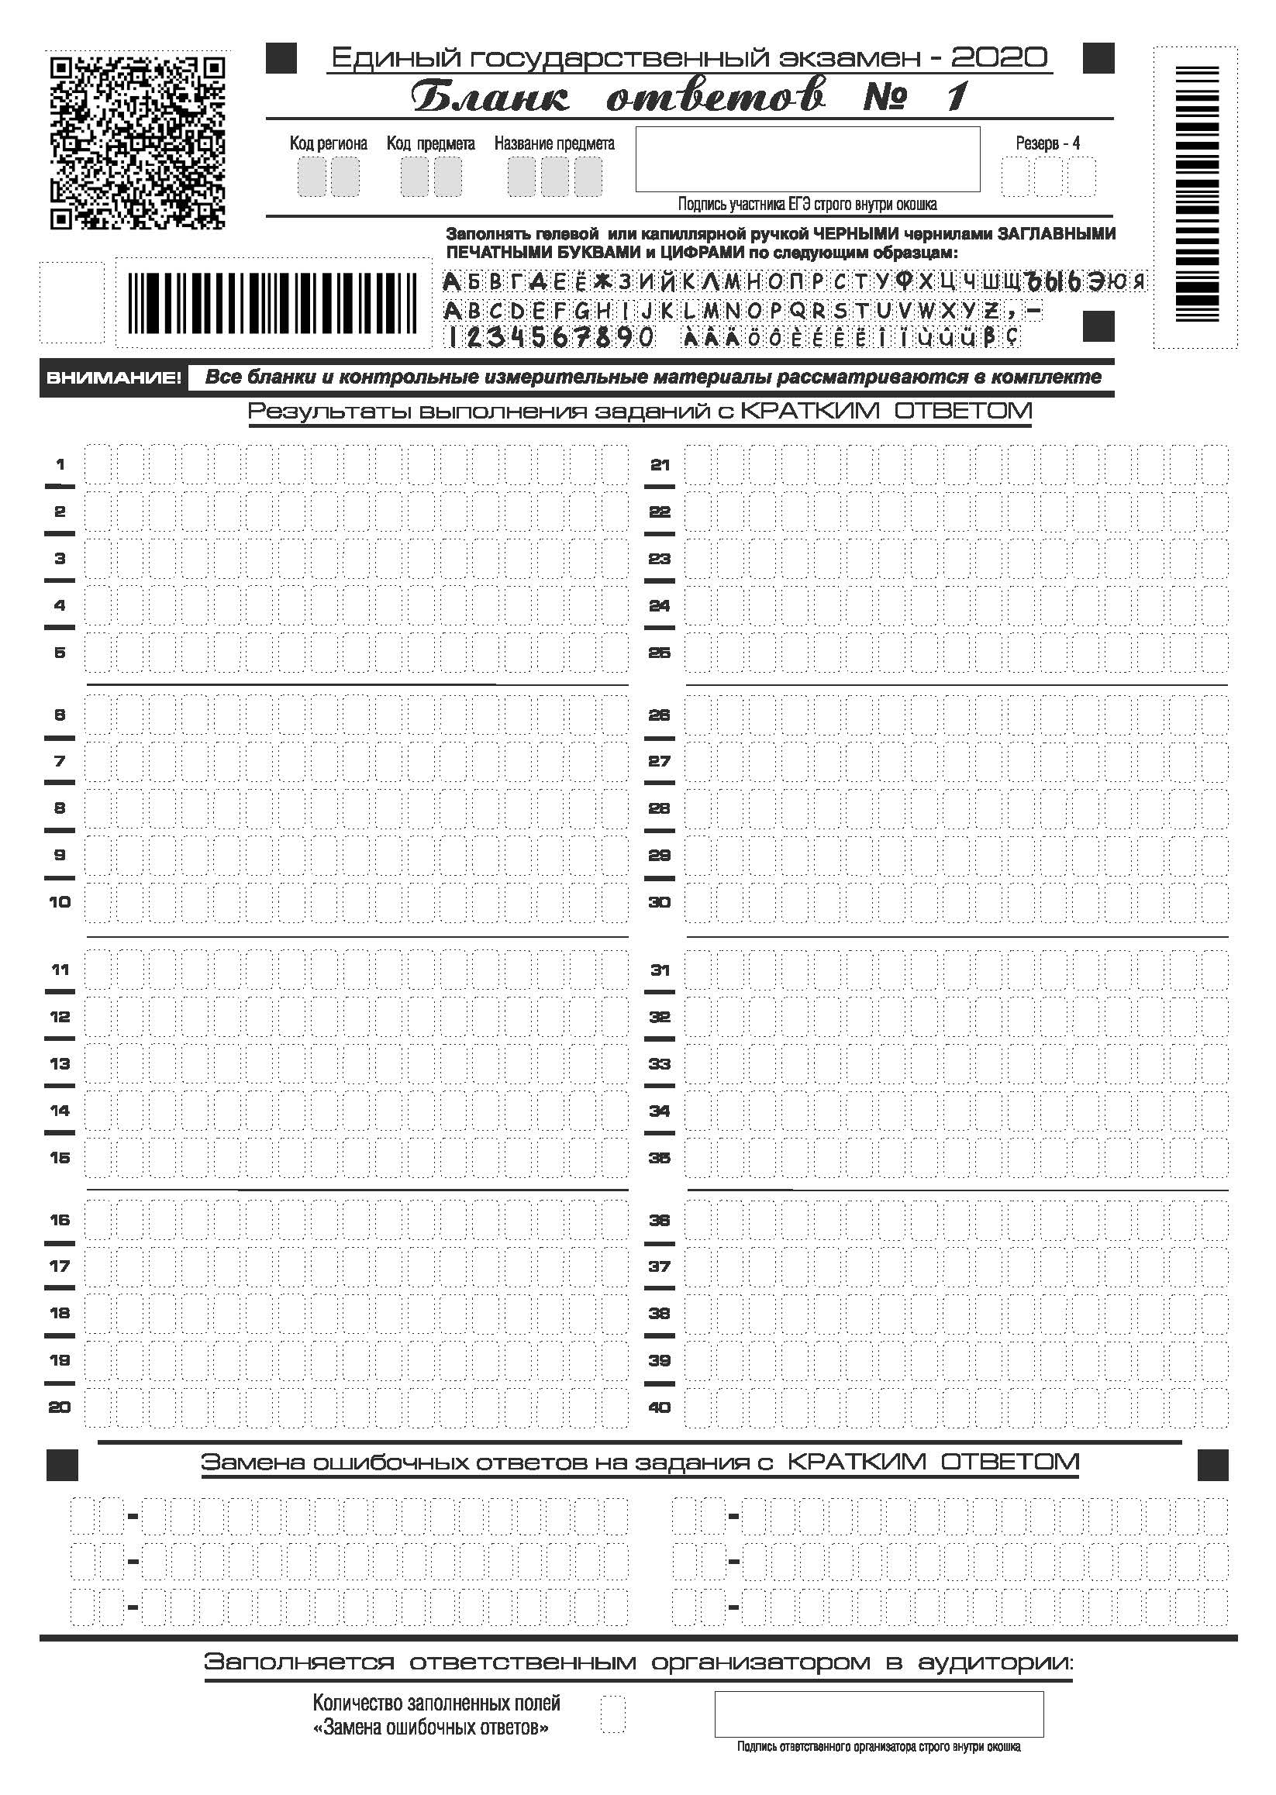

Slide 18
