Slide 1

ЕГЭ
английский язык
ВАРИАНТ 3
Время выполнения работы 3 часа 10 мин ( 190 минут)
Работа состоит из четырёх разделов: «Аудирование», «Чтение", "Грамматика и лексика», «Письменная речь». Раздел 1 («Аудирование») содержит 9 заданий. Рекомендуемое время на выполнение заданий раздела 1 составляет 30 минут. Раздел 2 («Чтение») содержит 9 заданий. Рекомендуемое время на выполнение заданий раздела 2 составляет 30 минут. Раздел 3 («Грамматика и лексика») содержит 20 заданий. Рекомендуемое время на выполнение заданий раздела 3 составляет 40 минут. Раздел 4 («Письменная речь») состоит из 2 заданий. Рекомендуемое время на выполнение заданий этого раздела работы – 90 минут.

Slide 2

Раздел 1. Аудирование
1
Задание 1
Прослушайте шесть высказываний. Установите соответствие между высказываниями каждого говорящего A–F и утверждениями, данными в списке 1–7. Используйте каждое утверждение, обозначенное соответствующей цифрой, только один раз. В задании есть одно лишнее утверждение. Занесите свои ответы в таблицу.
There are many advantages of having a dog.
People love dogs because they look pretty.
Dogs may turn out to be better friends than people.
It’s not a good idea to have a dog as a pet.
People love dogs because dogs are faithful.
Dogs are good pets because they are clever.
Dogs don’t love people as much as you may think.
Говорящий | A | B | C | D | E | F
Утверждение

Slide 3
Задание 2
Вы услышите диалог. Определите, какие из приведённых утверждений А–G соответствуют содержанию текста (1 – True), какие не соответствуют (2 – False) и о чём в тексте не сказано, то есть на основании текста нельзя дать ни положительного, ни отрицательного ответа (3 – Not stated). Занесите номер выбранного Вами варианта ответа в таблицу. Вы услышите запись дважды.
A. Peter thinks travelling is the best option for summer holidays.
B. Jane saved money for the trip doing a part-time job.
C. Jane’s best friend can’t travel with her because the friend is ill.
D. Jane and Peter want to see only Moscow when in Russia.
E. Jane is planning to find a guide for their trip to Russia.
F. Jane doesn’t think they’ll have language problems in Russia.
G. Jane and Peter have already got their visas to Russia.
2
Говорящий | A | B | C | D | E | F | G
Соответствие диалогу

Slide 4

Задание 3
Вы услышите интервью. В заданиях 3–9 запишите в поле ответа цифру 1, 2 или 3, соответствующую выбранному Вами варианту ответа. Вы услышите запись дважды.
3
What do we learn about Maggie’s musical education?
1) She attended a musical school for 9 years.
2) She didn’t like playing the piano very much.
3) She didn’t have a special music talent.
4
Why did Maggie want to become an actress?
1) This profession runs in her family.
2) Acting on stage felt natural to her.
3) She wanted to overcome the stage fright.
5
What does Maggie say about directors and directing?
1) She thinks she was fortunate to work with many talented directors.
2) She feels she could herself direct a film one day.
3) She thinks David Lynch is the best director.
6
What does Maggie say is the most important thing for her about a film?
1) The story.
2) The screenplay.
3) The partners.
7
Maggie often plays mothers because …
1) she is a future mother herself.
2) such roles provide lots of opportunities to an actress.
3) people like her in such roles.
8
What does Maggie think of her appearance?
1) She thinks she’s very beautiful.
2) She thinks she should take care of the way she looks on screen.
3) She thinks her looks don’t interfere with her job.
9
What does Maggie love about being an actress?
1) Being able to play both men and women.
2) Being able to look beautiful on screen.
3) Being able to express complex characters.

Slide 5
Раздел 2. Чтение
10
Установите соответствие между заголовками 1–8 и текстами A–G. Занесите свои ответы в таблицу. Используйте каждую цифру только один раз.
В задании один заголовок лишний.
How people used to treat them 5.How they confuse the scientists
How they get their food 6. When they scare the people
Where they live 7. How they breed
How people start to collect their images 8. What endangers them
A. Flamingos are very social and often live in large groups, called colonies, throughout the world. They are found in both the Eastern and Western hemispheres. The American Flamingo is the only one that lives in the wild in North America, and on many Caribbean islands such as the Bahamas, Cuba, and Hispaniola. It also lives in northern South America, the Galapagos Islands, and parts of Mexico.
B. Flamingos fish while walking in shallow water and mud. When a flamingo notices its potential dinner (for example, shrimp, snails, and plantlike water organisms), it plunges its head into the water, twists its head upside down, and scoops the fish up using its upper beak like a shovel. Flamingos get their pink coloring from the carotenoid pigment in their food, which is the same pigment that makes carrots orange.
C. Flamingos build nests that look like mounds of mud along waterways. The parents take turns sitting on the egg to keep it warm and after about 30 days the egg hatches. Young flamingos are born white, with soft, downy feathers and a straight bill. Both adult birds look after the newborn flamingo. The young leave the nest after about five days to join other young flamingos in small groups, returning to their parents for food.

Slide 6
D. Scientists aren’t 100% sure why flamingos stand on one leg, but they have some theories. One theory says that it is to keep one leg warm. Another idea is that flamingos are drying out one leg at a time. A third theory states that it helps them deceive their catch, because one leg looks more like a plant than do two. Whatever the reason, it is truly amazing that these top heavy birds can balance on one leg for hours at a time.
E. Ancient Egyptians believed that flamingos were the living representation of the god Ra. In the Americas, the Moche people of ancient Peru worshipped nature and paid a great deal of attention to these birds and often depicted flamingos in their art. However, Andean miners killed flamingos for their fat, which is believed to be a remedy for tuberculosis, and in Ancient Rome their tongues were considered a delicacy.
F. Many people have plastic flamingos in their yards as ornaments. This is a fun and inexpensive way to add some elegance to one’s landscaping. In many parts of the world flamingos are popular collectibles, appearing in the form of magnets, water globes, and jewelry. They are also said to be an image that people find to be calming and exciting at the same time. For these purposes people buy millions of plastic flamingos annually all around the world.
G. Flamingos have been affected in many ways by global warming. One of the biggest concerns is making nests and laying eggs. Flamingos depend on rainfall to help them mate and without adequate rain they won’t engage in it. Many researchers find that global warming reduces the chance of rain and can cause drought in some of the areas where they live. This could mean a significant reduction of offspring in the years ahead.
Текст | A | B | C | D | E | F | G
Заголовок

Slide 7
Прочитайте текст и заполните пропуски A–F частями предложений, обозначенными цифрами 1–7. Одна из частей в списке 1–7 — лишняя. Занесите цифры, обозначающие соответствующие части предложений, в таблицу.
11
Running a multilingual European Union
The use of 23 official languages is the public face of the European Union (EU). The reasons A________________ are not hard to identify: they are democracy, transparency and the right to know. New legislation must be published and made available in a language all EU citizens can understand. The use of all official languages also makes it easier for people to participate in public debates and consultations B_____________________.
Its law-making function and the direct involvement of its citizens explain C_____________________ like the United Nations or NATO, which operate only at the intergovernmental level with no legislative function. The United Nations, with more than 190 members, uses only six languages. The Council of Europe, D__________________, publishes official documents only in English and French, as does NATO.
Running a multilingual EU comes at a price. But it is a modest price when set against the results. The annual cost of translation and interpretation is about 1% of the EU budget, E____________________. The total cost has risen by only a small margin despite the arrival of 12 new countries since 2004.
The EU institutions have adjusted their procedures over the years to handle the rising number of official languages. Translators work with written texts, and interpreters with the spoken word. But they must be able to translate or interpret into their main language, F_____________________, from at least two other EU languages.
with more members than the EU
which is usually their mother tongue
that the EU launches, often online
which is a little over € 2 for every citizen
why the EU uses so many official languages
that was earlier translated into three main languages
why the EU uses more languages than multinational bodies
Пропуск | A | B | C | D | E | F
Часть предложения

Slide 8
Прочитайте рассказ и выполните задания 1–7. В каждом задании обведите букву A, B, C или D, соответствующую выбранному вами варианту ответа.
Space could solve water problems
Have you ever tasted saltwater? I guess you have and if so, you will agree with me that it’s not very refreshing. In fact, drinking more than a few cups worth can kill you.
According to the United States Geological Survey, whose mission is to collect and disseminate reliable, impartial, and timely information that is needed to understand the nation’s water resources, about ninety-seven percent of the water on our planet is saltwater; the rest is stored in lakes, rivers, glaciers and aquifers underground. Moreover, only about one-third of the world’s potential fresh water can be used for human needs. As pollution increases, the amount of usable water decreases.
Water is the most precious and taken-for-granted resource we have on Earth. It is also one of the most threatened resources. Increased population and possible climate change will put more and more strain on supplies of this vital resource as time goes on. What could we do in this situation? Though it may seem like science fiction, the solution could lie in outer space.
I’m not saying we’re going to be teleporting to a spring on the other side of the galaxy or colonizing another planet just to have longer showers – it’s much more mundane than that. What we could achieve realistically in this century is the successful use of the solar system’s rare metals and water, barring the invention of the matrix.
You may be surprised to learn that the metal in your keys, coins, cell phone, computer, car and everywhere else, originally came to this planet from space. When Earth formed, the heavy metals sank to the center and formed a solid core. The lighter elements formed the mantle and the crust we live on. Asteroids and comets that struck the Earth brought water and metals to the surface.
There are thousands of asteroids orbiting near Earth. Most asteroids are made of rock, but some are composed of metal, mostly nickel and iron. Probes could be sent out to these to identify useful ones. Then larger probes could push them towards the Earth where they can be handled in orbit.
In order to fuel ships and probes, we simply need to find a source of water, such as a comet or the surface of the moon. We collect the water and pass an electric current through it from a solar panel. The water separates into oxygen and hydrogen, which in liquid form is a powerful rocket fuel.

Slide 9
Is this really possible? We may soon find out. Private company SpaceX has already started delivering equipment to the International Space Station (ISS). The ISS is proof that countries once at each other’s throats, like America and Russia, can work together and pull off multi-billion dollar projects.
Recently, a company called Planetary Resources Inc. made the news for getting big names like Google and Microsoft to invest in exploring asteroids for material gain. Although it will take many decades, it is wise to put the gears in motion now.
We’ve already landed probes on the surface of asteroids and taken samples from them. We can put something as large as the ISS, which weighs just short of 500 tons, according to National Aeronautics and Space Administration (NASA), in orbit.
We can make a half-million-mile round-trip to get rocks from the moon. We can do all of these things already. They just need to be applied and developed in a smart way.
12
What problem is raised in the article?
A) Cooperation in space.
B) Threats of climate change.
C) Danger of drinking salt water.
D) Lack of water supplies on Earth.
13
According to the author, the information published in the US Geological Survey is meant to …
A) help to monitor the state of the country’s water resources.
B) assure the nation that there is still enough of usable water.
C) warn the public about the dangers of water pollution.
D) demonstrate the quality of water the nation uses.
14
The author thinks that outer space …
A) is dangerous because of asteroids.
B) is not studied properly.
C) should be colonized.
D) is a source of important supplies.

Slide 10
15
According to the author, the space water sources may be used for …
A) the production of electricity.
B) fuel production.
C) moon exploration.
D) water supplies for spaceships.
16
The Google and Microsoft (paragraph 9) are mentioned to …
A) show that space research is important for computer science.
B) prove that asteroids can be commercially attractive.
C) explain how Planetary Resources Inc. became famous.
D) that asteroids can interfere with the Internet.
17
The expression “put the gears in motion” in “…it is wise to put the gears in motion now” (paragraph 9) means …
A) to move.
B) to explore.
C) to begin.
D) to invest.
18
What idea is stressed in the last two paragraphs?
A) Asteroids are unique objects for scientific research.
B) International Space Station is the heaviest object in space.
C) There is room for further achievements in space exploration.
D) Only smart administration can manage space programs.

Slide 11
Раздел 3. Грамматика и лексика
Прочтите текст ниже. Преобразуйте слова, напечатанные заглавными буквами в конце строк, обозначенных цифрами 19-24, чтобы они грамматически соответствовали содержанию текста. Заполните пропуски словами, которые вы получили. Каждый проход соответствует отдельной задаче из группы 19-24.
A solution for drivers
It’s a problem for any driver to drive in sunny weather. Wearing sunglasses _______much – it’s still very hard to see anything in front of you.
Now there is a solution to this problem. In 2011 LCD sunglasses ______. They dynamically block direct sunlight. There’s no doubt that in the future more drivers _____ them.
Meteora
Meteora is an area that attracts thousands of tourists from all over the world. Meteora _______ in Greece. It is famous for the ancient monasteries _______ right on the eroded rocks.
Now tourists enjoy ________ them and they take numerous pictures. The best way to reach this amazing place is to take a bus from Athens.
19
NOT/HELP
20
INVENT
21
USE
22
SITUATE
23
BUILD
24
VISIT

Slide 12
Преобразуйте, если необходимо, слова, напечатанные заглавными буквами, так чтобы они грамматически и лексически соответствовали содержанию текста. Каждый пропуск соответствует отдельному заданию из группы 25-29. Впишите слова в поле ответа.
The Crown
Even those people who are not fans of the royal family enjoy the series The Crown. This is _______ a palace drama based on a true story. In fact, one of the show’s great strengths is that the viewers understand that this story is real.
The first season caught everybody’s attention, but The Crown’s second season went even deeper into its characters and their __________. The most ______ episodes are undoubtedly the ones devoted to Elizabeth II as a monarch. She has to deal with her prime ministers and the ______, with the press, and with the Kennedys.
You can also enjoy the beautiful settings and the costumes created for the show. And it’s ________ to forget some of the scenes from the Second World War history – you won’t believe some of the facts presented in the film.
25
ACTUAL
26
RELATION
27
INTEREST
28
GOVERN
29
POSSIBLE

Slide 13
Прочитайте текст с пропусками, обозначенными номерами 30 – 36.
Эти номера соответствуют заданиям 30 – 36, в которых представлены возможные варианты ответов (А, B, C, D). Установите соответствие номера пропуска варианту ответа.
St. Paul’s School
I have sweet memories of my childhood and my family. I also (1) _______ going to St. Paul’s School at the age of eleven. There I was made to work really hard for the first time in my life. At my prep school I was top in almost every subject without having to do much more than any other child, and (2) _______ I was called “swot” or “swotty”, it never worried me. At St. Paul’s there turned (3) _______ to be several boys who were clever, but none of them could touch me when it came to maths. I enjoyed a subject so many of my classmates seemed to dread. I couldn’t wait for the next algebraic equation, a further geometric puzzle or the challenge of solving an arithmetic test in my head while others in the form sucked their pencils as they (4) _______ pages of figures.
I did quite well in other subjects and although I was not much good at games I took up the cello and was invited to join the school orchestra, but my form master (5) _______ none of this was important because I was obviously going to be a mathematician for the rest of my life. I didn’t understand what he meant at the time, as I knew Dad had left school at fourteen to help my grandfather to sell fruit and vegetables at his small grocery. Mum had gone to London University, but she (6) _______ had to work to keep Dad “in the style to which he’d become accustomed.” Or that’s what I (7) _______ to hear Mum telling him at breakfast from time to time.
30
31
32
33
34
35
36
review B) remind C) remember D) repeat
however B) although C) therefore D) nevertheless
over B) off C) in D) out
reflected B) thought C) considered D) judged
spoke B) said C) talked D) told
still B) even C) just D) so
A) held B) used C) kept D) made
30
31
32
33
34
35
36

Slide 14
37
Раздел 4. Письменная речь
You have received an email message from your English-speaking pen-friend Elizabeth:
From: Elizabeth @mail.uk
To: Russian_friend@ege.ru
Subject: Reading history
…Yesterday I finished reading a book about the 14th century England. What kinds of books do you like reading? What would you call the most interesting period in Russian history and why? If there were a time machine, what country and what era would you like to visit? I got a new camera for my birthday this year!…
Write an email to Elizabeth. In your message: − answer her questions; − ask 3 questions about her birthday this year. Write 100–140 words. Remember the rules of email writing.
From: Russian_friend@ege.ru
To: Elizabeth@uk.com
Subject: Reading history

Slide 15
Выберите только ОДНО из двух предложенных заданий (38.1 или 38.2), укажите его номер в БЛАНКЕ ОТВЕТОВ № 2 и выполните согласно данному плану. В ответе на задание 38 числительные пишите цифрами
Imagine that you are doing a project on what teenagers in Zetland eat more often for breakfast. You have found some data on the subject – the results of the opinion polls (see the table below). Comment on the data in the table and give your opinion on the subject of the project.
38.1
Preferences for breakfast | Number of respondents (%)
Sandwiches | 42
Egg-based dishes | 21
Fruit | 17
Cereals | 15
Dairy | 5
Write 200–250 words. Use the following plan: – make an opening statement on the subject of the project; – select and report 2–3 facts; – make 1–2 comparisons where relevant and give your comments; – outline a problem that can arise with breakfasts and suggest a way of solving it; – conclude by giving and explaining your opinion on the importance of having breakfast.

Slide 16
Imagine that you are doing a project on the best ways of travelling in Zetland. You have found some data on the subject – the results of the opinion polls (see the pie chart below). Comment on the data in the pie chart and give your opinion on the subject of the project.
38.2
The best ways of travelling
By ship
7%
By caravan
15%
By plane
29%
By train
26%
By car
23%
Write 200–250 words.
Use the following statement on the subject of the project;
– select and report 2–3 facts;
– make 1–2 comparisons where relevant and give your comments;
– outline a problem that one can face travelling and suggest a way of solving it;
– conclude by giving and explaining your opinion on the role of travelling.

Slide 17
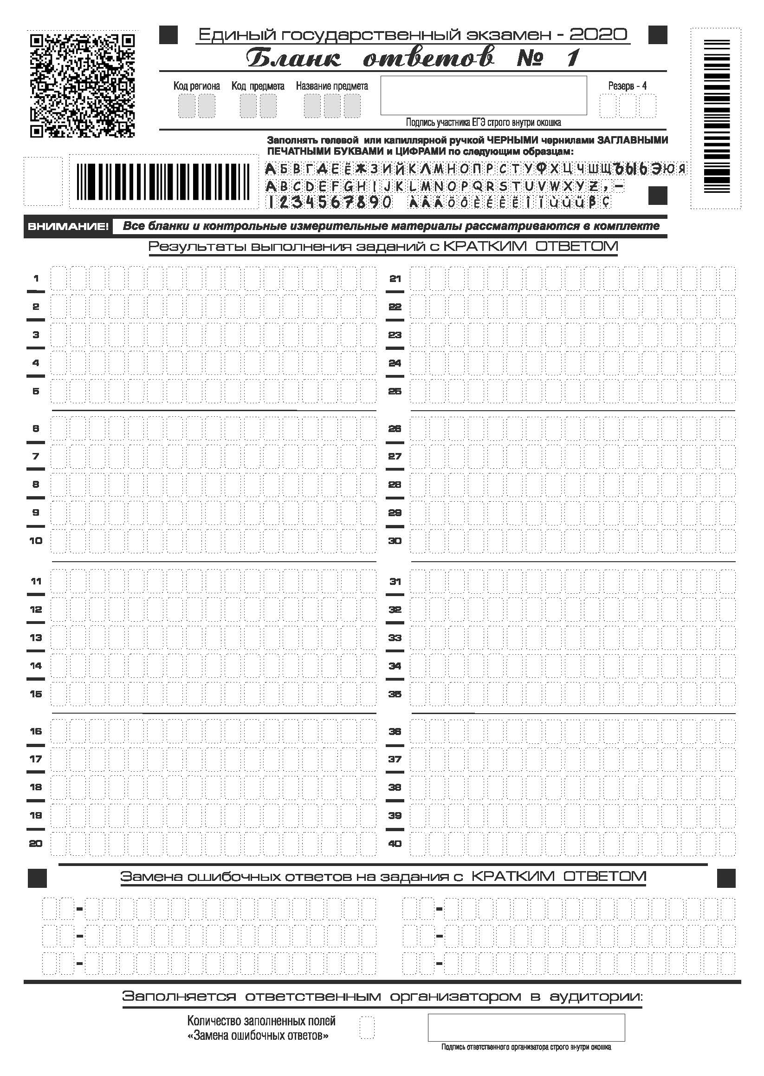

Slide 18
