Slide 1

ЕГЭ
английский язык
ВАРИАНТ 1
Время выполнения работы 3 часа 10 мин ( 190 минут)
Работа состоит из четырёх разделов: «Аудирование», «Чтение", "Грамматика и лексика», «Письменная речь». Раздел 1 («Аудирование») содержит 9 заданий. Рекомендуемое время на выполнение заданий раздела 1 составляет 30 минут. Раздел 2 («Чтение») содержит 9 заданий. Рекомендуемое время на выполнение заданий раздела 2 составляет 30 минут. Раздел 3 («Грамматика и лексика») содержит 20 заданий. Рекомендуемое время на выполнение заданий раздела 3 составляет 40 минут. Раздел 4 («Письменная речь») состоит из 2 заданий. Рекомендуемое время на выполнение заданий этого раздела работы – 90 минут.

Slide 2

Раздел 1. Аудирование
1
Задание 1
Прослушайте шесть высказываний. Установите соответствие между высказываниями каждого говорящего A–F и утверждениями, данными в списке 1–7. Используйте каждое утверждение, обозначенное соответствующей цифрой, только один раз. В задании есть одно лишнее утверждение. Занесите свои ответы в таблицу.
Your health may stop you from taking baths.
Taking baths is not environmentally friendly.
Technical innovations make a shower a great experience.
Taking a bath isn’t as wasteful as you may think.
Taking showers helps me to stay healthy.
Taking a bath is a perfect way to relax.
There are both pluses and minuses about baths and showers.
Говорящий | A | B | C | D | E | F
Утверждение

Slide 3
Задание 2
Вы услышите диалог. Определите, какие из приведённых утверждений А–G соответствуют содержанию текста (1 – True), какие не соответствуют (2 – False) и о чём в тексте не сказано, то есть на основании текста нельзя дать ни положительного, ни отрицательного ответа (3 – Not stated). Занесите номер выбранного Вами варианта ответа в таблицу. Вы услышите запись дважды.
A. Katy is a regular cinema goer.
B. Katy and Mike promised their friends to see the film.
C. Mike offers his help with Math to Katy.
D. Katy has some chores to do in the evening.
E. Katy loves sports, especially yoga.
F. Katy and Mike will watch Men in Black on Thursday.
G. Katy agrees to see a film on DVD with Mike.
2
Говорящий | A | B | C | D | E | F | G
Соответствие диалогу

Slide 4

Задание 3
Вы услышите интервью. В заданиях 3–9 запишите в поле ответа цифру 1, 2 или 3, соответствующую выбранному Вами варианту ответа. Вы услышите запись дважды.
3
Which of the following is NOT true about Alice’s novel Stars?
1) It’s her debut book.
2) It’s quite popular with readers.
3) It’s published all over the world.
.
4
What do we learn about Alice at the beginning of the interview?
1) She won numerous prizes for her writing.
2) She became famous when still at college.
3) Writing is not her only occupation.
5
What’s the name of the main character of the novel Stars?
1) Jessica.
2) Liam.
3) Arthur.
6
Alice’s novel starts with a …
1) police investigation.
2) marriage.
3) a catastrophe.
7
What is unusual about the format of Alice’s novel?
1) It’s narrated by the voice in character’s head.
2) It’s a number of e-mail messages.
3) It’s an exchange of private letters.
8
According to Alice, what was the biggest difficulty in writing her novel?
1) Explaining to the reader every event.
2) Leaving the reader enough indications on what’s happening.
3) Keeping the novel not too long
9
When does Alice do most of her writing?
1) At working hours.
2) Returning home from work.
3) At the weekends.

Slide 5
D. As symbols of respect and courage, knights turned out to be an intriguing mix of all the things that made males the best, as their education included the most effective sorts of exercises for the brain and the human body. Knight tournaments were a good way for the knights to try out the actual travails of fighting and never having to go through the pain and troubles of having to look after themselves, and of their kingdoms.
E. Were there any women pirates in Renaissance England? They were in the minority, but they were never the less there and very able. Lady Mary was a daughter of a pirate and married to a pirate. When her husband died, she recruited her castle staff and went to sea herself. Her luck ran out when she captured a German captain, who was a friend of Queen Elizabeth. So Lady Mary quit piracy … and started selling stolen goods.
F. Russia is an amazing holiday destination. It should be visited during the festival season, as it reveals the rich cultural tradition and fascinating customs of its people. While the festivals come from the Christian legacy Russia shares with Europe and America, the manner of celebration is unique. Enthusiastic travelers suggest planning a Russian holiday during the festival time and to be sure that the memories will last a lifetime!
G. Normally very fine textiles are found in graves. Obviously, the quality of clothing worn in the Middle Ages would reduce with lower ranks, but even the slaves did not wear cloth as rough as people thought in the past and some still do today. Slaves would probably wear their master’s clothes, which may have been very thin in places and not decorated. They would usually receive the underclothes to be worn as overclothes.
Текст | A | B | C | D | E | F | G
Заголовок

Slide 6
Прочитайте текст и заполните пропуски A–F частями предложений, обозначенными цифрами 1–7. Одна из частей в списке 1–7 — лишняя. Занесите цифры, обозначающие соответствующие части предложений, в таблицу.
11
The languages of integration
Every year the European Day of Languages is marked on 26 September. The idea behind the event is to raise public awareness of all the languages spoken in Europe and the importance of language learning in A______________. The European Day of Languages celebrates linguistic diversity as one of Europe’s strengths, B_______________ of school.
The European Union is convinced C_____________________ compared with the professional and personal opportunities lost due to inadequate language skills. That is why many national governments encourage people to learn languages at all educational levels and at all ages during their working life.
Many local authorities provide immigrants with language training, familiarization courses on local society and culture, D_____________________. The latter elements are often provided in the immigrants’ own languages.
One example is from the Flemish city of Ghent in Belgium, E_____________________ including 1200 hours of Dutch, plus 75 hours of civic orientation courses. Hungary developed its national integration policy on the basis of a six-month pilot project called Matra F_____________________, 700 hours of cultural and legal orientation, and financial assistance with living expenses. The Finnish education system supports the maintenance and development of the mother tongues of immigrants to ensure what it calls functional bilingualism.
and assistance in finding jobs in a new country
spreading tolerance and mutual understanding
upbringing healthier and more athletic children
that the cost of promoting language learning is modest
that included 1200 hours of language teaching for immigrants
and encourages lifelong language learning in and out
where immigrants are offered an introductory programme
Пропуск | A | B | C | D | E | F
Часть предложения

Slide 7
Прочитайте рассказ и выполните задания 1–7. В каждом задании обведите букву A, B, C или D, соответствующую выбранному вами варианту ответа.
Your amazing brain
You carry around a three-pound mass of wrinkly material in your head that controls every single thing you will ever do. From enabling you to think, learn, create, and feel emotions to controlling every blink, breath, and heartbeat – this fantastic control center is your brain. It is a structure so amazing that in the foreword to Discovering the Brain, famous scientist James Watson wrote, “The brain is the most complex thing we have yet discovered in our universe. It contains hundreds of billions of cells interlinked through trillions of connections. The brain confuses the mind.” Obviously to understand brain function, we need to confront its complexity.
Imagine your kitten is on the kitchen counter. She’s about to step onto a stove. You have only seconds to act. Accessing the signals coming from your eyes, your brain quickly calculates when, where, and at what speed you will need to dive to intercept her. Then it orders your muscles to do so. Your timing is perfect and she’s safe. No computer can come close to your brain’s awesome ability to download, process, and react to the flood of information coming from your eyes, ears, and other sensory organs.
Your brain contains about 100 billion microscopic cells called neurons – so many it would take you over 3,000 years to count them all. Whenever you dream, laugh, think, see, or move, it’s because tiny chemical and electrical signals are racing between these neurons along billions of tiny neuron highways. Believe it or not, the activity in your brain never stops. Countless messages zip around inside it every second like a supercharged pinball machine. Your neurons create and send more messages than all the phones in the entire world. And while a single neuron generates only a tiny amount of electricity, all your neurons together can generate enough electricity to power a low-wattage bulb.
Neurons send information to your brain at more than 150 miles (241 kilometers) per hour. For example, a bee lands on your bare foot. Sensory neurons in your skin relay this information to your spinal cord and brain at a speed of more than 150 miles (241 kilometers) per hour. Your brain then uses motor neurons to transmit the message back through your spinal cord to your foot to shake the bee off quickly. Motor neurons can relay this information at more than 200 miles (322 kilometers) per hour.

Slide 8
Riding a bike seems impossible at first. But soon you master it. How? As you practice, your brain sends “bike riding” messages along certain pathways of neurons over and over, forming new connections. In fact, the structure of your brain changes every time you learn, as well as whenever you have a new thought or memory.
It is well known that any exercise that makes your heart beat faster, like running or playing basketball, is great for your body and can even help improve your mood. But large-scale efforts of scientists from a group of institutes from the National Institutes of Health have recently showed that for a period of time after you’ve exercised, your body produces a chemical that makes your brain more receptive for gaining new knowledge. So if you’re stuck on a homework problem, go out and play a game of soccer, then try the problem again. You just might discover that you’re able to solve it.
12
According to the text, the most distinctive characteristic of the brain is its …
A) ability to control the body.
B) elaborateness.
C) size.
D) weight.
13
The claims that the brain is better than any computer because it …
A) processes more information.
B) works faster.
C) can download information from different sources.
D) reacts to information more adequately.
14
According to the text, the work of brain neurons influences …
A) electricity production.
B) our dreams.
C) everything we do.
D) character of messages we send.

Slide 9
15
The narrator compares the work of neurons to a pinball machine to …
A) show the character of brain work.
B) raise the awareness of the brain’s nature.
C) stress the amount of information that the brain processes.
D) illustrate the shape of the neuron highways.
16
Comparing sensory and motor neurons, we can make a conclusion that …
A) motor neurons transmit information faster.
B) there are more motor neurons.
C) sensory neurons transmit information faster.
D) there are more sensory neurons.
17
The structure of brain changes when …
A) our memory fails.
B) new neurons appear.
C) we are riding a bike.
D) we acquire new knowledge.
18
Physical exercises proved to be good for …
A) the production of brain chemicals.
B) solving homework problems.
C) giving the brain a rest.
D) maintaining a good mood.

Slide 10
Раздел 3. Грамматика и лексика
Прочтите текст ниже. Преобразуйте слова, напечатанные заглавными буквами в конце строк, обозначенных цифрами 19-24, чтобы они грамматически соответствовали содержанию текста. Заполните пропуски словами, которые вы получили. Каждый проход соответствует отдельной задаче из группы 19-24.
The largest snowfall in decades
This week’s snowfall in Brazil is one of the largest in decades. As snow on the ground is not a very common landscape in a so-called tropical country, everybody ______ excited when they saw streets in snow. In the cities by the sea people are used to spending the summer sun bathing. They ______ very much when they saw snow covering the city. It ______ long before social media became loaded with pictures of white fields and roads, and snowmen.
Flood in Santa Claus’ home
The usual images of the North Pole are impressive ice sheets, but scenes from a webcam there reveal a different story. Meteorologists have reported that temperatures in early July were one to three degrees Celsius _____ than the year’s average over most of the Arctic Ocean.
Thanks to rapidly melting ice, Santa Claus now ______ his own swimming pool. The North Pole is currently a lake, Canada.com reports. The lake is about a foot deep, ______ entirely of the melted ice itself. It shows a dramatic change is the Arctic climate.
19
FEEL
20
SURPRISE
21
NOT/BE
22
HIGH
23
HAVE
24
CONSIST

Slide 11
Преобразуйте, если необходимо, слова, напечатанные заглавными буквами, так чтобы они грамматически и лексически соответствовали содержанию текста. Каждый пропуск соответствует отдельному заданию из группы 25-29. Впишите слова в поле ответа.
Understanding poetry
Poetry is language used to form patterns of sound and thought into work of art. Good poems often seem to suggest more than they say, and complete understanding of the poem often depends upon the sensitivity and ______ of the reader.
Reading poetry in English can be especially ______ to speakers of other languages because it requires them to think in English.
It also requires them to consider the subtle ______ and connotations of words.
To understand the poem is to understand its images. An image is a detailed ______ that appeals to the senses.
It is like a picture drawn with words and like words, it can have ______ meanings.
These images often do more than describe a scene or experience – they try to create an experience for the reader.
25
IMAGINE
26
HELP
27
MEAN
28
DESCRIBE
29
VARY

Slide 12
Прочитайте текст с пропусками, обозначенными номерами 30 – 36.
Эти номера соответствуют заданиям 30 – 36, в которых представлены возможные варианты ответов (А, B, C, D). Установите соответствие номера пропуска варианту ответа.
My family
I don’t believe anyone could describe me as a snob. However, I do believe that the saying “There’s a place for everything, and everything has its place” (1) _______ equally well to human beings.
I was born in Yorkshire in Victorian times and I can safely (2) _______ that during this period my family played a considerable role. My father, Sir Raymond Hardcastle, was not only an inventor and industrialist of great imagination and skill, but he also built up one of the nation’s most successful companies. At the same time he always (3) _______ his workers as if they were all part of the family. Indeed it was this example that he (4) _______, whenever he dealt with those less fortunate than himself that has been the benchmark by which I have attempted to conduct my own life.
I have no brothers and just one elder sister, Amy. (5) _______ there were only a couple of years between us, I cannot pretend that we were even particularly close, perhaps because I was an outgoing child, while she was shy and reserved. Her only interests in life were gardening, crochet work and the occasional visit to Scarborough festival. She never (6) _______ an attempt to get out of the family circle.
Gerald and I first met when I had been a houseguest at Lord Fanshaw’s country home in Norfolk. As it turned (7) _______, we had much in common. We were married in July 1895 and our son Guy was born a year later. My father simply doted on Guy and left everything to him.
30
31
32
33
34
35
36
30
A) concerns B) applies C) affects D) influences
A) say B) speak C) tell D) talk
A) counted B) dealt C) judged D) treated
A) did B) made C) set D) put
A) however B) although C) therefore D) nevertheless
A) made B) did C) took D) held
A) off B) out C) in D) over
31
32
33
34
35
36

Slide 13
37
Раздел 4. Письменная речь
You have received an email message from your English-speaking pen-friend Sandra:
From: Sandra @mail.uk
To: Russian_friend@ege.ru
Subject: Food
…I’m living alone now as my parents are visiting my elder sister and her new baby. I never thought we spend so much on food! Where do you usually buy food? What’s the most expensive and the cheapest thing to eat in Russia? What do you prefer – to eat in or to eat out, and why? This month I’m working as a baby-sitter for my neighbours…
Write an email to Sandra. In your message: − answer her questions; − ask 3 questions about her experience as a baby-sitter. Write 100–140 words. Remember the rules of email writing.
From: Russian_friend@ege.ru
To: Sandra@uk.com
Subject: Food

Slide 14
Выберите только ОДНО из двух предложенных заданий (38.1 или 38.2), укажите его номер в БЛАНКЕ ОТВЕТОВ № 2 и выполните согласно данному плану. В ответе на задание 38 числительные пишите цифрами
Imagine that you are doing a project on what online platforms schools use in Rusland. You have found some data on the subject – the results of the opinion polls (see the table below). Comment on the data in the table and give your opinion on the subject of the project.
Platform | Number of respondents (%)
Zoom | 47
Google classroom | 30
Edvibe | 11
Jazz | 8
Pruffme | 4
38.1
Write 200–250 words. Use the following plan: – make an opening statement on the subject of the project; – select and report 2–3 facts; – make 1–2 comparisons where relevant and give your comments; – outline a problem that can arise with distance learning and suggest a way of solving it; – conclude by giving and explaining your opinion on the role of e-learning in schooling.

Slide 15
Imagine that you are doing a project on advantages of living in the countryside in Zetland. You have found some data on the subject – the results of the opinion polls (see the pie chart below). Comment on the data in the pie chart and give your opinion on the subject of the project.
38.2
Advantages of living in countryside
Less amount of crime
5%
Lots of space
32%
Cheaper and more economic
16%
Closer to nature
27%
Access to organic food
20%
Write 200–250 words.
Use the following statement on the subject of the project;
– select and report 2–3 facts;
– make 1–2 comparisons where relevant and give your comments;
– outline a problem that can arise with living in the countryside and suggest a way of solving it;
– conclude by giving and explaining your opinion on the best place for living for you.

Slide 16
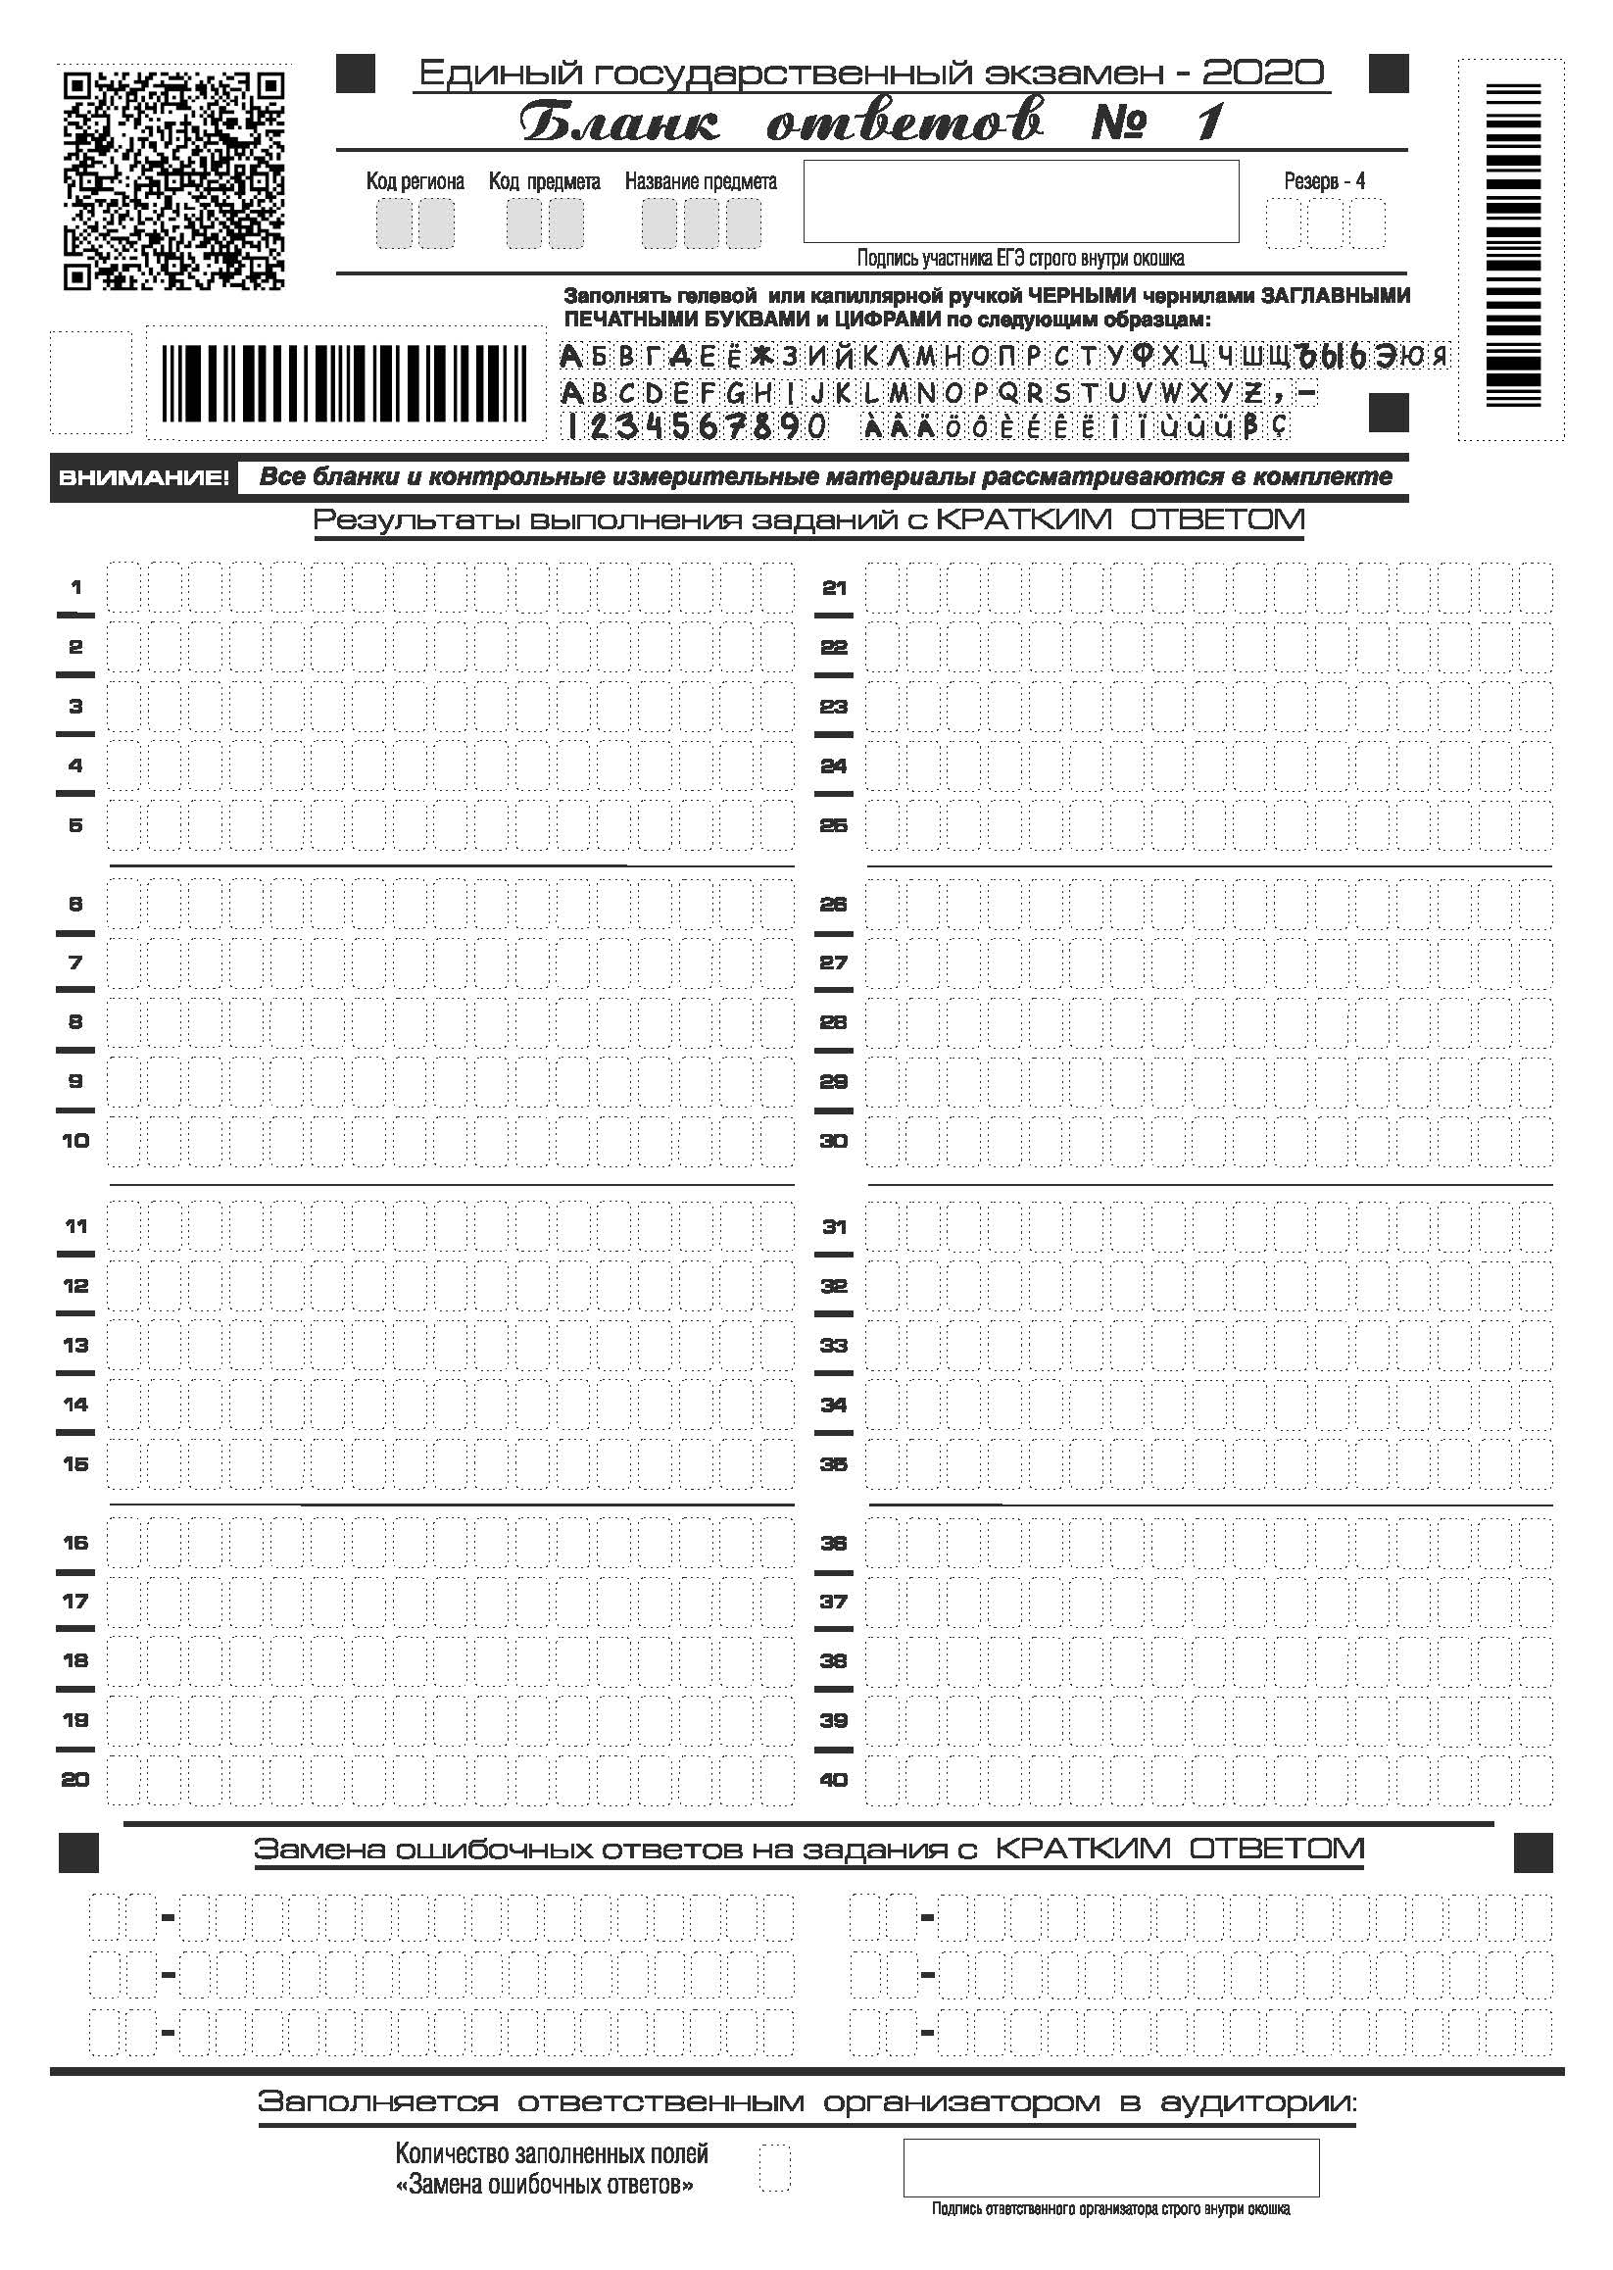

Slide 17
